Slide 1
Regional Approaches to Coordinated Assessment, Prioritization and Housing Placement
Eddie Barber, Simtech Solutions Inc.
Gary Sanford, Metro Denver Homeless Initiative
Matthew D. Simmonds, Simtech Solutions Inc.

Slide 2
Session Overview
Common Themes of Opening Doors, 25 Cities, Zero: 2016, and the Mayor’s Challenge
Understanding Regional Differences (and the impact to approach)
Legacy Practices from HMIS 1.0
Sharing of Boston and Denver’s CAHP Systems
Prioritization & Match: Targeted Resource Allocation Strategies

Slide 3
Common Themes of Opening Doors, 25 Cities, and the Mayor’s Challenge
Coordinated Entry / Assessment systems
Effective resource allocation strategies
Focusing efforts on target populations
Veterans
Chronically Homeless
Families, Youth, and Children

Slide 4
Understanding Regional Differences
High Street Population vs High Shelter Population
Availability of Affordable Housing Stock
Urban vs Rural
How Many Doors?
Technical Capacity
$$$ vs $

Slide 5
Legacy Practices from HMIS 1.0
Data is collected at agency and project levels
Providers are generally working in data “silos,” limiting what is known about clients and the best way to move towards outcomes
Data quality is a challenge to maintain
“Data entry” is a task that is often separate from client interactions
APRs measure outcomes at the project level

Slide 6
Coordinated Assessment and Housing Placement (CAHP) Systems
“A Coordinated Assessment & Housing Placement (CAHP) system is a client-centered process that streamlines access to the most appropriate housing intervention for each individual or family experiencing homelessness”
Source: 25 Cities Coordinated System and Housing Placement System (CAHP) Overview

Slide 7
Denver CAHP Overview

Slide 8
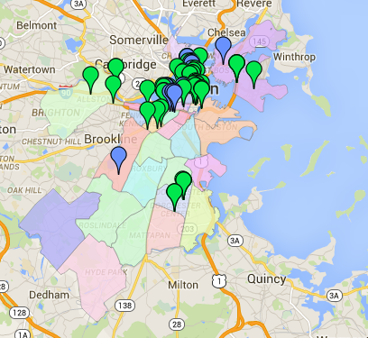
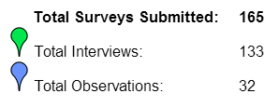
Boston, MA
Population: 645,966*
* 2013 Census
2609 Individuals
3378 People in Households
5978 Total Homeless**
0. 9% Homeless
** 2014 PIT Count

Slide 9
Boston’s IT System
Secure Web Based System
Integrated with HMIS
Open System amongst providers
VA Accessing and entering data
VI-SPDAT ranking
Data Derived Chronic Homeless Status
Document Readiness Tracking
Housing Choice Assessment
Housing Resource Management
Community Prioritization is in Development
Clients referred from HMIS
Clients entered directly into CAHP System
Available Housing Resources Added
Housing Candidate List
Housing Resource List
Complete/Enter VI-SPDAT
Determine Program Type
Match with Permanent Supportive Programs
PSH Program List
Collect required Documents
Match with Rapid Re-housing Programs
RRH Program
List
Complete Housing Needs Assessment
Match with Mainstream Housing

Slide 10
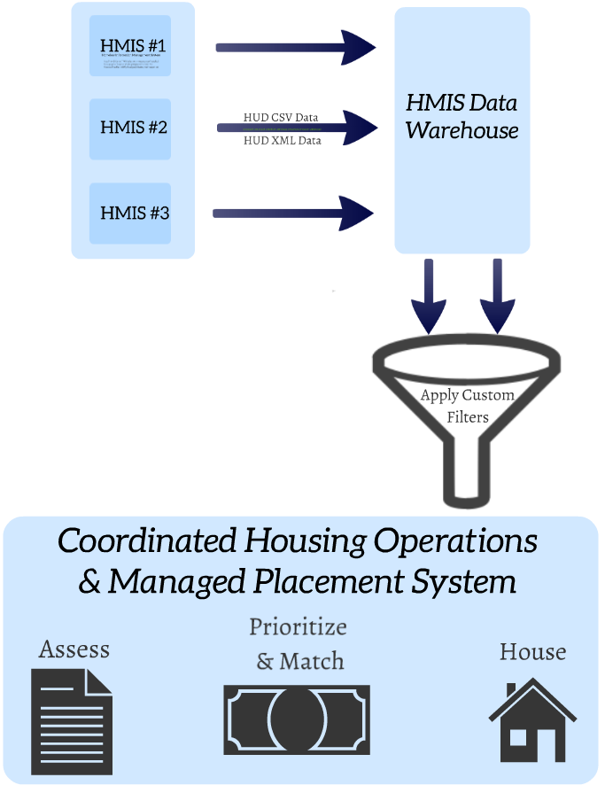
Technical Framework Overview

Slide 11
ASSESS
10 orgs entering clients and conducting VI-SPDATs
ASSIST
10 orgs participating in case conferencing
MATCH
9 orgs allocating resources
Notes:
(Optional) Please fill in the number orgs engaging in key or CAHP-related functions. Note- you can report out on # of orgs and/or # of programs

Slide 12
Current Statistics
417 Vets in Current Housing Candidate Pool
34 Document Ready

Slide 13
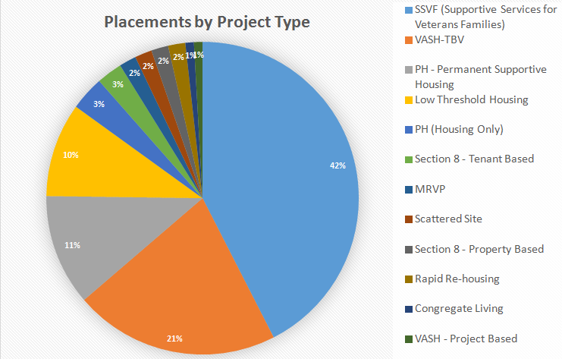
Notes:
MRVP is a state version of section 8.

Slide 14
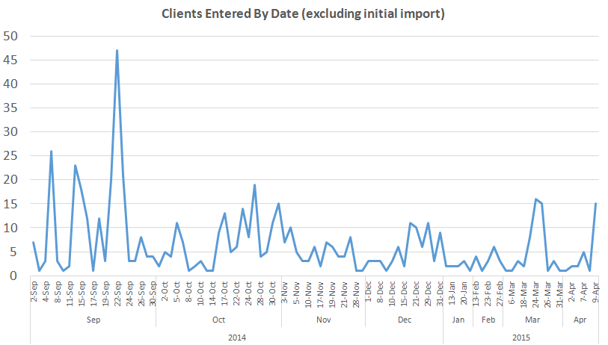

Slide 15
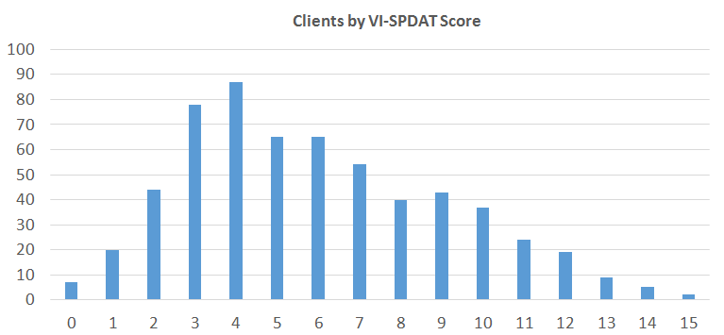
Notes:
Scale is anticipated to change to base 17 on May 1.

Slide 16
Pros of the VI-SPDAT
A common “quick and dirty” rating system
Common rating language
Connection to other providers
A good starting point
Notes:
Provide key insights about your Common Assessment tool- what you liked about the tool, about using a common assessment tool, etc.

Slide 17
Cons of the VI-SPDAT
Provides equal weight to a variety of measures such as health, mental health, sharing money, length of time homeless, etc.
Relies on clients to self-report details which may or may not be reliable
Is time consuming for staff
Re-traumatizes clients by asking questions about history
Not measuring risk of mental health issues accurately

Slide 18
Prioritization for HUD CoC Resources
Source: 25 Cities Coordinated System and Housing Placement System (CAHP) Overview

Slide 19
Prioritization for HUD CoC Resources
“Communities choosing a tool such as the VI-SPDAT that assigns a score to each person assessed might find persons receiving the highest score do not necessarily meet the highest priority according to the Prioritization Notice. In such cases, HUD expects the CoC to use the assessment tool as a starting point but use the guidelines of the Prioritization Notice to establish a single prioritized list.”
Source: Prioritizing Persons Experiencing Chronic Homelessness FAQs, HUD

Slide 20
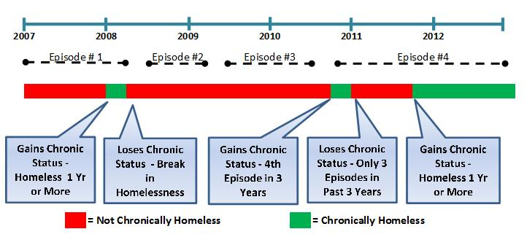
Chronic Homelessness is a Fluid Definition…
Definition of Chronic Homelessness:
“either (1) an unaccompanied homeless individual with a disabling condition who has been continuously homeless for a year or more, OR (2) an unaccompanied individual with a disabling condition who has had at least four episodes of homelessness in the past three years.”
Source: Defining Chronic Homelessness: A Technical Guide for HUD Programs, September 2007

Slide 21
…But its Implementation is Not.
Source: Question 3.17 of the HUD HMIS Data Standards to be asked at client entry.

Slide 22
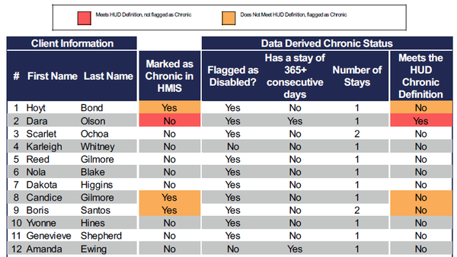
Data Quality Monitoring and Controls
Change in approach can result in artificially low counts of chronically homeless counted in the HUD PIT and any other reports that rely on question 3.17 to determine chronic homeless status.

Slide 23
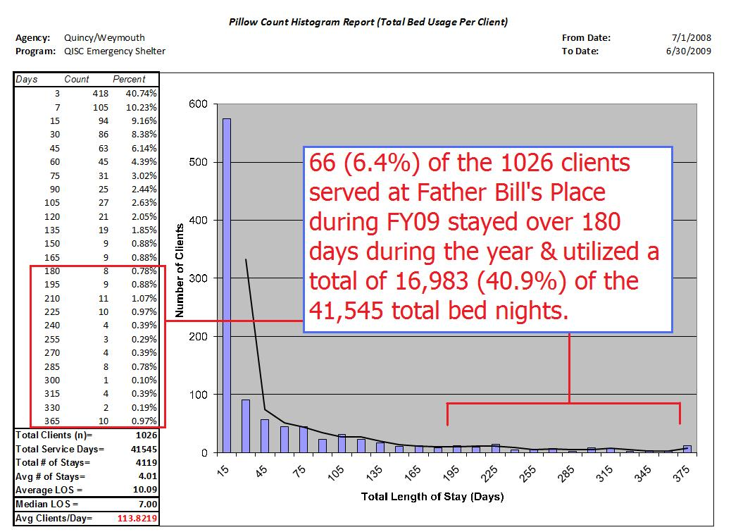
Cumulative Length of Stay
Source: Father Bill’s and MainSpring Analysis of Shelter Utilization Patterns, Simtech Solutions Inc., November, 5, 2012

Slide 24
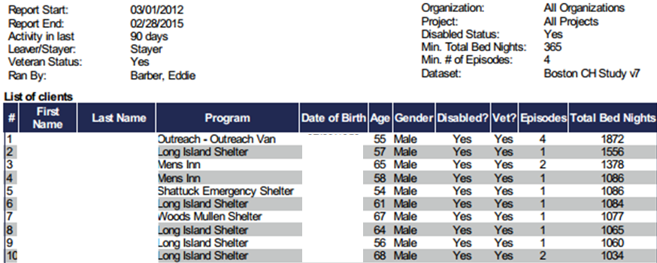
Housing Prioritization with both Chronic and Cumulative Length of Stay
Fresh list of 73 data-derived chronic homeless vets in Boston.
Includes outreach, emergency, and safe haven.

Slide 25
Surprises and Thoughts
Perception that the “Rate of influx in Boston is too high to reach goal of functional zero”
Boston is a magnet for New England for all homeless populations, including vets
Massachusetts is a magnet due to Chapter 115 benefits that are made available to vets

Slide 26
Building a Culture of Collective, System-Level, Performance
Collective input on build out of CAHP system
Weekly case conferencing
Weekly match sessions
Data-driven decision making
Focus is on housing, not homelessness

Slide 27
Contact Information
Eddie Barber – Eddie@SimtechSolutions.com
Gary Sanford – Gary.Sanford@MDHI.org
Matt Simmonds – Matt@SimtechSolutions.com

Slide 28
Questions & Comments?

