Slide 1
Tools and Techniques for Ensuring an Accurate HMIS Implementation
Matthew D. Simmonds
President
Simtech Solutions, Inc.
October 12, 2012

Slide 2
What Tools & Practices Should We Consider?
Supporting Documentation
Service Level Agreements (SLAs)
HMIS Vendor Compliance Reviews
HMIS Conversion Audits
HMIS Implementation Audits
Ongoing Data Quality Monitoring
Data Cleansing (Automated and Manual)

Slide 3
What is the purpose of a Service Level Agreement (SLA)?
The intent of an SLA is to provide the following:
Reduce the areas of conflict
Encourage healthy dialogue in the event of disputes
Eliminate unrealistic expectations
Define the roles of both parties
Set realistic expectations

Slide 4
What should be covered in a Service Level Agreement (SLA)?
Uptime requirements
Privacy and security guidelines
Issue response protocol
Compliance with HUD data collection requirements
Compliance with HUD reporting requirements
Data exchange capabilities
Disaster Recovery/backup
Dispute Resolution

Slide 5
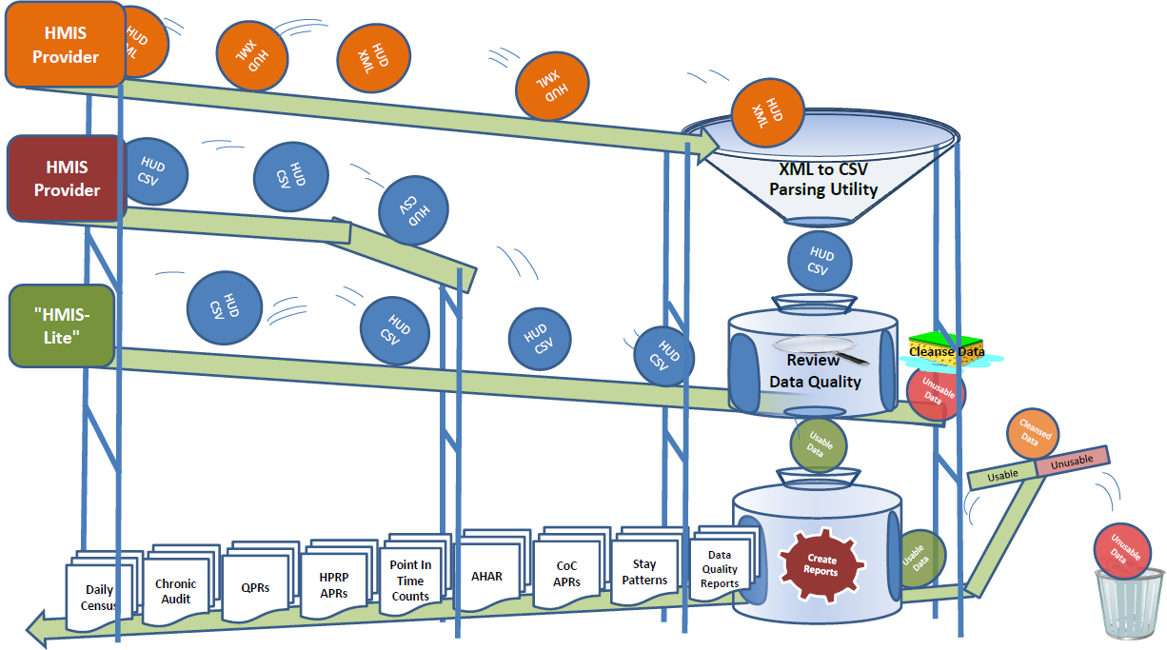
Process Flow for Distributed Reporting & Data Warehousing

Slide 6
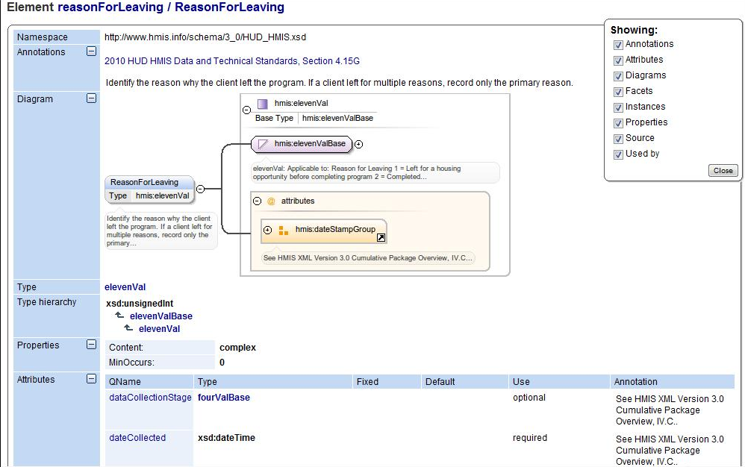
HUD XML Exchange Format

Slide 7
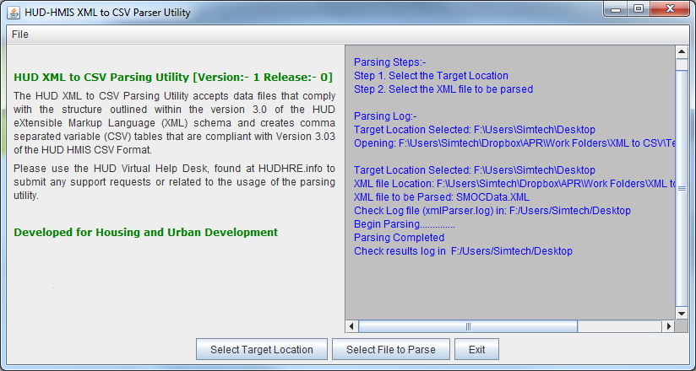
XML to CSV Parsing Utility
XML Data is passed through the XML to CSV Parser, which converts it into the HUD CSV Exchange Format.
The parsing utility is available for download from HUDHRE.info.

Slide 8
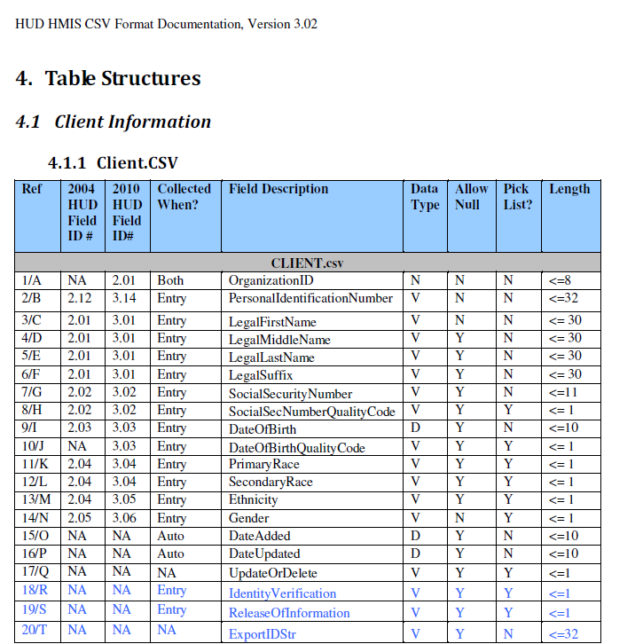
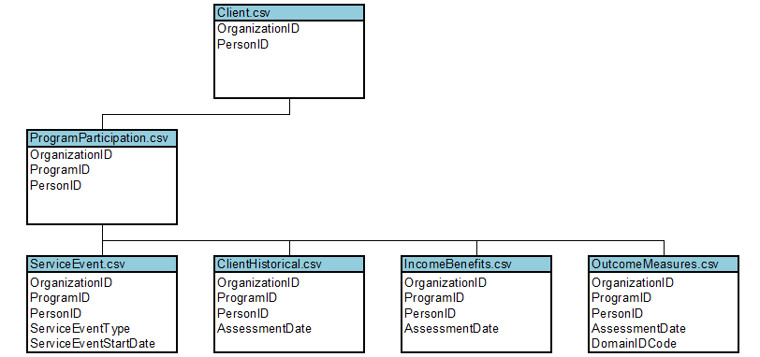
HUD CSV Exchange Format

Slide 9
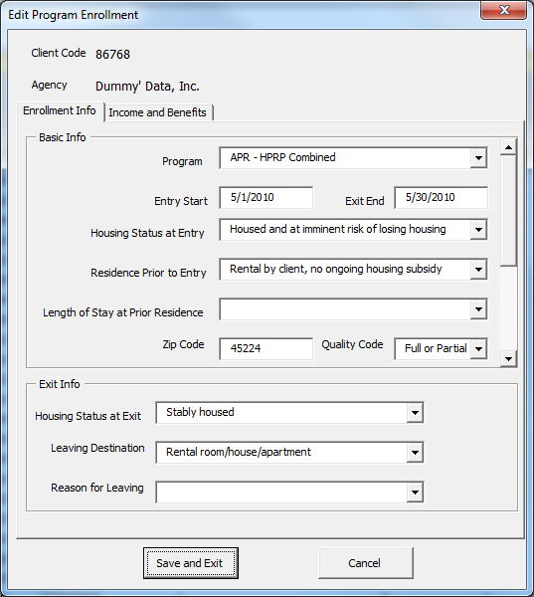
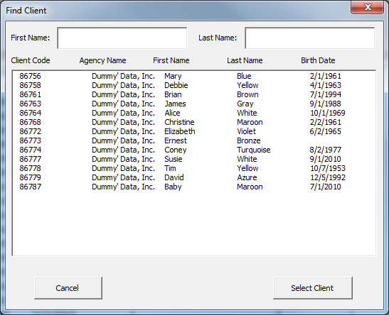
‘HMIS-Lite’ Applications
Client-side applications can be used by providers that do not use traditional web-based HMIS systems such as Domestic Violence programs, faith-based providers and those in areas without Internet access.

Slide 10
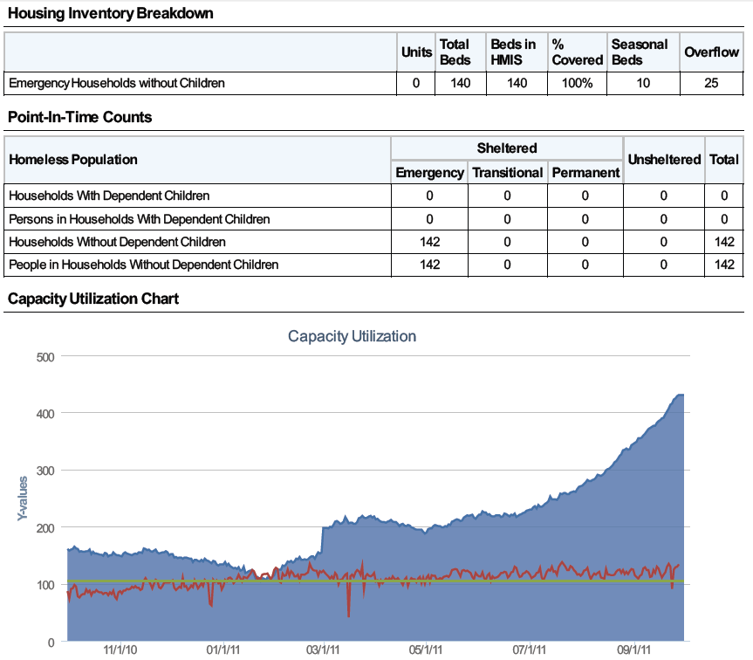
Check Data Quality – Program 1
Data Quality Scorecards can be used to verify the data meets certain data quality thresholds.
The above program appears to be operating at well above capacity towards the end of the reporting period.

Slide 11
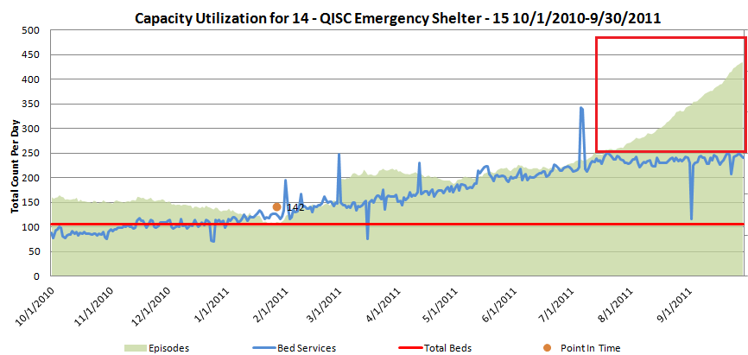
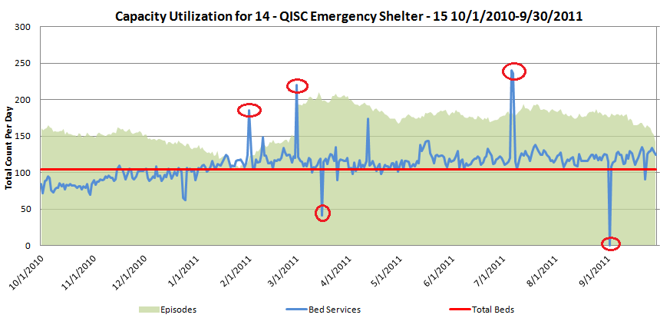
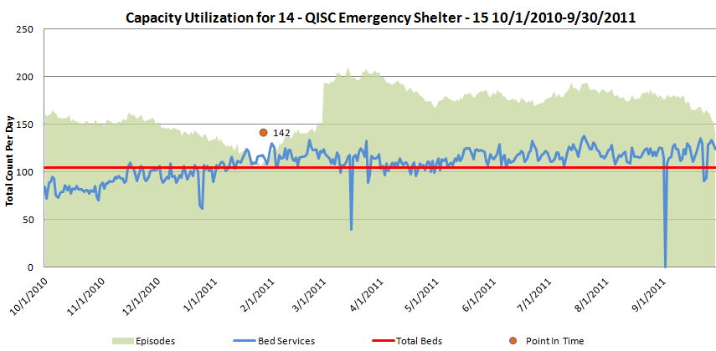
Data Cleansing
Data that does not meet the requirements can be optionally cleaned up by the system automatically. This might include auto-exiting clients that have not been recently seen, removing duplicates, and other data handling.

Slide 12
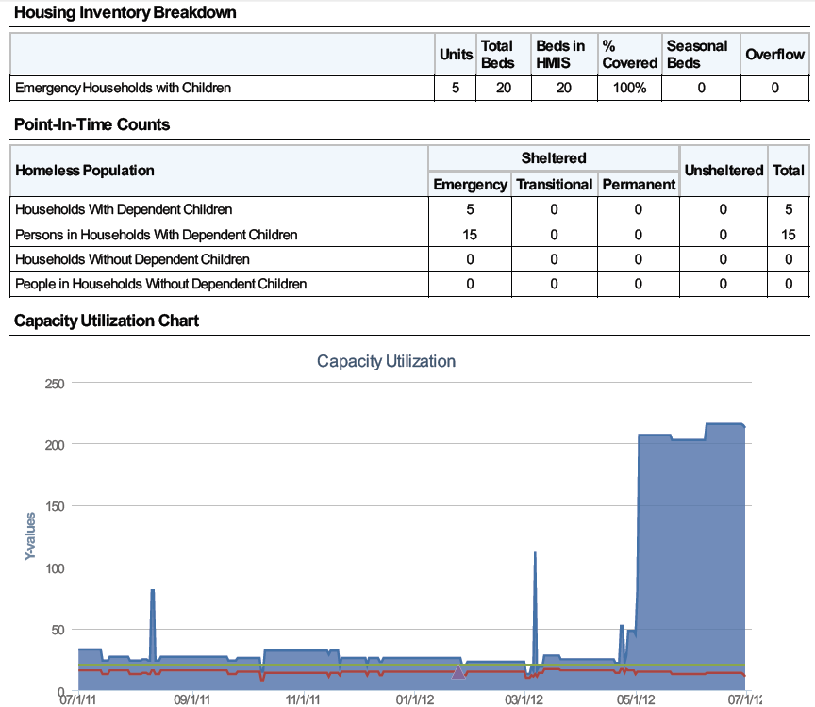
Check Data Quality – Program 2
The above program appears to be operating at well above capacity towards the end of the reporting period.

Slide 13
Data Rejected
If, after cleaning, the data still appears to be erroneous it is it is rejected

Slide 14
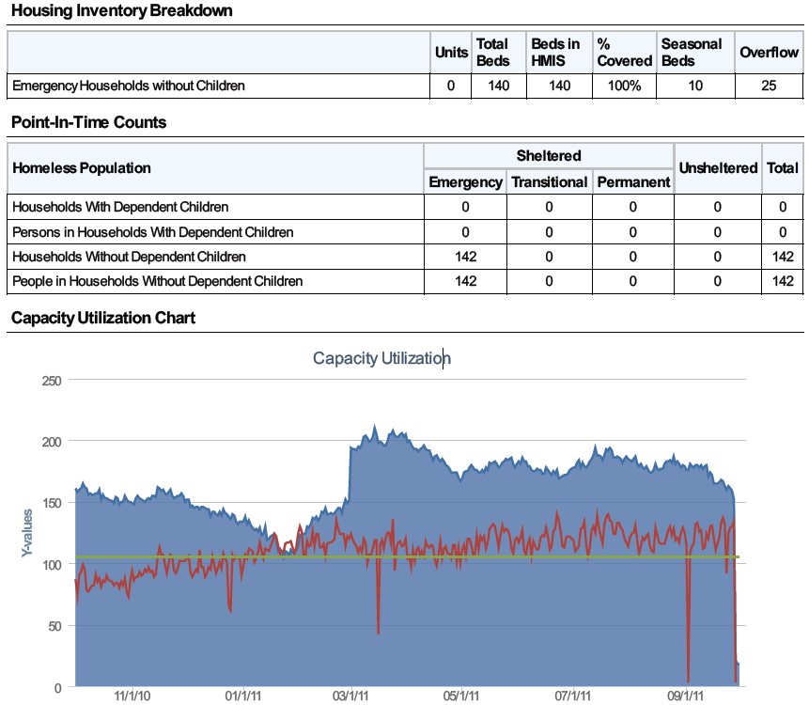
Data Accepted
If, after cleaning, the data is deemed to be acceptable it can be used to create other reports.

Slide 15
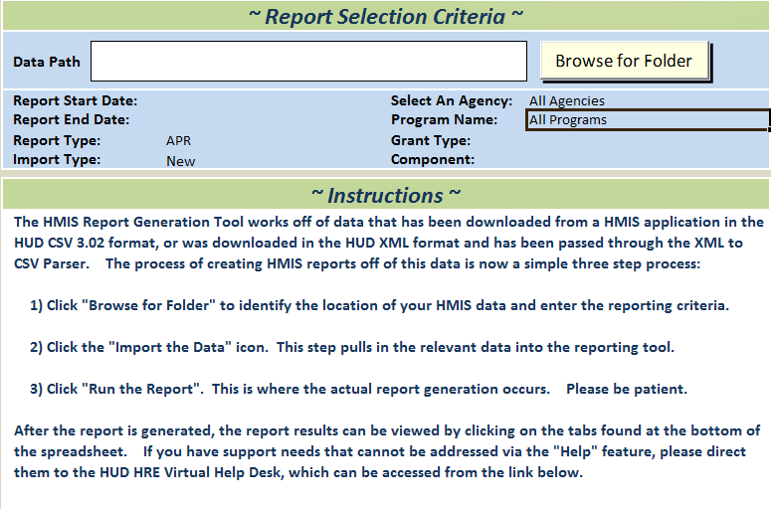
Create Reports
Once the data has been verified and/or cleaned, reports can be created.
With either a warehouse or DRM, these reports can be created over a variety of difference data sources at once. This is useful for regional reports such as AHAR as well as reports such as APRs that may require data from multiple sub-grantees.
These reporting tools can also be used to validate a vendor’s work.

Slide 16
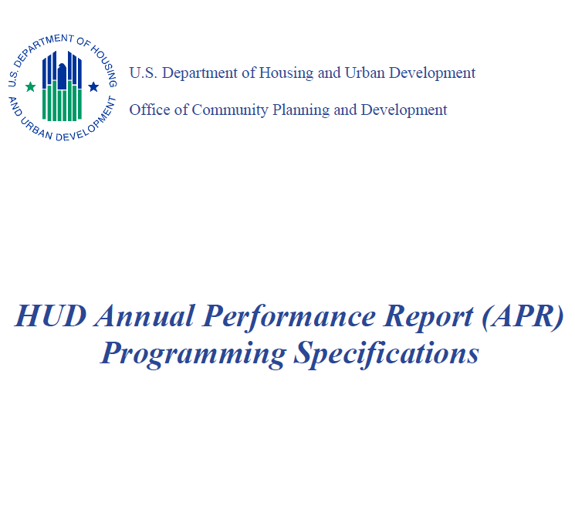
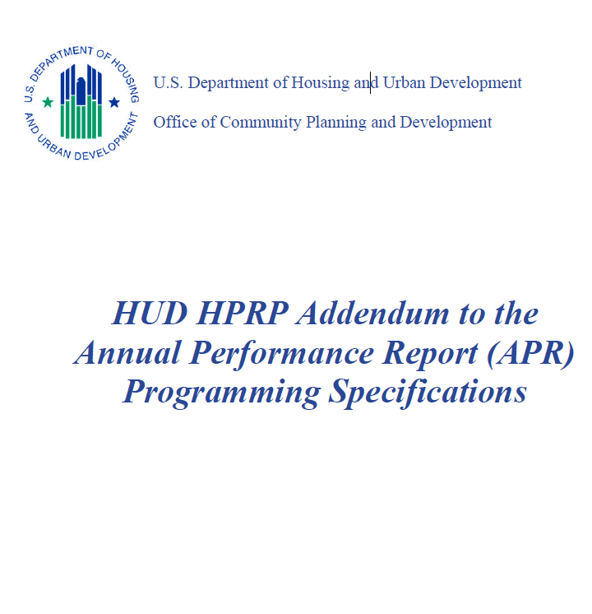
Report Specifications
If any Report Programming Specifications have been developed, they can be used to implement mandated reports

Slide 17
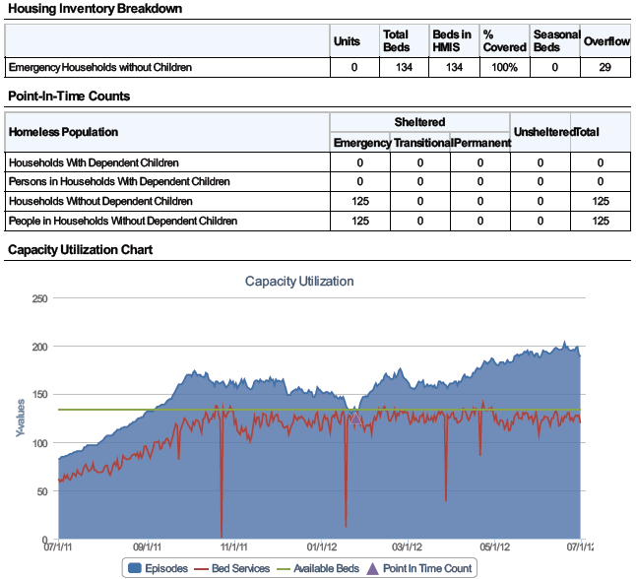
Data Quality Scorecards – Capacity Utilization
The Capacity Utilization component of Data Quality Scorecards provides an “at-a-glance” preview of a wide array of program attributes including bed capacity, the utilization of these beds over time according to both bed service records and program enrollments, and what was reported for the annual HUD point in time count.

Slide 18
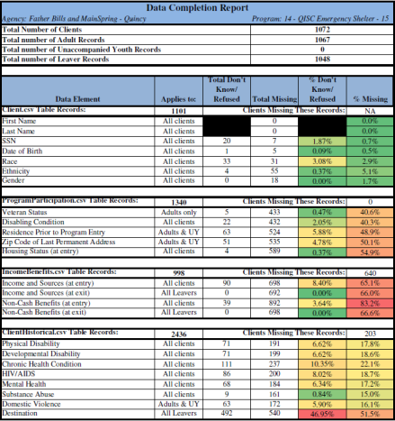
Data Quality Scorecards – Data Completion
The Data Completion Rate portion of Data Quality Scorecards allows users to identify the aspects of the reporting set that are viable for reporting.

Slide 19
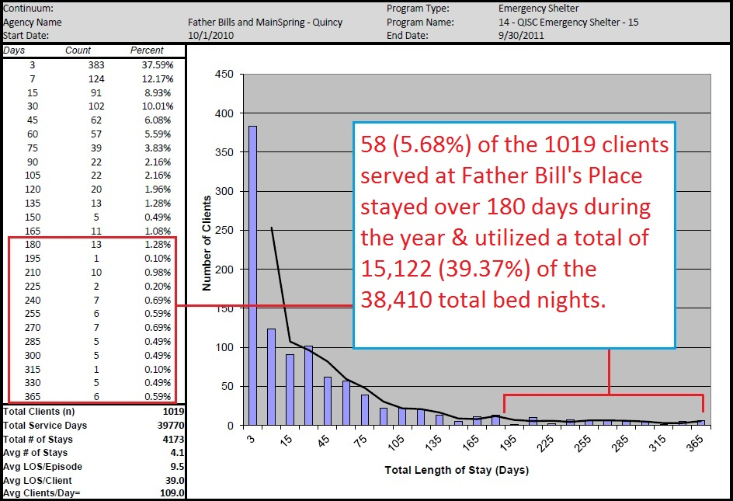
Stay Pattern Analysis
This Length of Stay Histogram shows the total number of days each client stayed at a shelter during the reporting period. This helps maximize the ROI of re-housing dollars.

Slide 20
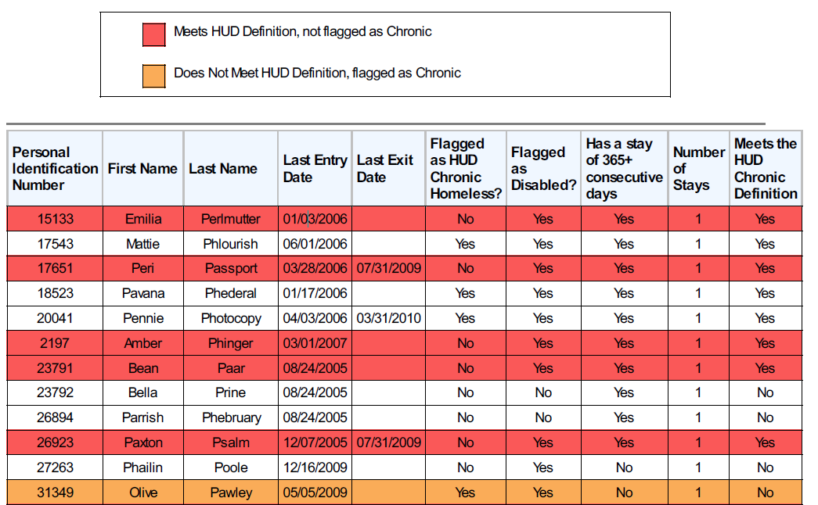
Chronic Homeless Status Audits
Identifies clients that appear to be incorrectly marked as not chronic when they meet the definition, as well as clients incorrectly marked as chronic when they do not.

Slide 21
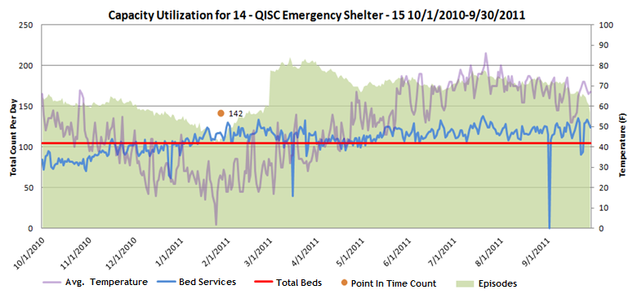
Daily Client Census
Using non-HMIS data alongside HMIS data can be of significant value. This chart shows the impact of the weather on shelter demand.

Slide 22
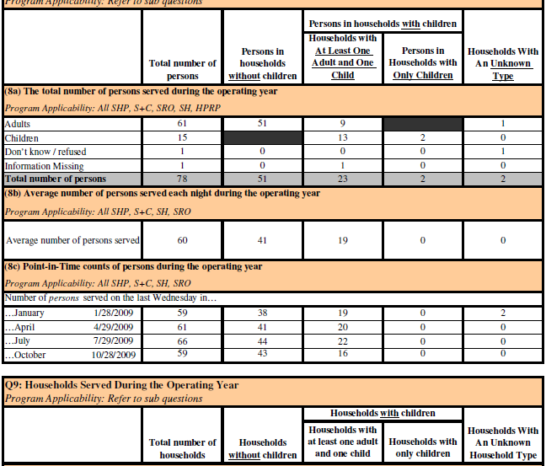
CoC Annual Performance Report
The report sample above is from the APR Generation Tool which was built according to the HUD APR Programming Specifications and is made available, free of charge, at HUDHRE.info.

Slide 23
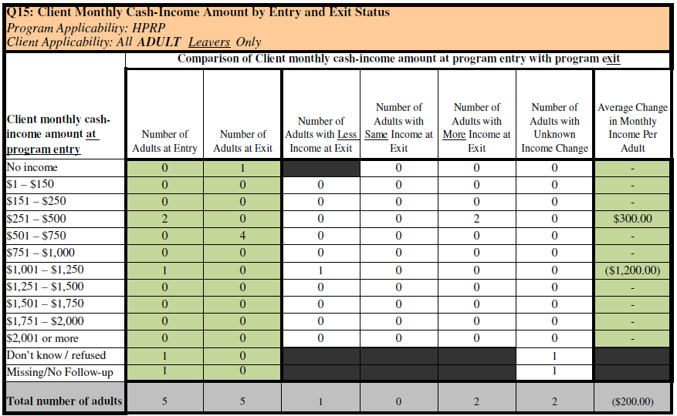
HPRP Annual Performance Report
The HMIS Vendor Test Kits that were released with the APR Generation Tool include sample data that can be entered or uploaded into a HMIS.
Once done, the report output from the HMIS can be tested by comparing it with the output from the APR Generation Tool.

Slide 24
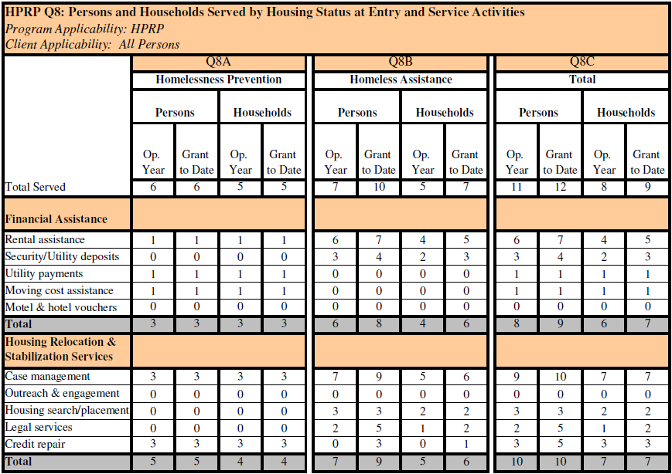
HPRP Quarterly Performance Report
Auditing the financial assistance given to each client allows for this data to be used for cost-benefit studies.

Slide 25
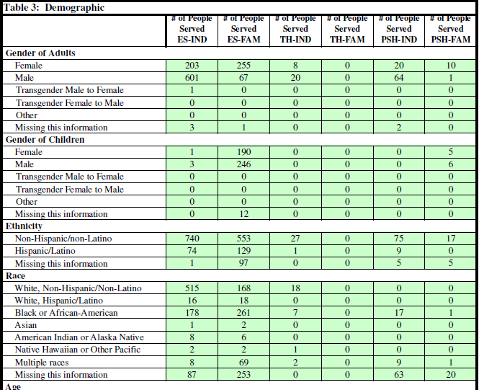
Annual Homeless Assessment Report
No formal programming specifications exist for the AHAR as of yet.
Notable disparities between AHAR and APR are detailed within the APR Programming Specs.
ES-IND needs to look at Bed Management model.

Slide 26
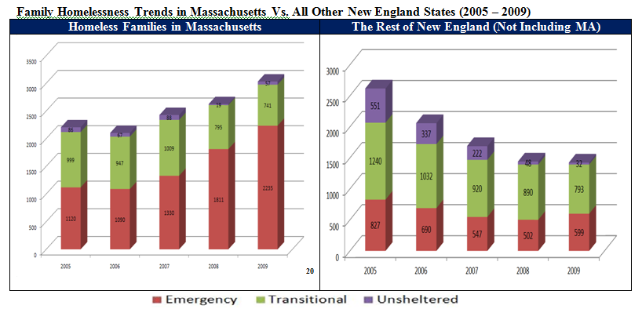
Point In Time Trends
The CoC PIT count is created using a mash of data from HMIS sources, non-HMIS sources for faith based and DV providers, as well as mobile phone and tablet apps for street outreach providers.
Regional reports are a compilation of data from the varied local reports.
It is important for proper reporting to ask the root questions. For example, ask gender and veteran status separately to discern the total number of female veterans.

Slide 27
Questions?

Slide 28
Matthew D. Simmonds
Matt@SimtechSolutions.com
617-395-6669 ext. 21

