Slide 1
Rethinking the Traditional Reporting Model
Presented by:
Edward Barber
Simtech Solutions Inc.

Slide 2
Reporting Challenges
Reporting for HUD, PATH, VA, private donors…
National non-profits with a local presence
Various Activities – Prevention, shelter, outreach, MH, legal services, detox, housing…
Different data types - Operational, consumer, & reporting
Different region types and sizes
Poor data quality
Low HMIS participation rates
Need for timely access to data

Slide 3
Current Setup
HMIS Vendor responsible for all aspects
Data Collection
Data Validation
Daily Operations
Program Management
Reporting
Each function requires development and testing

Slide 4
Current Setup
Changes cause additional work
With every change, no matter how minor, each vendor needs to wait for guidance, implement, test, and release
Additional Work = additional time and money

Slide 5
Proposed Setup
Vendor remains responsible for
Data Collection
Data Validation
Operations
Program Management
Reporting is offloaded, provided by a central authority (HUD)
Distributed Reporting Model
Distributed Data Warehousing

Slide 6
Distributed Reporting Model
APR Generation Tool
Licensed by HUD, available free for all to use
Excel-Based Tool to generate an Annual Performance Report (APR)
Relies on Exchange Formats (CSV, or XML in conjunction with the XML to CSV Parser)
Peer reviewed to ensure reporting logic is accurate
One central place to receive support (HUD Ask-A-Question)

Slide 7
Distributed Reporting Model
Ideal for projects, agencies, continuum-of-care’s, states, etc. needing to report off only 1 unified data set.
Export data from HMIS using exchange format, load this data into tool, and view report. Nice and simple
Can also be used as a means to collect data from those unable to use HMIS (DV, small faith-based organizations)

Slide 8
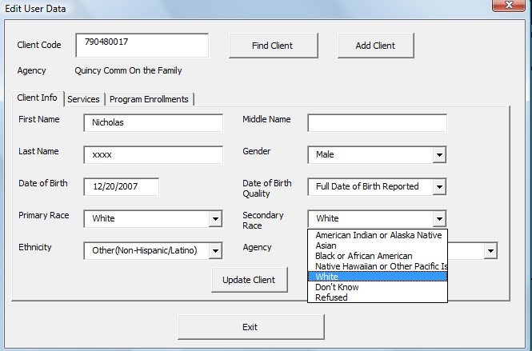
Offline “HMIS-Lite” Application
Do not need to share the client data, just the results.
Allows DV providers and others to participate.
Simplistic format reduces training requirements.
Only need MS Excel to use.
Can produce HUD CSV as well as reports such as the HUD APR and the PIT.

Slide 9
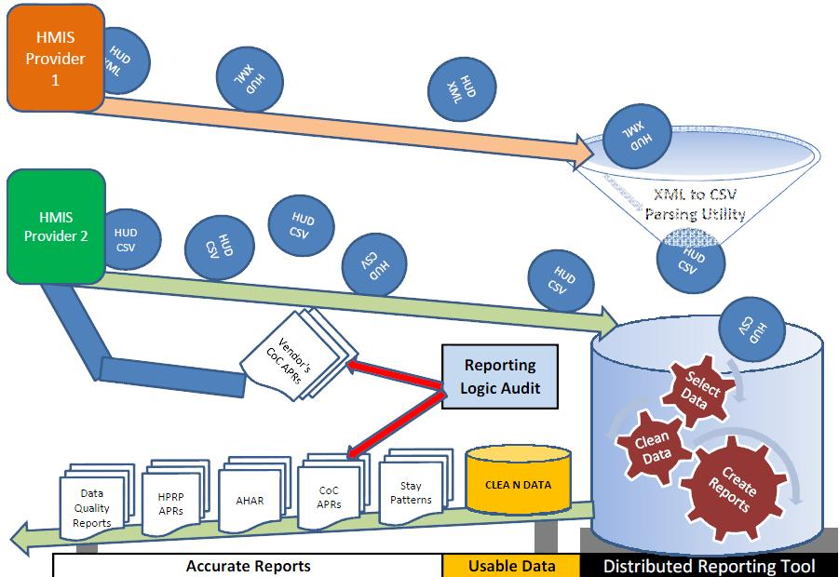
Distributed Reporting Process Flow

Slide 10
Distributed Data Warehousing
In situations where a report requires data from multiple sources, a more versatile solution is required
Data warehouses are ideal for this, but have some drawbacks
Security: “Is my data really safe?”
Complexity: “We’re just a small organization with virtually no I.T. budget, how can we set this up”
What if, in addition to distributing the reports, we distribute fully functional data warehouses?

Slide 11
Distributed Data Warehousing
Combining open source technologies with the power of virtualization, a fully functional data warehouse can be distributed openly to any organization wishing to use it.
Set up could be as easy as installing any other program on a computer
This would allow an organization to aggregate data from multiple sources.
No concern of cost or complexity that an in-house data warehouse has
No concern of security that a third party data warehouse has

Slide 12
Tools for Measuring Homelessness

Slide 13
Can it work?
In Massachusetts, 4 separate CoC’s were able to use a mix of distributed reporting tools and data warehousing to complete the 2013 PIT count

Slide 14
Point in Time: A case study
Distributed reporting tools were developed for the Point in Time count
Data could be entered directly into the tool by hand
Data could be imported from a data set exported in the HUD CSV 3.02 format
Tool could be prepopulated using data existing in warehouse that came from HMIS

Slide 15
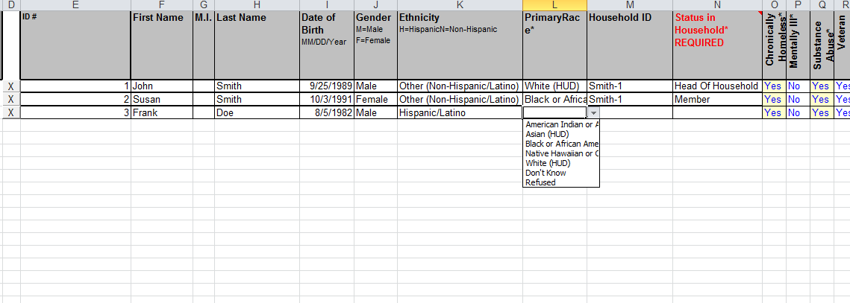
Point in Time: A case study
Data entered manually

Slide 16
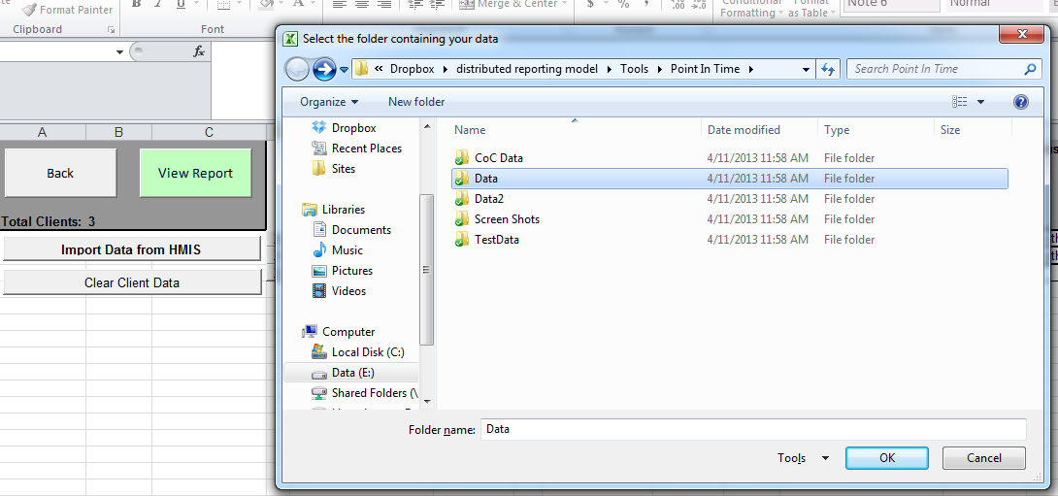
Point in Time: A case study
Data Imported Using CSV

Slide 17
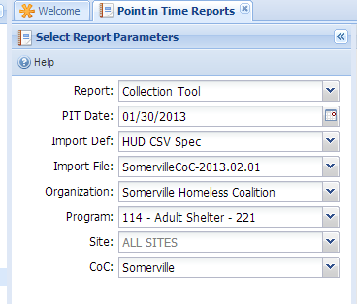
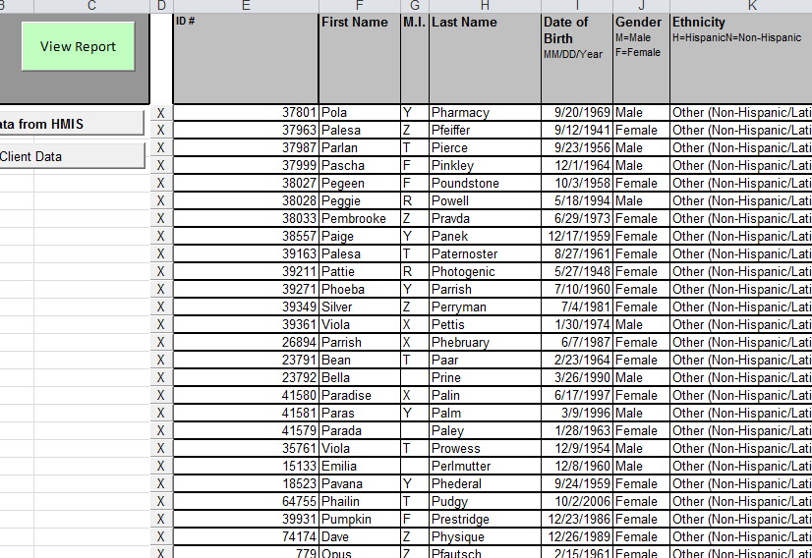
Point in Time: A case study
Tool pre-populated using data warehouse

Slide 18
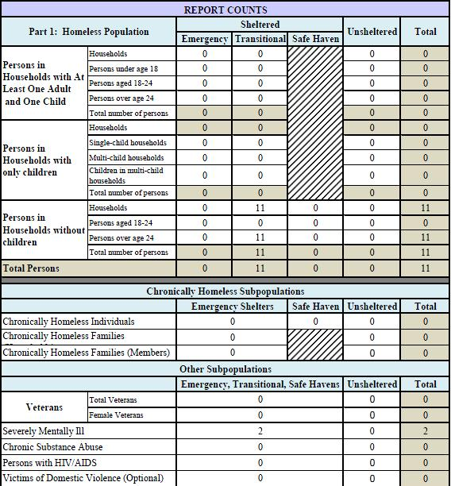
Point in Time: A case study

Slide 19
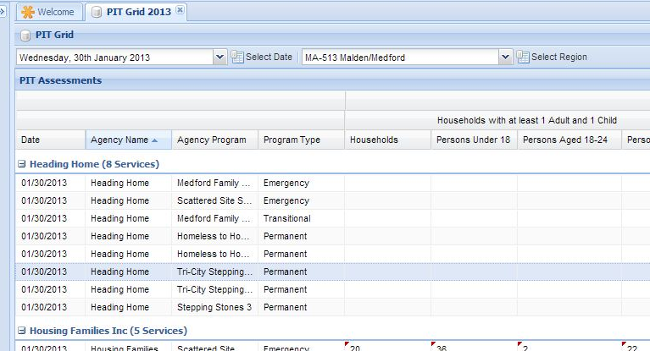
Point in Time: A case study
The CoC Admin collected the reports from each program, then entered in the results into the data warehouse

Slide 20
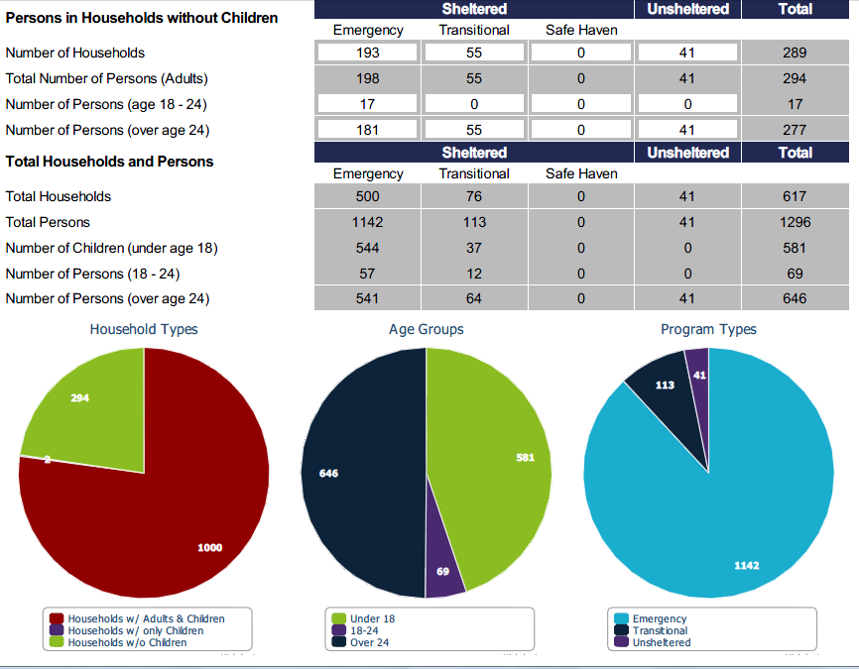
Completed Report
Notes:
Sample Queries:
Vets with mental illness and stays over 180 days
APR results for all single adults over age 50
Highest Level of Education for all young adults.

Slide 21
Is this necessary?
“Isn’t it less complicated to have reports done out of HMIS”
If reporting requirements were static and never changed, then yes.
They are dynamic, and thus do change, and sometimes at an extremely rapid pace

Slide 22
Next Steps
With a unified reporting framework in place, more is possible
Data from sources in addition to HMIS can be implemented
Point in Time Unsheltered Count is not tracked in HMIS
Weather, Crime, Income, etc
Better breakdown by region

Slide 23
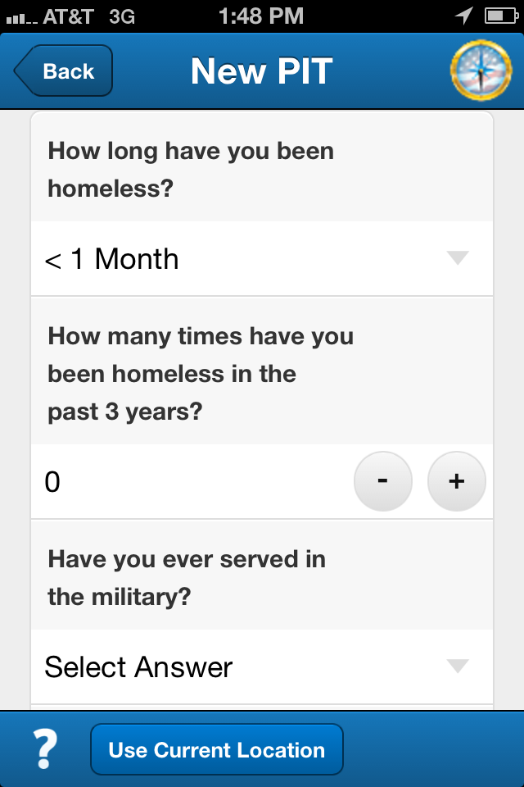
Non-HMIS Data Gathering – Mobile
Can capture the location of each interaction.
Locations can be assigned to regions of any type.
Results can be gathered in real time.
Low hardware costs.

Slide 24
Hackathon Challenge
“create a simple mobile app that will allow anyone to contact their local representatives by email, let them know how many homeless live in their districts, and encourage them to consider this issue while voting on legislation.”

Slide 25
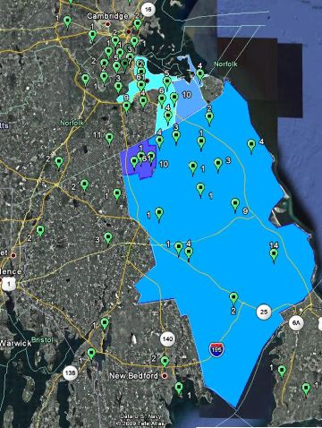
Congressional District Vs HUD CoCs
MA 8th Congressional District
Quincy and Brockton HUD CoCs
113th Congressional District Shapefiles can be found at
https://www.census.gov/geo/maps-data/data/tiger-line.html
Notes:
Data sources:
Congressional District Shape Files: https://www.census.gov/geo/maps-data/data/tiger-line.html

Slide 26
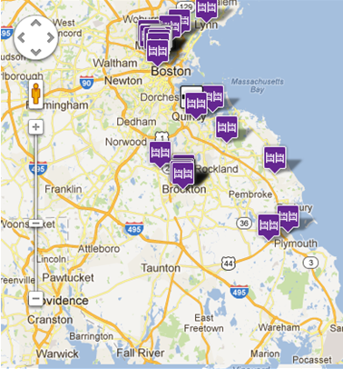
Congressional District Vs Shelter Sites
MA 8th Congressional District
Boston Area Shelter Locations
Clients need to be enrolled into a project at a location, not just into a project.
The project locations are assigned to regions of various types (VAMC, CoC, census tract, etc).
Unsheltered are assigned to an exact address, not a HUD CoC region.
Notes:
Data sources:
Congressional District Shape Files: https://www.census.gov/geo/maps-data/data/tiger-line.html

Slide 27
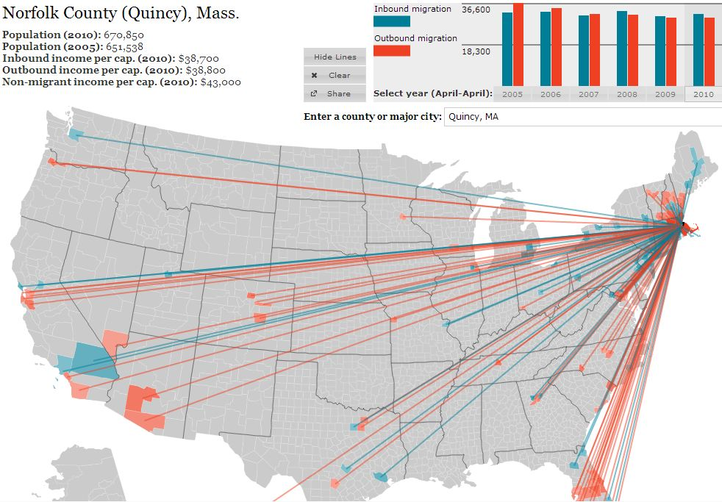
Migration To and From A Region
Source: Forbes American Migration Interactive Map

Slide 28
Reporting Over Aggregated Counts
Potential Issues
Need all data or trends will be skewed
Can only report by CoC until program location level data is captured everywhere
Notes:
http://www.huduser.org/portal/datasets/fmr/fmrs/FY2013_code/select_Geography.odn
datasets/
http://www.huduser.org/portal/datasets/il/il2013/select_Geography_mfi.odn

Slide 29
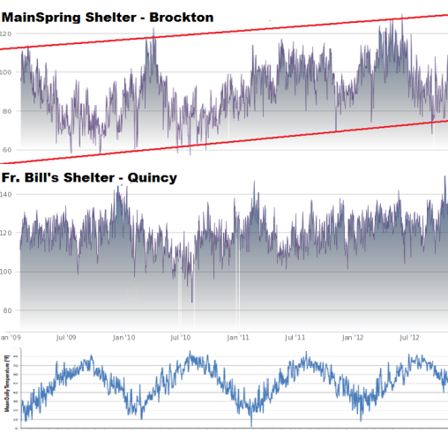
Daily Client Census
Items of Note
No client level data needed
Can be used to forecast future demand
Weather data shows impact of temperature on demand
Same data can be used to show bed availability
Data can be published by vendor and consumed or posted manually by user.
HIC data, eligibility info, contact details, and other details can be attached to locations.

Slide 30
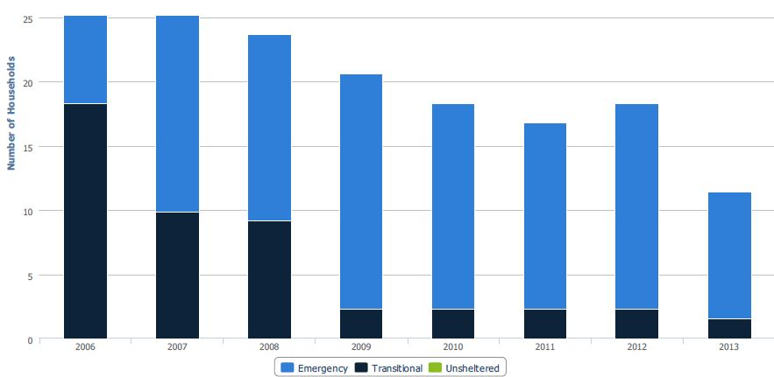
Clients Served In A Region
Brockton Homeless Family Trends 2006-2013
Items of Note
2009-2013 include many families from nearby towns that were placed in hotels in Brockton by the state.
Somerville does not have any hotels used for sheltering the homeless.
Somerville Homeless Family Trends 2006-2013

Slide 31
Other Supporting Data
Quincy/Weymouth Families Placed in Brockton/Plymouth Hotels
Brockton/Plymouth Families Placed in Quincy/Weymouth Hotels
Estimated Transportation Costs for a Full Year of Schooling
26 miles x $3.50/mile x 12 children swapped x 180 school days/year = $196,560
30 minutes each way = 1 hour/day or 180 hours of life wasted per year/per student

Slide 32
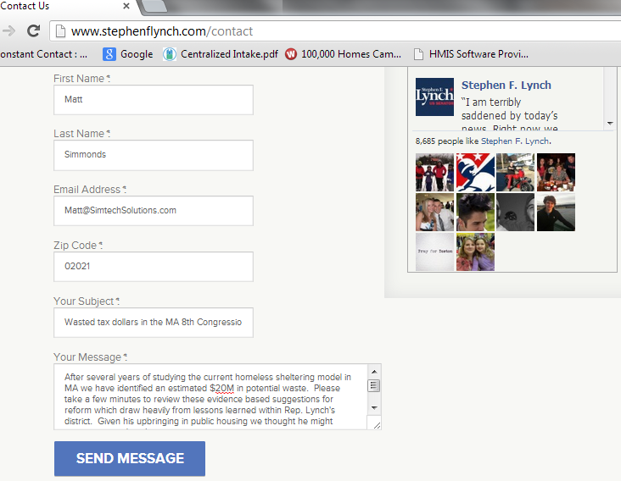
Contact Local Rep
Notes:
http://simtechsolutions.com/homeless-data-services/info-and-resources/proposed-reforms-to-the-massachusetts-emergency-shelter-system1/

Slide 33
Contact Information
Eddie Barber Simtech Solutions, Inc eddie@simtechsolutions.com 617-395-6669 x 23
Notes:
http://www.huduser.org/portal/datasets/fmr/fmrs/FY2013_code/select_Geography.odn
datasets/
http://www.huduser.org/portal/datasets/il/il2013/select_Geography_mfi.odn

