Slide 1
Rethinking the Homelessness Response Framework
Presented by Matt Simmonds, Simtech Solutions Inc.

Slide 2
A bit of background…
President and founder of Simtech Solutions
Developer of the first HMIS data warehouse in the US
Author of HUD CSV Data Exchange Format (V3) and the HUD Annual Performance Report (APR) Programming Specifications
Developer of the HUD HMIS Report Generation Tool
Oversee the ongoing development and management of a HMIS data warehouse that currently supports over 3100 projects that serve the homeless.
Oversee the ongoing development and management of a mobile app to automate the point in time count that was used by 47 regions in 2019.
Family guy who loves snowboarding, craft beer, coaching sports, golf, fishing, and attempting to solve complex problems.

Slide 3
What are we trying to accomplish?
Help people by connecting them to services they need
Measure our progress
Demonstrate results
Improve our case management practices
Better understand the people we are serving
Improve how we allocate limited resources
Increase our efficiency
End homelessness
Other thoughts??

Slide 4
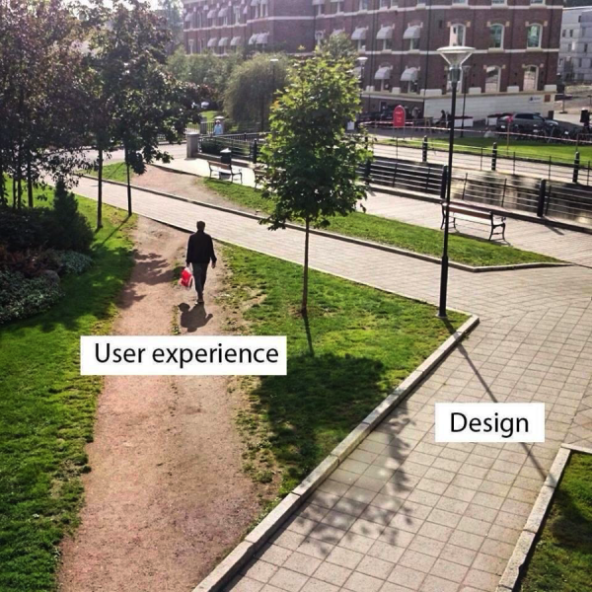
Align the Desire Paths with
System Design

Slide 5
Align System Design to Operations
Examples of misalignment…
High turnover emergency shelters cannot keep up with enrollments and exits (so staff never exit anyone)
Street outreach workers constantly lag in their data entry (so they don’t enter everything)
Projects with multiple locations or multiple grantees are split into multiple projects
Admin locations are used as the operating location for scattered site projects
Jane and John Doe are used for holding names of people who don’t want to share info
Project names in HMIS often don’t match with the project name used in the grant from HUD.
Finance is another system. Projects either spend their $ too fast or leave it on the table.

Slide 6
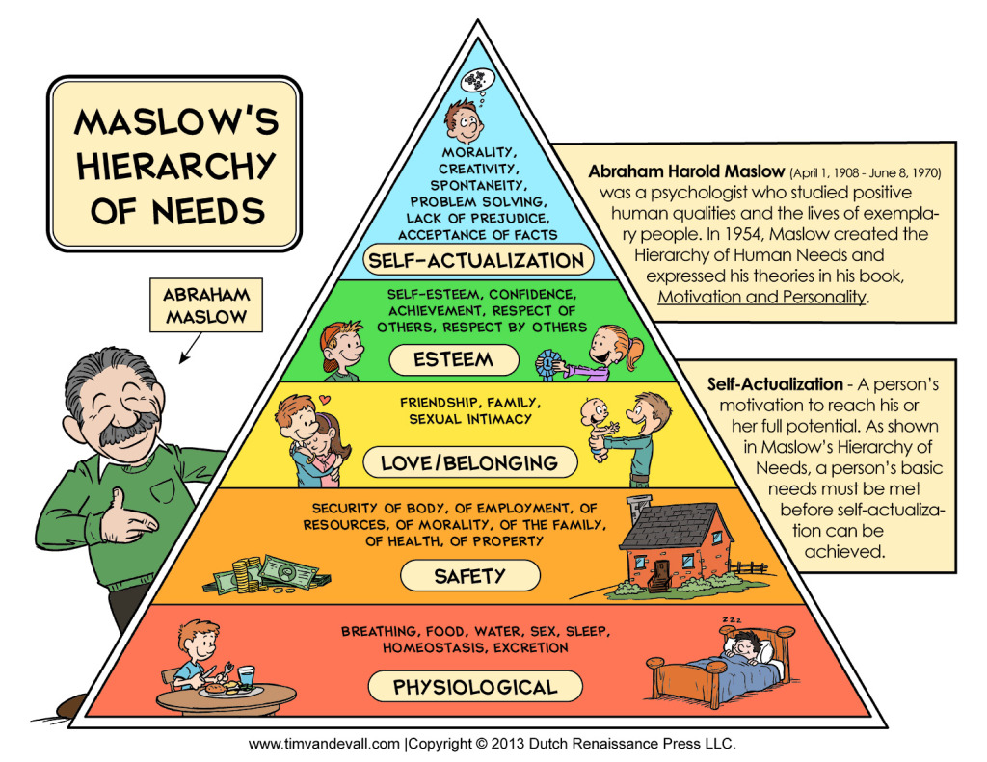
Survival Needs
Instead of asking “What do you need?”, we tend to assess first and then tell people what they need based on the assessment.
DV victims in Massachusetts family shelters present their survival need first. 13% indicated domestic violence as the reason for entering shelter whereas 60% later indicate experience with DV.
Notes:
Address the needs first, and then follow up with an assessment later, once there is no longer a survival need.

Slide 7
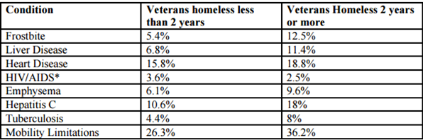
Address Survival Needs, Assess, or Both?
Findings within the National Survey of Homeless Veterans in 100,000 Homes Campaign Communities* suggest that individuals who remain homeless for longer periods of time are more likely to develop serious health conditions.
Length of homelessness is the greatest determinant of vulnerability, not the conditions resulting from the long duration.
Source: Community Solutions

Slide 8
“Every System is Perfectly Designed for the Outcome it Gets”
- Dr. W. Edwards Deming
Notes:
Deming Institute – Theory of Management, Systems of Profound Knowledge https://deming.org

Slide 9
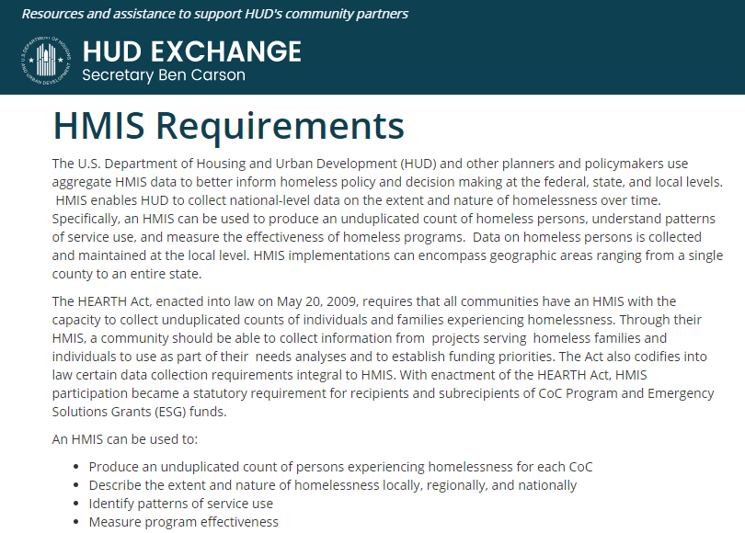

Slide 10
Common Challenges faced by HMIS-Centric Regions
Not all homeless providers receive HUD funding;
Different funding providers have different requirements;
Systems, and the standards they are being built to adhere to, are often too focused on mandated reporting rather than the work of helping people;
Some providers operate in multiple regions that use different HMIS systems;
Different organizations have different operational needs. Systems face scope creep and try do everything, which impede their ability to do a discreet set of functions well;
Finding and accessing services is a cumbersome process;
Data is fragmented between providers, systems, and regions;
Coordinated Entry Systems tend to exclude the most vulnerable and service-resistant;
First responders, such as police and medical personnel, are disconnected from coordinated entry systems;
Data entry is overly burdensome on staff; and
Different Federal partners have different geographic boundaries for the regions they support

Slide 11
Limitations of the Current HUD HMIS Standards
Heavy reliance on self-reported information;
Clients are enrolled into a project, not into a project at a location;
Consent is not tracked in a consistent manner;
Vulnerability is not assessed in a consistent manner;
Intake and exit assessment data needs to be repeated for each enrollment, even if there are no changes, and can conflict with data from other overlapping enrollments at the same time.

Slide 12
Reduce Self-Reported Data w/ Internal Controls
There are opportunities to avoid missing data altogether by enhancing the internal controls within the HMIS systems. Examples include…
HMIS Data Element Potential Data Source
Prior Living Situation Project Type of the Referring Project
Exit Destination Project Type of the Target Project
CoC Code Location Address + HUD CoC Shape Files
Income Check payment systems (see Community Partnerships)
Exit Date Last service date if no activity in 30 days, or entry into another residential project

Slide 13
Service-oriented architecture (SOA) is a style of software design where services are provided to the other components by application components, through a communication protocol.
Each service provides a discrete function.

Slide 14
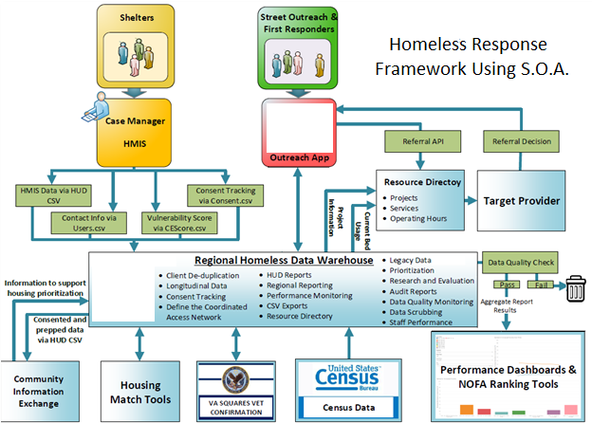

Slide 15
Key Components of a SOA Framework
Key technical assets, or “services”, to be considered within a region’s framework include:
HMIS
Non-HMIS data sets (systems of record)
Mobile tech to support street outreach
Data Warehouse to aggregate and analyze the information
Community Resource Directories
Housing Management Tools to match people with available housing resources
Research Dashboards

Slide 16

Key Service: Mobile Tech for Outreach
Address the survival needs first;
Build up a relationship, and the HMIS record, over time;
Track the service encounters to support chronic homeless determination;
Alert outreach workers if someone is trying to reach the person.

Slide 17
Key Service: Data Warehouse
A Data Warehouse can extend a region’s framework to include…
  Data quality monitoring tools to improve data quality and support HMIS conversions;
  Data scrubbing tools to clean up years of bad data;
  Integration with other key data sets that can help inform the work;
  HUD reports that can be generated off of multiple sources;
  Geospatial reporting capabilities;
  Client profiles to determine chronic homelessness status off of empirical data;
  Dashboards and reports that are focused on key target populations (young adults, chronic, vets, etc.);
  “By-Name Lists” that are prioritized based on community guidelines;
  Project and System Performance Measurement Dashboards;
  NOFA Rating and Ranking Tools

Slide 18
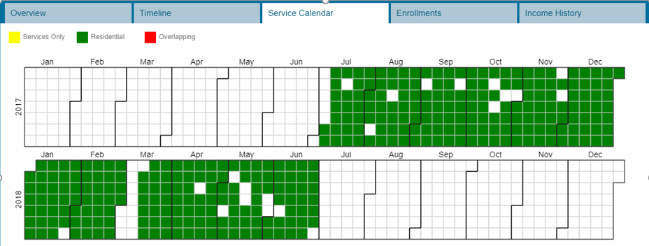
Longitudinal Client Data

Slide 19
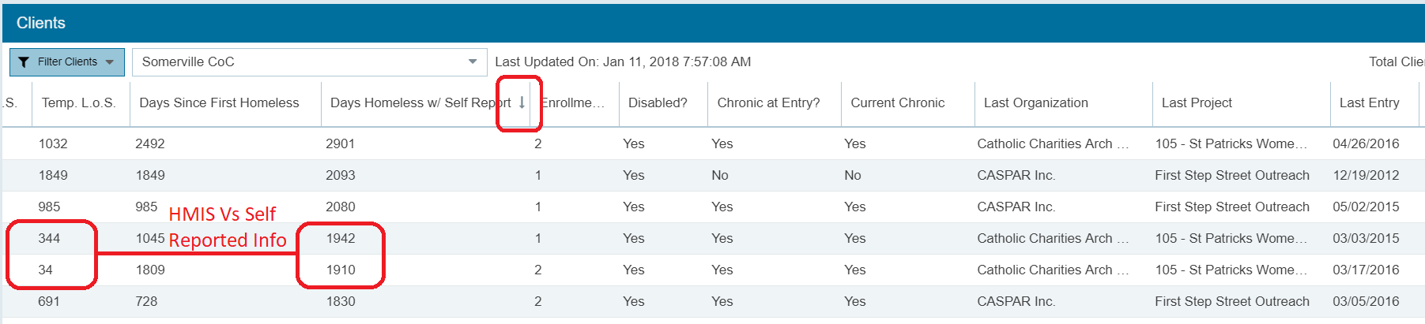
Longitudinal Client Data – By Name Lists
Prioritization can be driven off of empirical data, vulnerability assessment, or a weighted score using both;
A warehouse can integrate data collected from both HMIS and outreach apps;
Data can be used to meet third-party documentation requirements of chronic homeless status (see the HMIS Data Standards Manual, Page 56

Slide 20
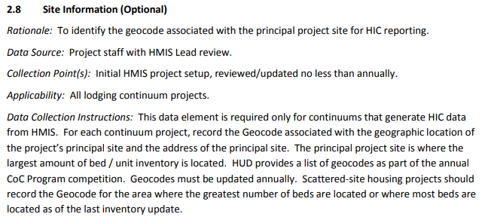
Geospatial Reporting

Slide 21
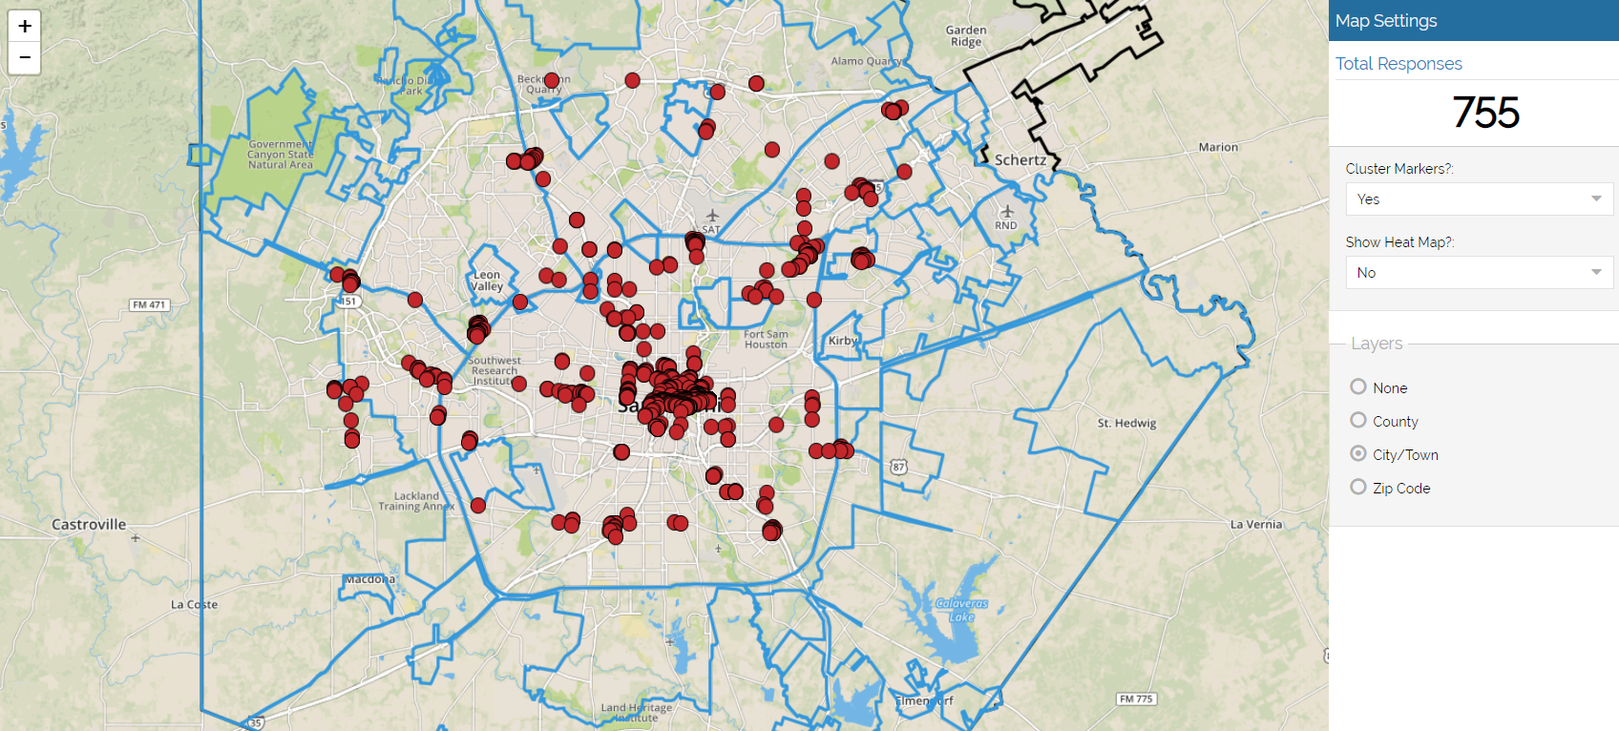
Determine the Region Based on the Location

Slide 22
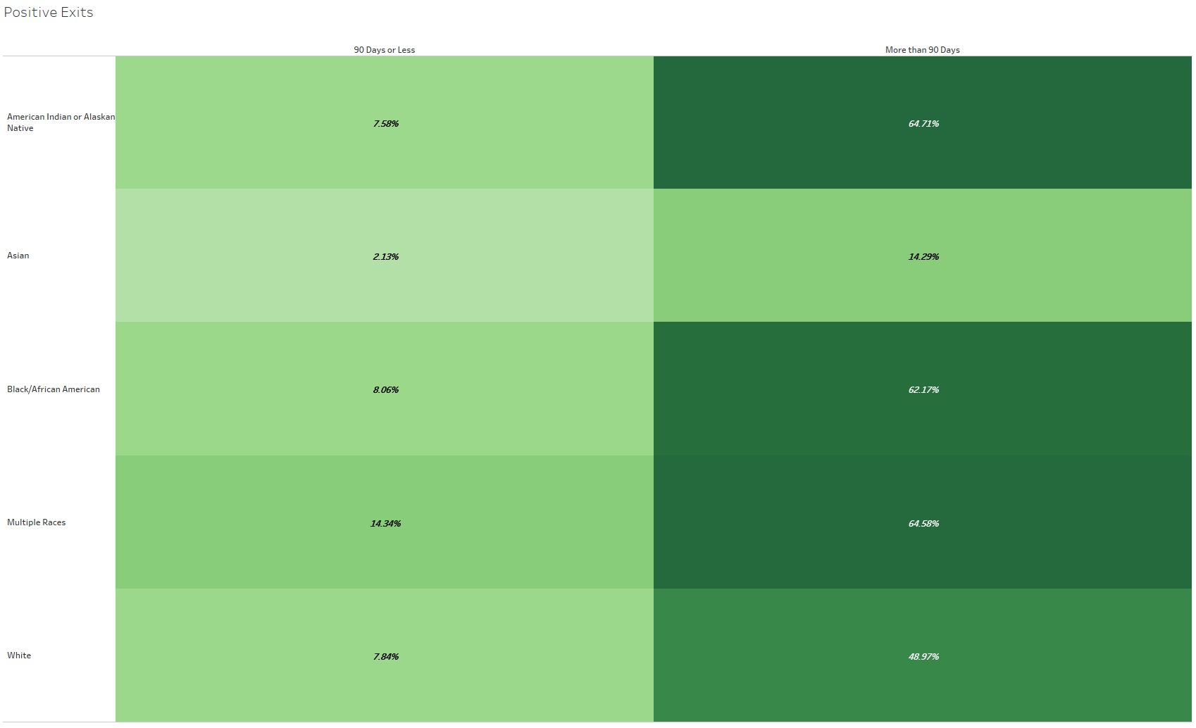
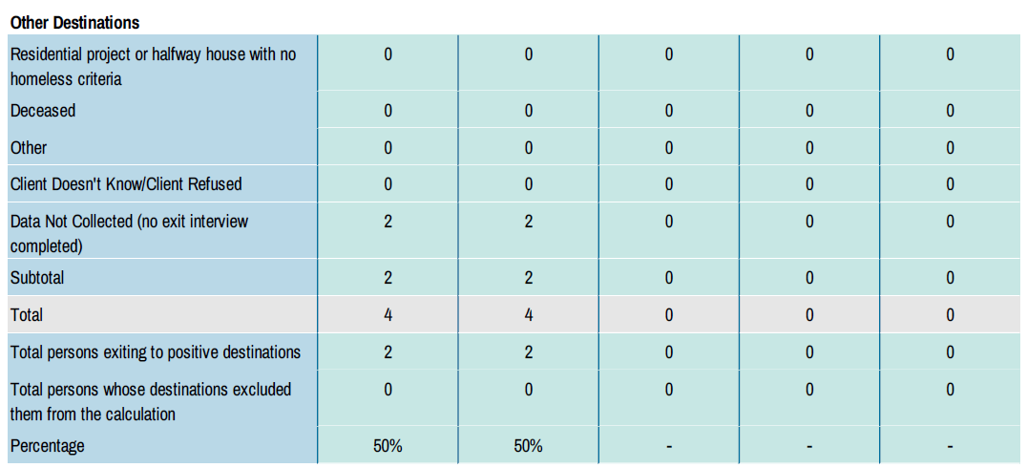
HUD Reports and Performance Dashboards
APR
Tableau

Slide 23
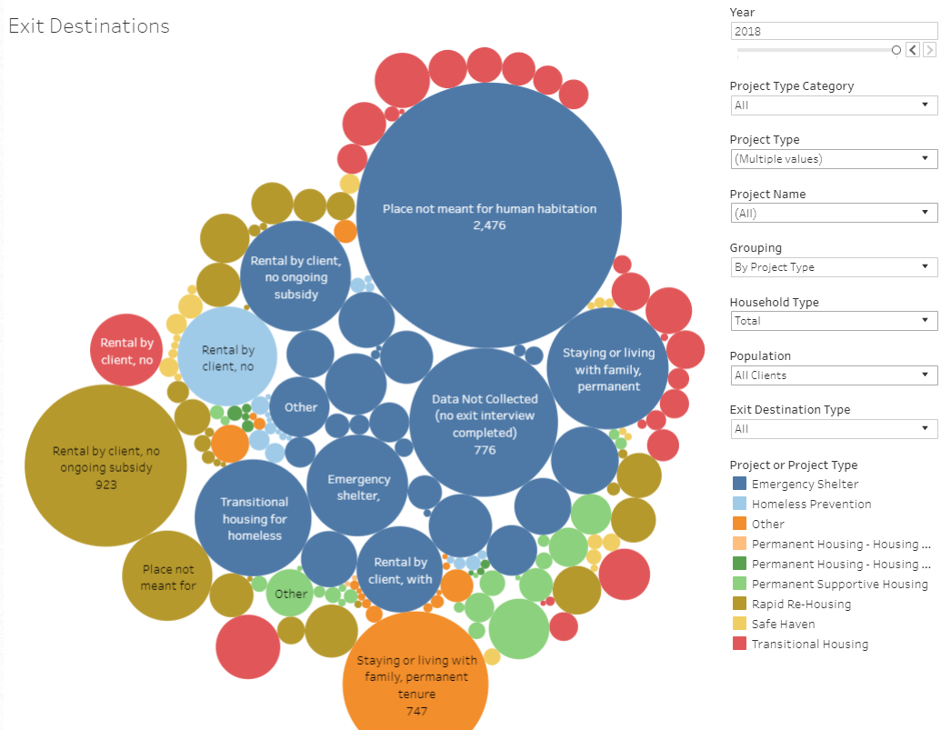
Performance
Dashboards

Slide 24
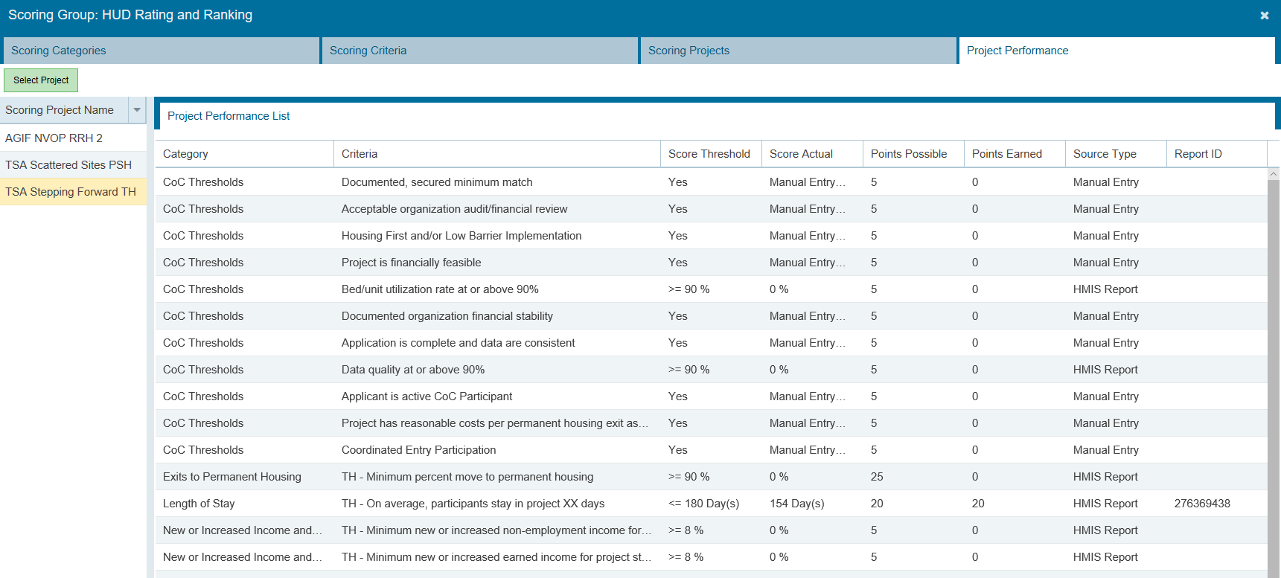
NOFA Rating and Ranking Tools
Scoring criteria is set by committee, then applied within the warehouse to automate the creation of scorecards.

Slide 25
“We must accept that human error is inevitable – and design around that fact”
Paul Batalden, MD

Slide 26
Key Service: Non-HMIS Data Sets
The Social Security Administration conducted a study of homeless people, and their self-reported SSI/SSDI status, and found that "Fully 41 percent (934/2257) of clients who reported receiving SSI/DI benefits did not receive them according to SSA."

Slide 27
Key Service: Non-HMIS Data Sets
Benefits of integrating with a “system of record”, and not relying upon self-reported information include:
Less assessment / intake fatigue for clients;
Less admin burden on staff;
Less risk of people gaming the system;
Improved data completion rates;
Less risk of data conflicts;
Each element is captured from a trusted source

Slide 28
Key Service: Non-HMIS Data Sets
“Systems of record” that can be used either as a source of information or as a DQ check of what is captured in HMIS. Examples of HMIS Data Elements, and potential sources for these, include…
HMIS Data Element Potential Data Source
Veteran Status SQUARES
Mental Health Status PATH Project Enrollment
Substance Abuse Bureau of Substance Abuse Services (BSAS)
Disabling Condition Social Security Administration
Income Check payment systems (see Community Partnerships)
Vulnerability Criteria Community Information Exchange

Slide 29
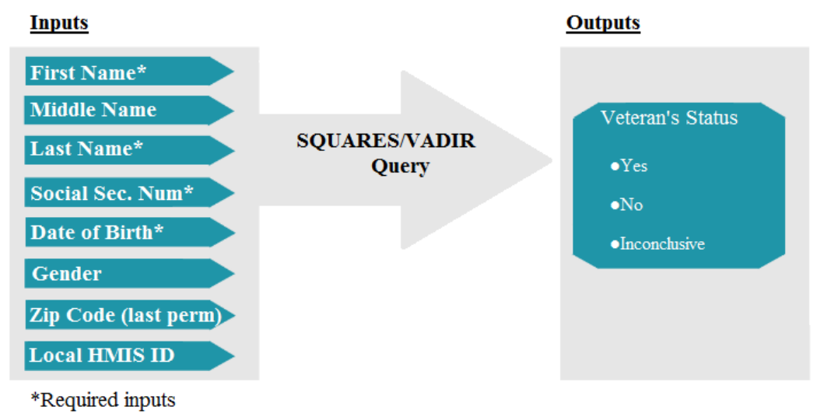
Key Service: Non-HMIS Data Sets

Slide 30
Key Service: Non-HMIS Data Sets
Manual match with the VA’s SQUARES System
Estimated time to log in, manually enter the four required elements, and record the results = 60 seconds per client.
Total estimated staff time to verify 195 clients = 3 hours and 15 minutes.
Automated match with the VA’s SQUARE System
On Friday September 14, 2018 at 10:08 AM EST, 195 records of people who were enrolled within rapid rehousing projects in San Antonio, and who self-reported as veterans, were automatically matched to the VA using an automated script.
Total run-time = 4 minutes (by a computer). Total staff time = 0 minutes.

Slide 31
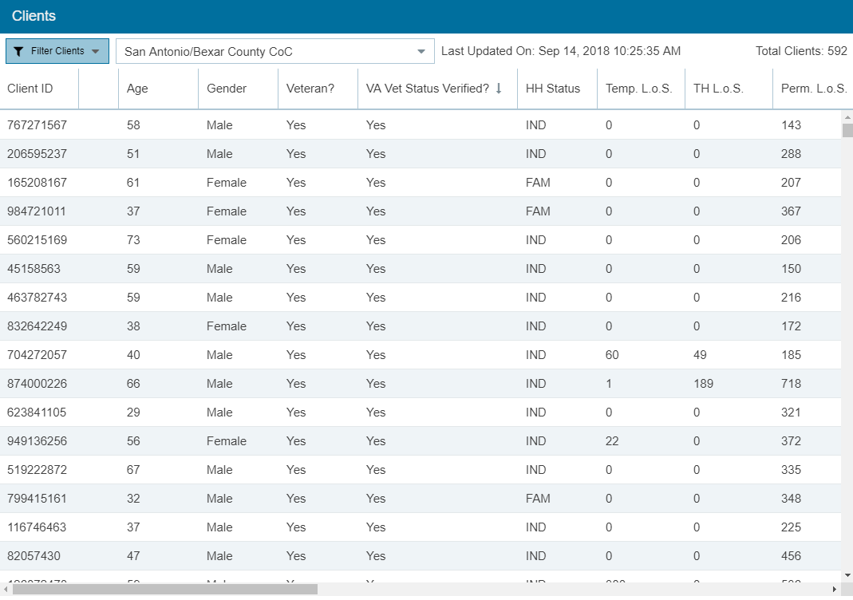
Automated SQUARES Results
Reduce Self-Reported Data w/ Data Integration
Matched Records = 177
Unmatched Records = 18

Slide 32
Key Services: Non-HMIS Data Sets
Other non-HMIS data sets to consider adding to the framework:
Medicaid Expenditures
Grant Inventory Worksheets
Fair Market Rents
US Census Data
Weather Data from the NOAA
Unclaimed Property Divisions
HIC and PIT data
SPM results
LOCCS?

Slide 33
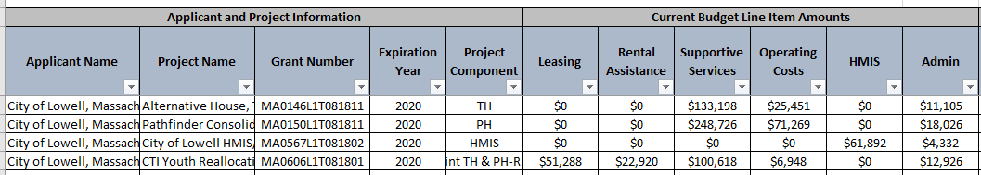
LOCCS Integration to Calculate Cost Per Outcome
Key Steps
Collect Grant Identifier and Grant Start and End Dates
Enable LOCCS data to be exported with the same grant ID #s (HUD??)
Benefits
Able to calculate cost per outcome (useful for NOFA rating and ranking)
Track spend down reporting

Slide 34
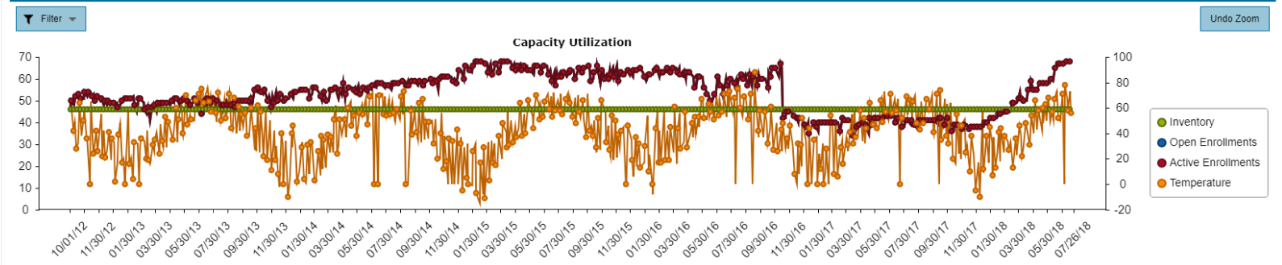
NOAA Weather Data and Bed Utilization
Used to determine if there are weather induced fluctuations in bed utilization.

Slide 35
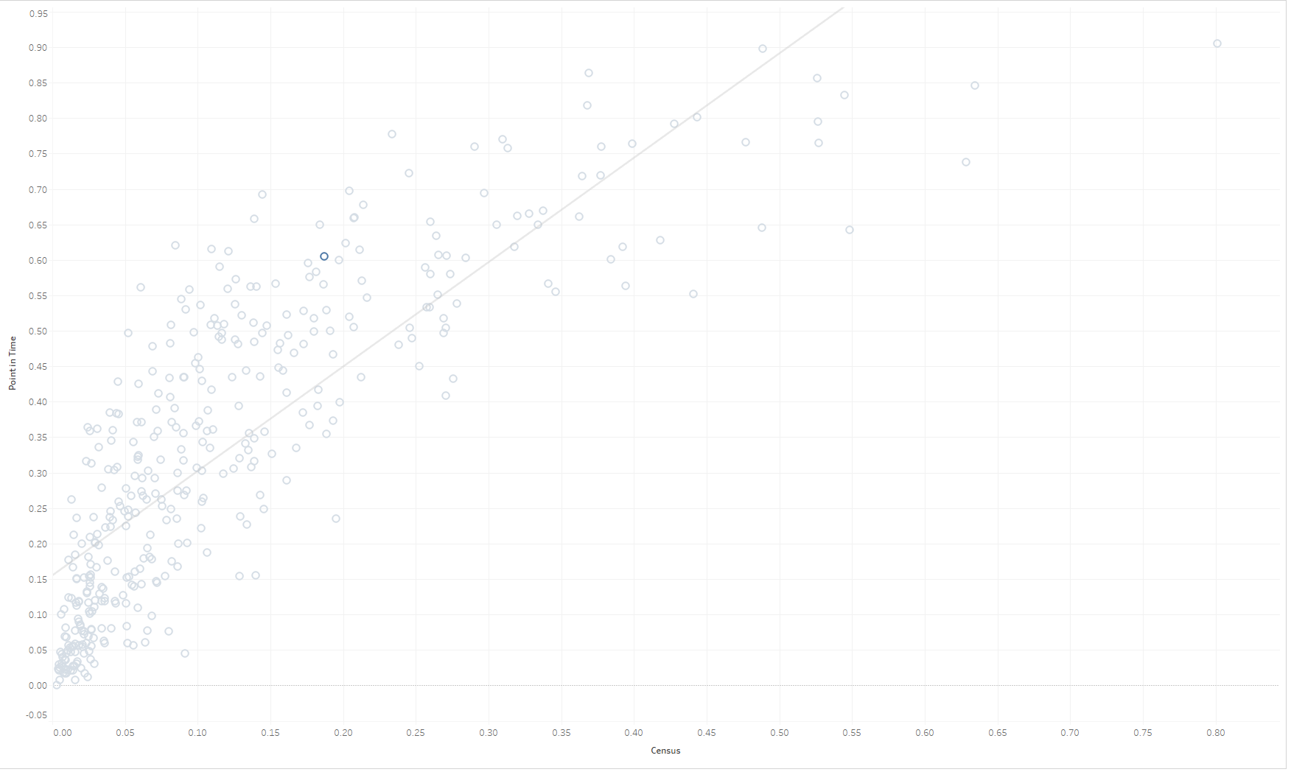
US Census and PIT Data – Racial Disparities
Percentage of African Americans experiencing homelessness versus the percentage in the general population.
http://www.simtechsolutions.com/race
1:1
US Average
Notes:
http://www.simtechsolutions.com/analysis/race/

Slide 36
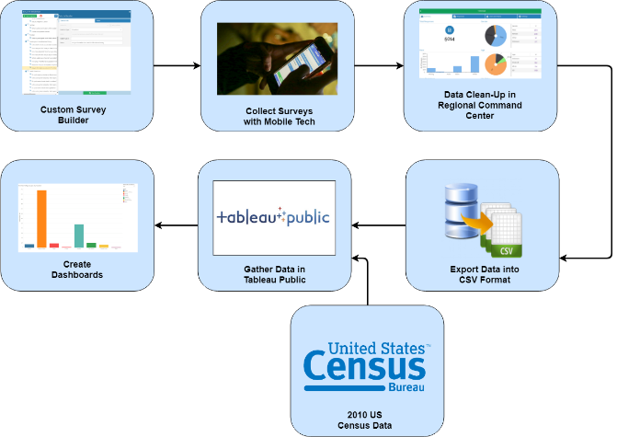
Using SOA to Measure the Impact of Disasters

Slide 37
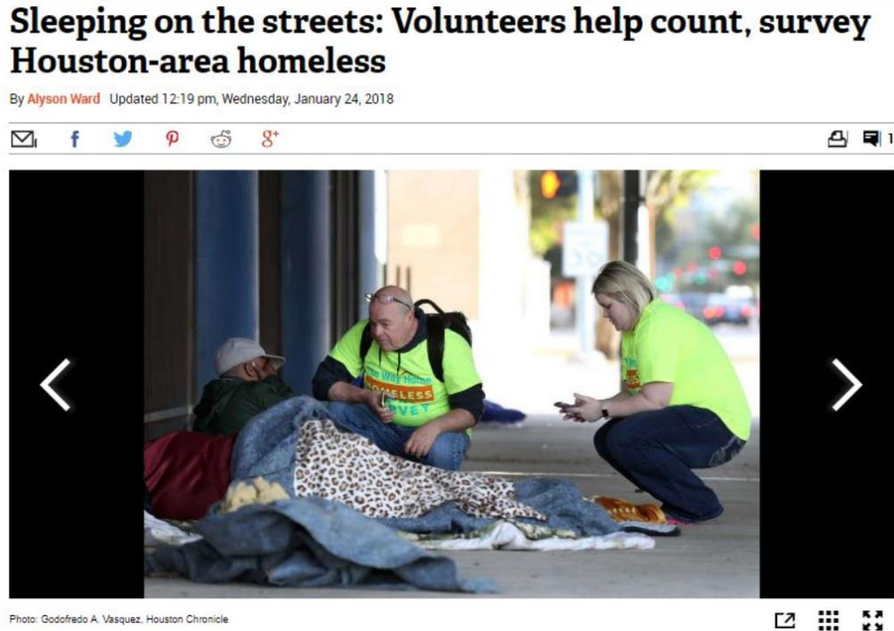
Measuring the Impact
Questions added for the PIT:
Are you homeless as a result of natural disaster? If yes, which one?
Where were you living when you became homeless this time?

Slide 38
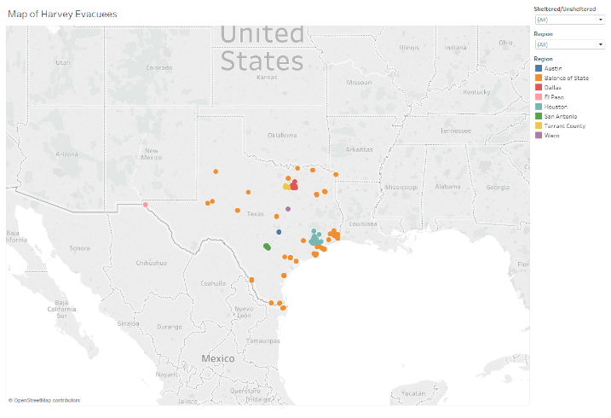
Impact of Hurricane Harvey on the TX System

Slide 39
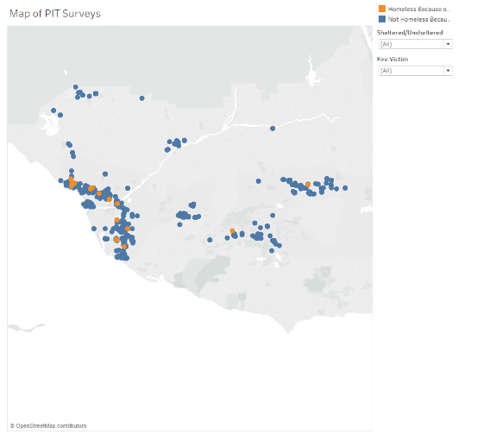
Impact of the Wildfires on Ventura’s System

Slide 40
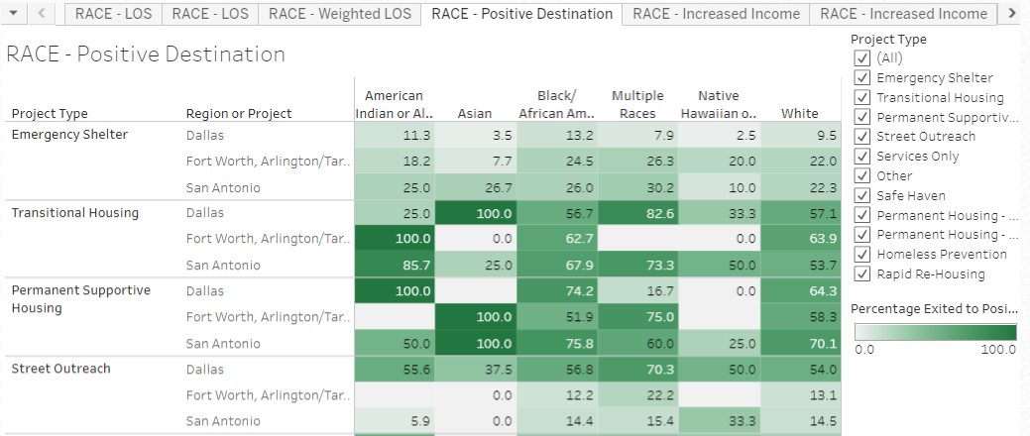
Racial Disparity Analysis using SOA
Results are culled from APRs with reports run by racial category for each project in every CoC that is part of the study.

Slide 41
Other SOA Objects to Consider
Consumer-Facing Tools that enable people to help themselves
Landlord Management and Support Tools
Accounts Payable
Artificial Intelligence services to support predictive modeling & prioritization
Biometrics and/or bar coding services to uniquely identify clients
Volunteer Recruitment and Management Tools
Donation / Supply Management
Roommate Match Systems
Affordable Housing Locators (requires a client choice assessment)
Family Reunification Matching Engines (requires permission)
Unclaimed Property Divisions
Client / Case Manager Messaging (requires client contact info in HMIS)
Document Management systems (see blockchain work in Austin)

Slide 42
Questions? Thoughts?
Contact Info: Matt Simmonds
Email: Matt@SimtechSolutions.com
More Info: http://www.simtechsolutions.com/framework

