Slide 1
Refining Coordinated Entry to Better Connect with People Living on the Streets
Presented by Matt Simmonds, President Simtech Solutions Inc.

Slide 2
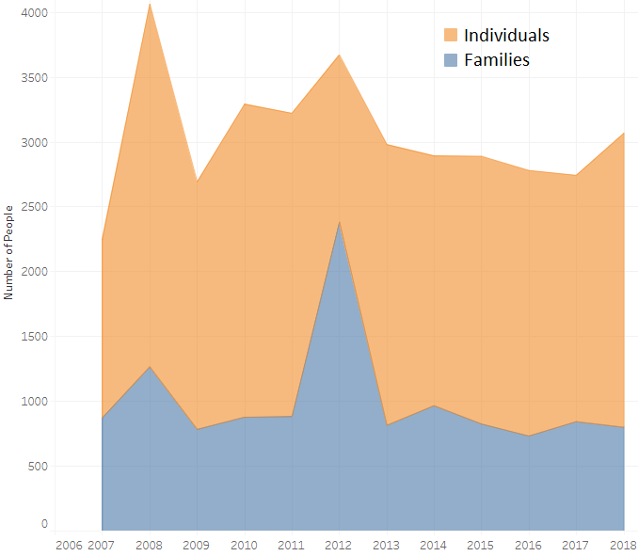
Bexar County Community Profile Individual & Families

Slide 3
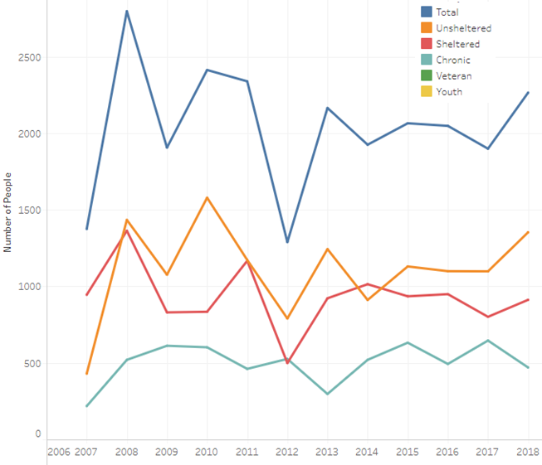
Individual Homeles Trends

Slide 4
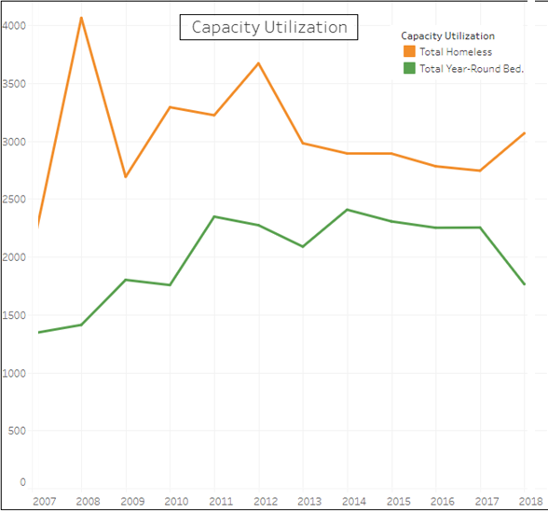
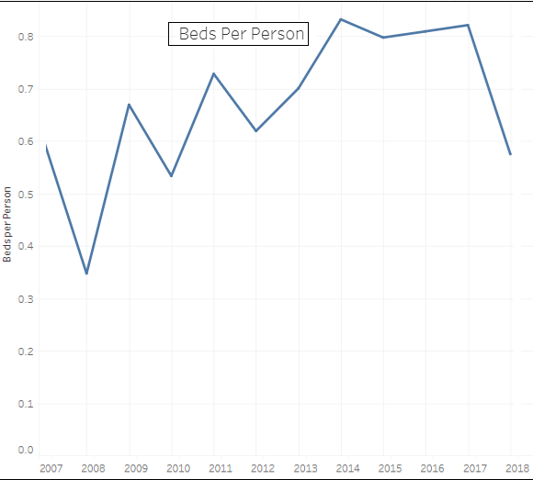
Bed Utilization & Availability
Notes:
Confirm changes in bed numbers and that this is for individuals only

Slide 5
The Federal Data TA Strategy
HUD has recognized there is work to be done across the US to better align regions with the Opening Doors Federal Strategic Plan to End Homelessness, and recently released the SNAPS Data TA Strategy to Improve Data Collection and Performance as a guide for regions. There are three main goals outlined within this strategy…

Slide 7
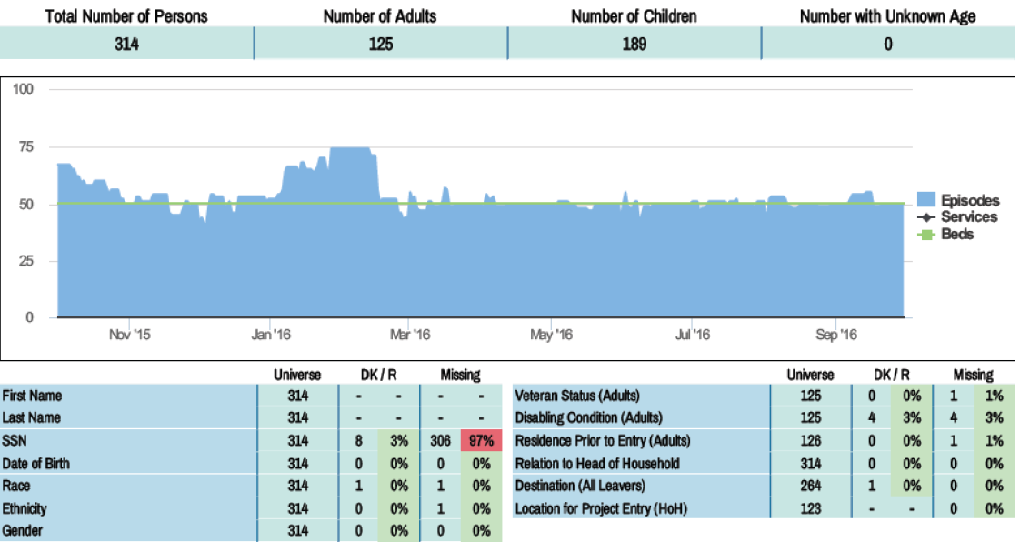
Notes:
Replace with H4H

Slide 8
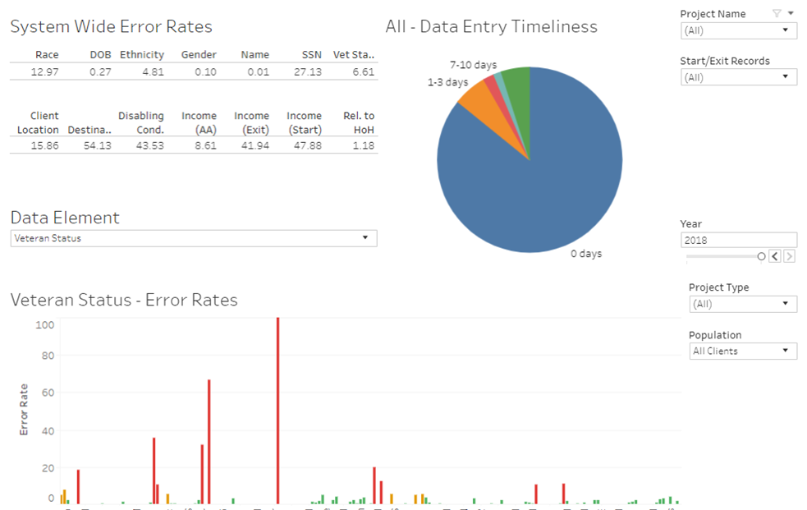

Slide 10
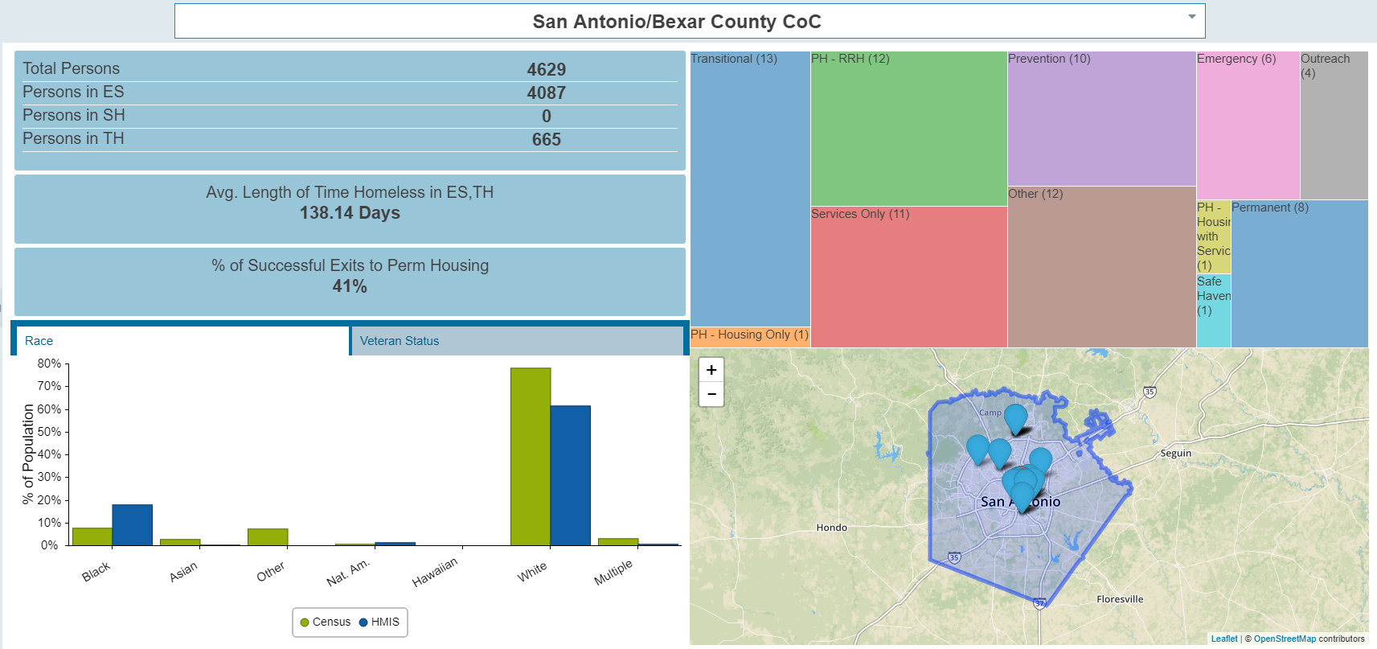

Slide 11
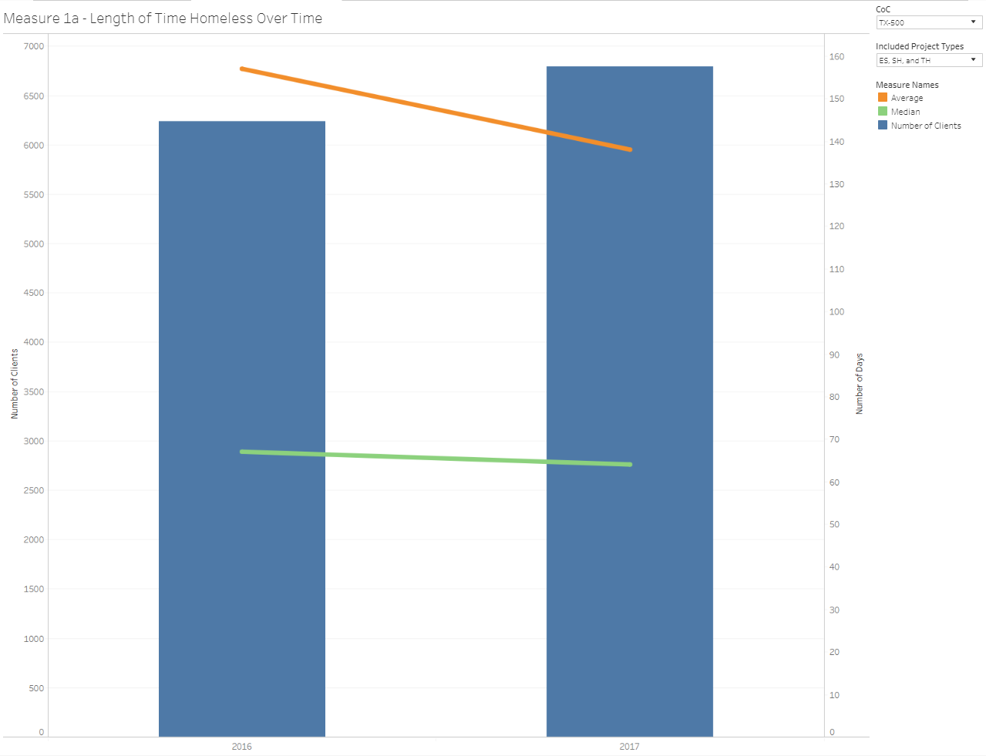
System Performance Measures * Includes both individuals and families, ignores unsheltered
Notes:
Need data from 1B to include length of time on street.

Slide 12
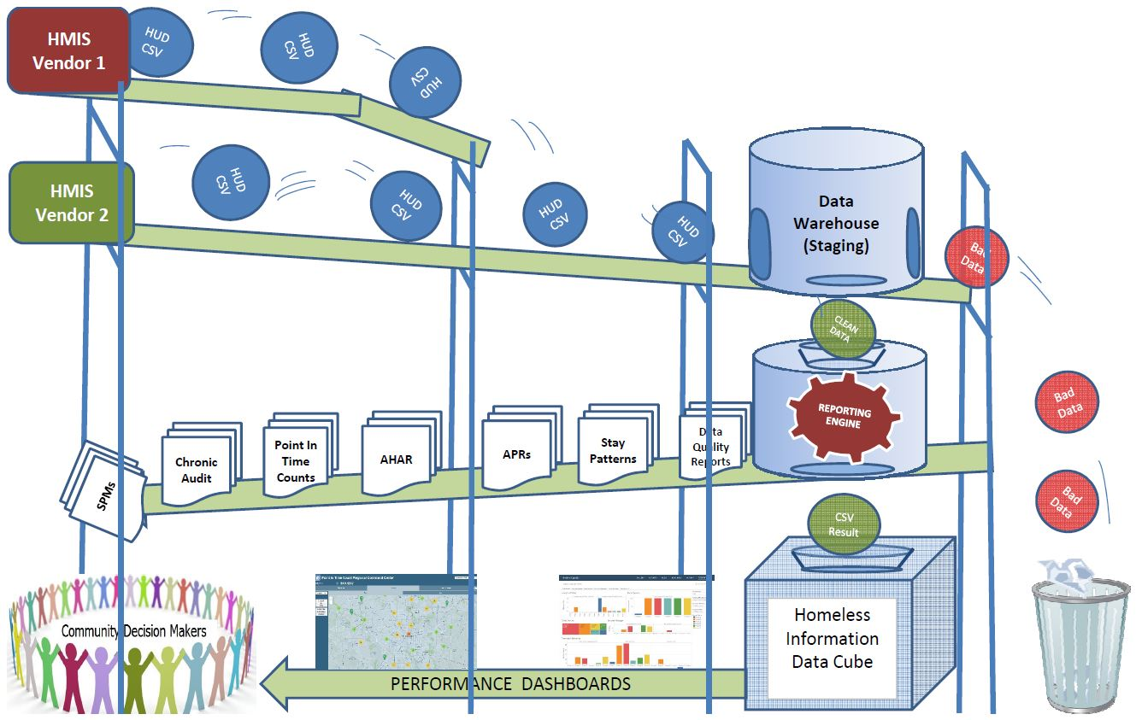
Process of Refreshing Project-Performance Measure Dashboards
Notes:
The process flow for producing project performance measures.

Slide 13
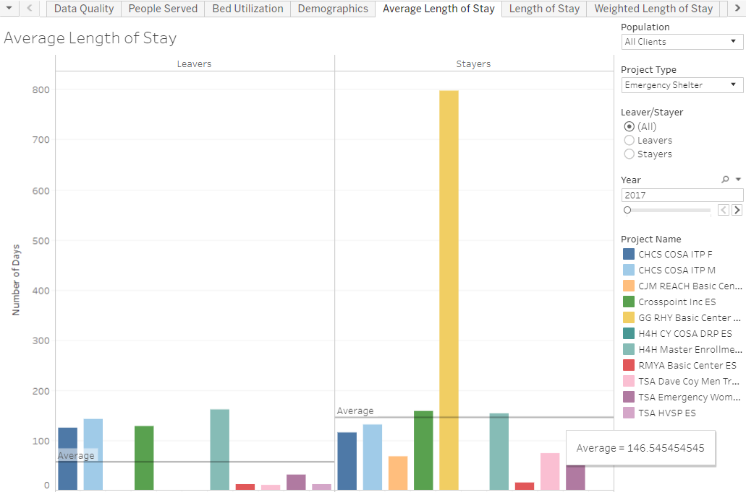
Length of Stay 2017

Slide 14
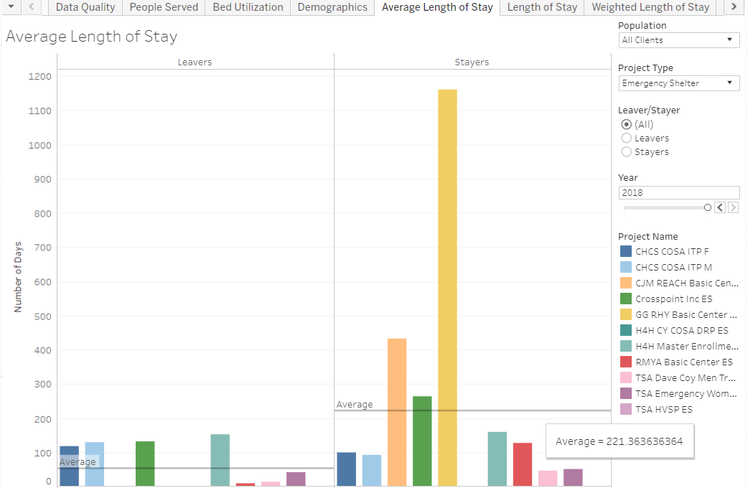
Length of Stay 2018

Slide 15
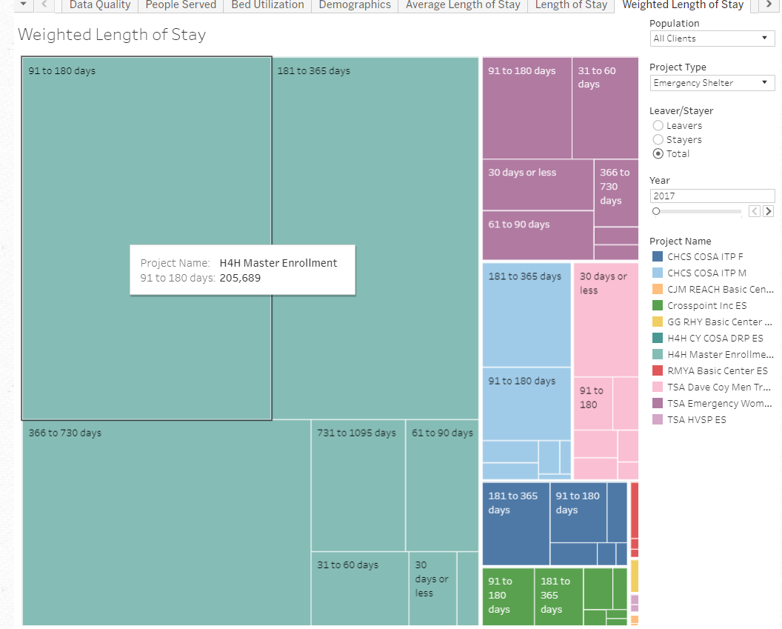
Weighted Average Length of Stay 2017

Slide 16
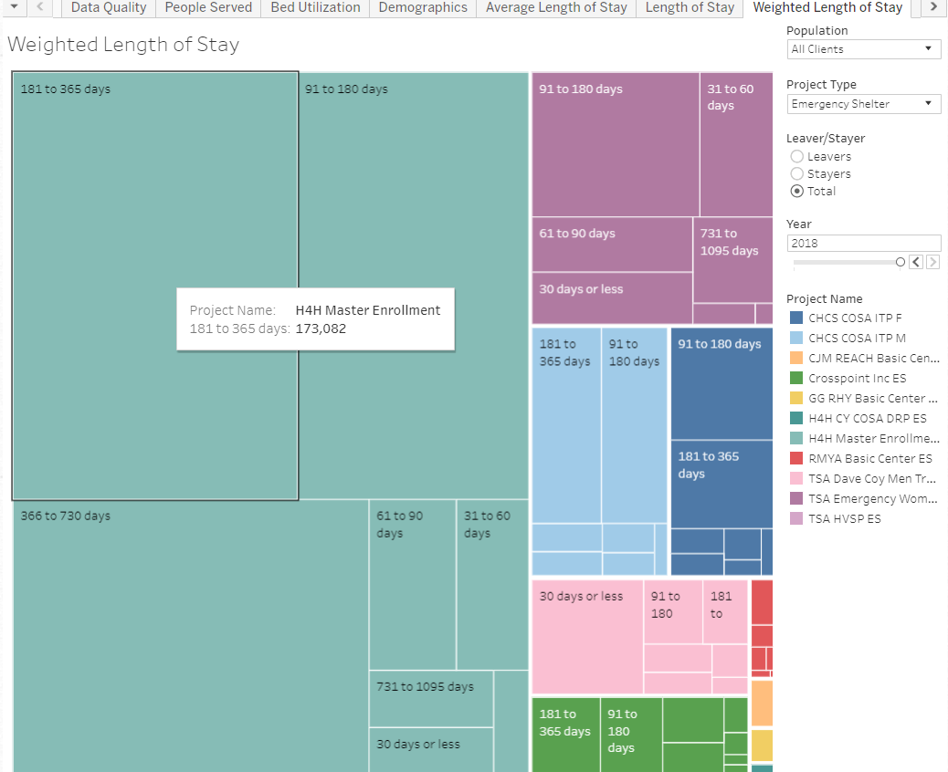
Weighted Average Length of Stay 2018

Slide 17
Current Constraints / Obstacles / Challenges:
Different funders and/or services provided = Different requirements
Some regions have multiple HMIS vendors
Confidentiality concerns
Data quality issues
Lack of time and $$$
Street outreach requires mobile tech

Slide 19
Reduce the Reliance on Self-Reported Data
Benefits of integrating with a “system of record”, and not relying upon self-reported information include:
Less assessment / intake fatigue for clients
Less admin burden on staff
Less risk of people gaming the system
Improved data completion rates
Less risk of data conflicts
Each element is captured from a trusted source

Slide 20
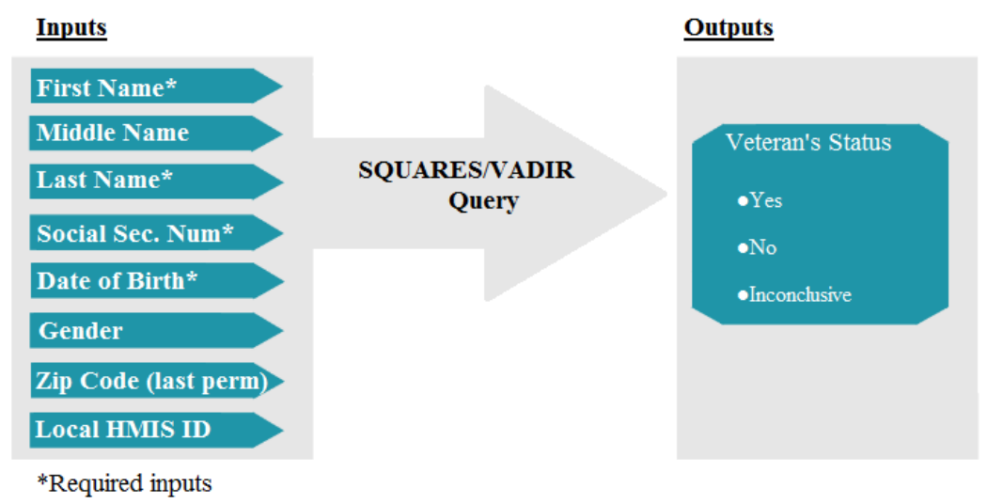

Slide 21
Manual match with the VA’s SQUARES System Estimated time to log in, manually enter the four required elements, and record the results = 60 seconds per client.
Total estimated staff time to verify 195 clients = 3 hours and 15 minutes.
Automated match with the VA’s SQUARE System On Friday September 14, 2018 at 10:08 AM EST, 195 records of people who were enrolled within rapid rehousing projects in San Antonio, and who self-reported as veterans, were automatically matched to the VA using an automated script. Total run-time = 4 minutes (by a computer)

Slide 22
Automated SQUARES Results
Matched Records = 177 Unmatched Records = 18

Slide 23
The Social Security Administration conducted a study of homeless people, and their self-reported SSI/SSDI status, and found that "Fully 41 percent (934/2257) of clients who reported receiving SSI/DI benefits did not receive them according to SSA."

Slide 24
Reduce the reliance on self-reported data by integrating with the “systems of record” whenever possible to capture information that can be used either as a source of information or as a DQ check of what is captured in HMIS. Examples of HMIS Data Elements, and potential sources for these, include…
HMIS Data Element Potential Data Source
Veteran Status SQUARES
Mental Health Status PATH Project Enrollment
Substance Abuse Bureau of Substance Abuse Services (BSAS)
Disabling Condition Social Security Administration
Non-HMIS Data Element Potential Data Source
Medical Costs Hospitals
Interactions with Police Criminal Justice System

Slide 25
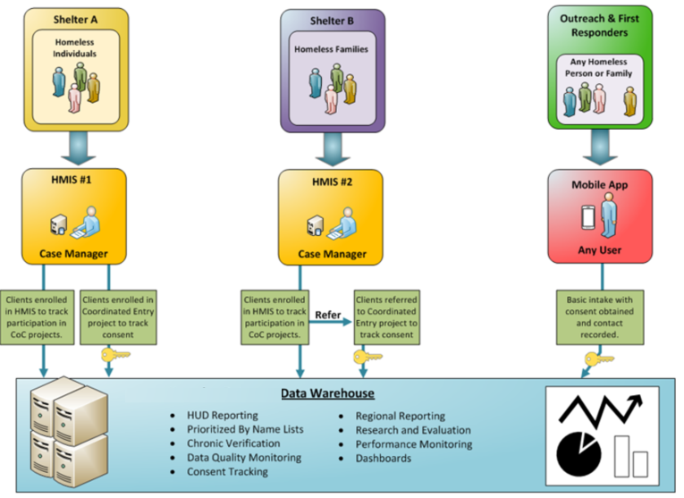
Notes:
“Since coordinated entry is a process that may be supported by multiple agencies and may span an extended period of time, CoCs are urged to set up a single coordinated entry “project” that all relevant agencies can access. Some CoCs may need to establish multiple projects if information cannot be shared or managed across agencies. As participants interact with the CoC’s first points of access, they should be “enrolled” in the Coordinated Entry “project” that is set up in the HMIS or other data collection system.”

Slide 26
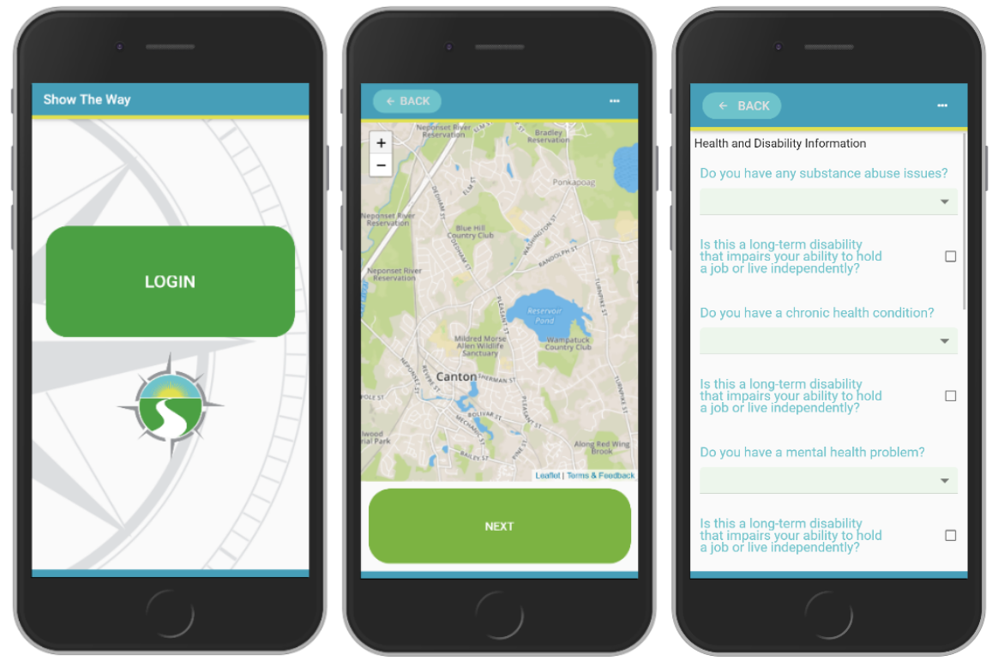
Show the Way is designed to better connect with people living on the streets…
Notes:
Send text to get download link

Slide 27
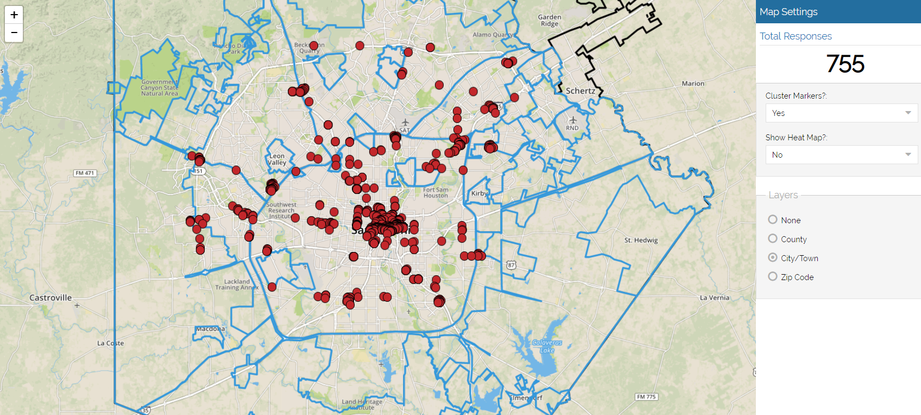

Slide 28
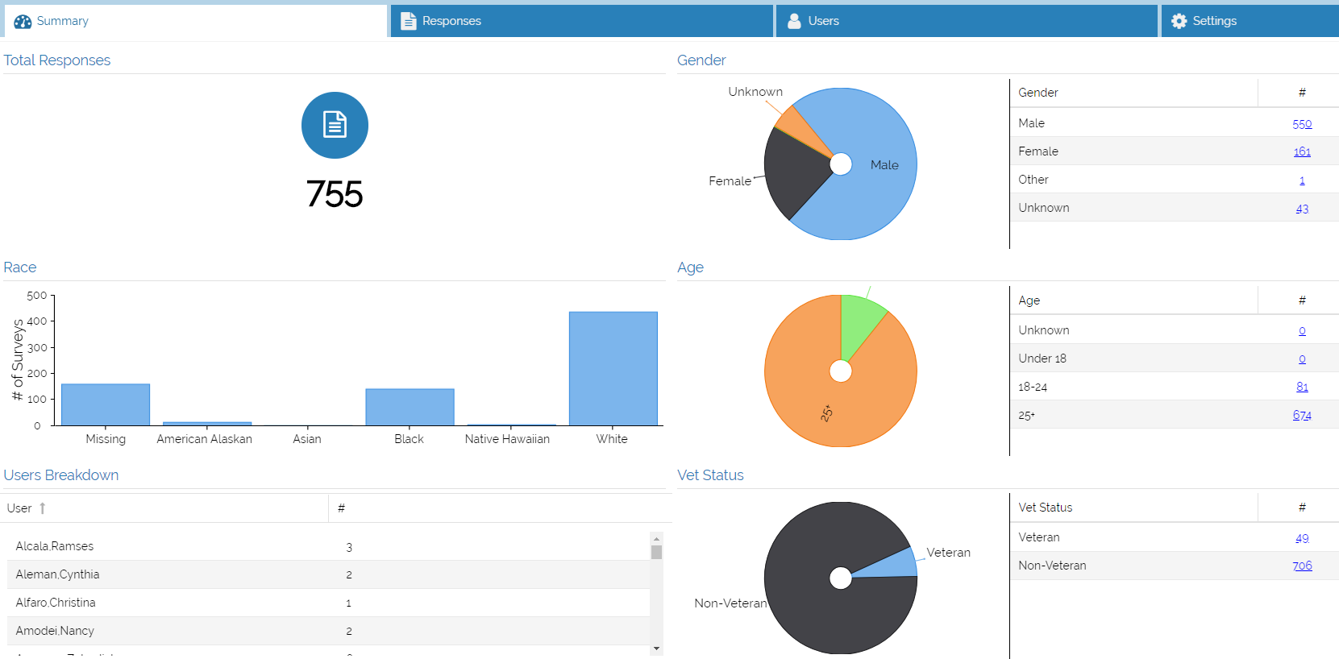

Slide 29
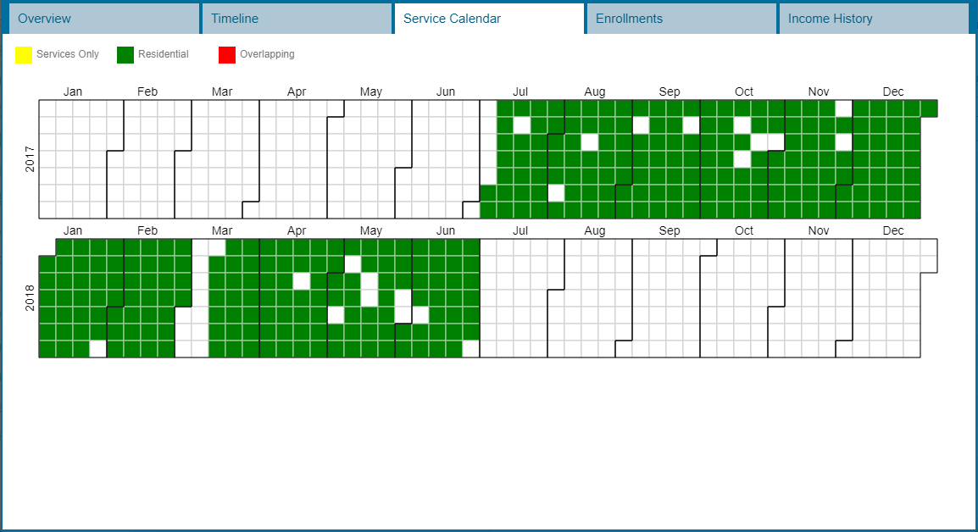

Slide 30
“HMIS reports of actual enrollments in ES, SH, or SO projects may be used to meet third-party documentation requirements”. HMIS Data Standards Manual, Page 56

Slide 31
Lessons Learned from the Pilot
Information on a person needs to be built up over time - as the trust builds.
Some are comfortable with biometrics, others are not.
Actively updated resource directories would be helpful.
Many homeless people have smart phones. Virtual case management is plausible.
First responders need to be able to post data but don’t necessarily need to be able to consume it.
The definition of a successful outcome is different for each situation.
This is going to continue to be an iterative and evolving process.

Slide 32
Key Action Steps to Optimize the System
Improve the understanding of your system
Reduce the reliance on self-reported data
Reduce overhead burden on staff
Make it easier for people to connect with help
Divert and rehouse whenever possible (the in door)
Fill the gaps in the data picture (unsheltered is over half the picture)
Coordinate efforts between providers and minimize duplication
Embrace data-driven decision making
Reward the strong performers
Use empirical data to guide the resource allocation strategy
Continue to review and revise your community action plan
Increase affordable housing stock (the exit)
Notes:
Get 2018 percentages

Slide 33
QUESTIONS???

