Slide 1
PIT Count Planning and Analysis Aided by Open Data and Open Source Tools
Kristin Zakoor, Assistant Director of Data, Texas Homeless Network
Danielle Winslow, Acting Deputy Director, All Home King County
Eddie Barber, Lead Developer, Simtech Solutions

Slide 2
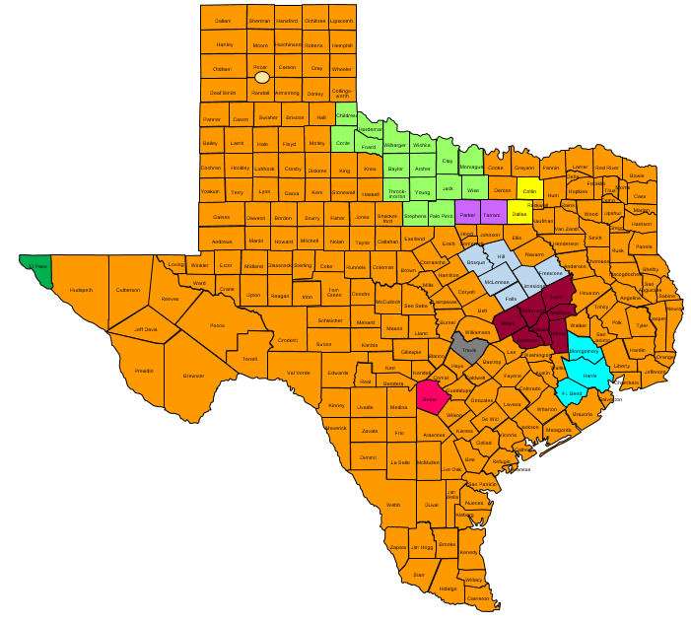
Texas Balance of State
Snapshot:
215 counties
25 Local Homeless Coalitions
Mix of Urban, Suburban, Rural
~1000 volunteers
Until 2018 used paper surveys then switched to mobile app
Notes:
The Texas Balance of State CoC covers 215 counties of the 254 counties in Texas.
We have 25 Local Homeless Coalitions within our geography.
In the context of our PIT planning, we had 31 primary PIT leads and each were requested to have a back up.
Some PIT leads were responsible for only one county with other PIT Leads coordinating counts across their entire LHC (which can include several counties)
To determine which communities would participate we used googles forms and sent them to previous PIT communities as well as LHC chairs
**Due to the large nature of our geography, we leave a lot of the logistics of the count up to each PIT lead and their area. We have found that allowing them to control their approach has yielded impressive and creative practices because they tend to know what methods will best serve their region.

Slide 3
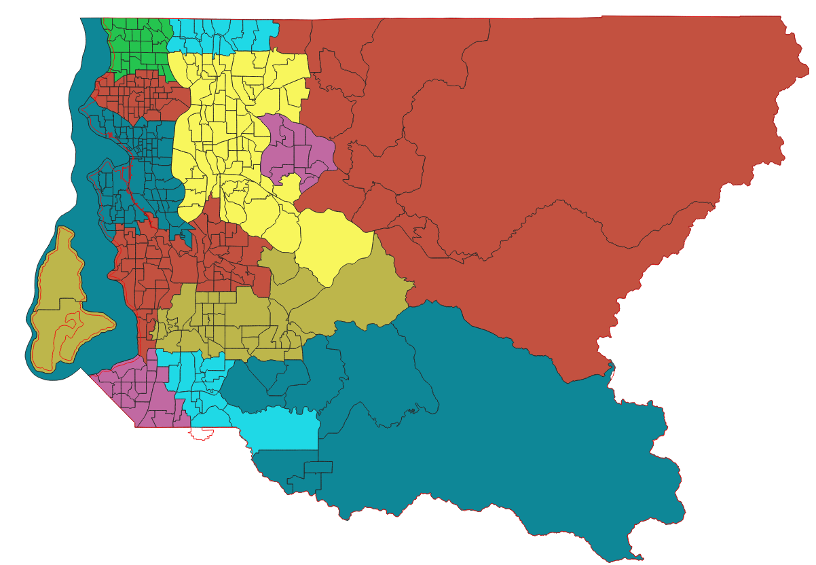
King County
Snapshot:
39 cities, including Seattle
Mix of urban, suburban, and rural areas
Mix of Urban, Suburban, Rural
~1000 volunteers
Count Includes
General Street Count
Youth and Young Adult Count
Sheltered Count (Emergency Shelter, Safe Haven, and Transitional Housing)
Peer-Conducted Survey
Notes:
King County is made up of 39 cities, including the City of Seattle and is a mix of urban, suburban, and rural areas
Count includes:
General Street Count
Youth and Young Adult Count
Sheltered Count (Emergency Shelter, Safe Haven, and Transitional Housing)
Peer-Conducted Survey
We work with a contractor to support, provide technical assistance, participate and ultimately complete the analysis and report for the Count. Overtime, we’ve learned the challenge of relying solely on a contractor because so much of our success relies on local knowledge and relationship to implement successfully.
Nearly 1000 volunteers and paid guides participate in the general street count
Technology:
We continue to use paper tally sheets and surveys, with our goals set towards increasing our technology tools for improved volunteer/guide participation, data accuracy and time/cost efficiencies.

Slide 4
Pre-Count Planning (TX-BOS)
Outreach to communities
Designate PIT Leads and Back-ups
Create “Pre-PIT” materials
PIT Lead manual
Promotional materials
Develop a safety plan
Plan for adverse weather
Free tools: Google docs & forms, Tableau, Canva, Basecamp
Notes:
The Texas Balance of State CoC covers 215 counties of the 254 counties in Texas.
We have 25 Local Homeless Coalitions within our geography.
In the context of our PIT planning, we had 31 primary PIT leads and each were requested to have a back up.
Some PIT leads were responsible for only one county with other PIT Leads coordinating counts across their entire LHC (which can include several counties)
To determine which communities would participate we used googles forms and sent them to previous PIT communities as well as LHC chairs
**Due to the large nature of our geography, we leave a lot of the logistics of the count up to each PIT lead and their area. We have found that allowing them to control their approach has yielded impressive and creative practices because they tend to know what methods will best serve their region.
Reference Basecamp- we have paid version but also free. Good project mgmt. tool

Slide 5
Pre-Count Planning (King County)
Confirm Action Group that provides input and oversight of the PIT activities, including an equity impact analysis of PIT components
Establish Area Leads by regional deployment center coverage area
Additional youth and young adult planning is done in partnership with general planning
For the first time in 2019, we used a customized volunteer registration platform that allowed for volunteer team and census tract assignments
Notes:
Our community and CoC Board has agreed that our homeless response must center and lead with race to end homelessness given the disproportionality of who experiences homelessness. For that reason, in addition to taking special consideration of the geographical differences in King County, we select leaders with strong equity analysis to participate on the Action Group to provide oversight and recommendations around Count activities. The Action Group meets monthly to review materials and processes through an equity impact analysis with the goal of making the Count as inclusive as possible.
We also establish area leads by deployment center which is the physical location volunteers responsible for canvassing a specific part of the County will report to. In order to assure 100% coverage we assign census tracks to teams.
Given the challenges to identify youth and young adults in our general methodology and our community’s added goal to count the number or YYA at imminent risk of homelessness, we have a sub-group of YYA planners and providers that conduct a specialized youth count the afternoon before the general street count.
Technology:
At the beginning of our 2018 planning we intended to introduce technology tools into our count to respond to previous volunteer feedback about the clumsiness of paper tally sheets and surveys.
In the end, we were only able to try out a customized volunteer registration platform that allowed the following abilities we didn’t have in past counts:
Volunteers went to a landing page that was messaged and branded in alignment with the rest of our Count materials
Volunteers could update preferences or changes in availability
Area leads and project management staff could easily see how many volunteers were signed up by region and make adjustments as needed
My favorite! Area leads and project management could create pre-assigned teams assign census tracks visually, which ensured 100% coverage of an area and in a manner that made sense on the ground.

Slide 6
Recruitment (TX-BOS)
Social media posts
Promotional materials
Partnerships
Local Service Provider
Faith Based
Local Government
Law Enforcement + Fire Dept.
Higher Education
Google Forms
Volunteer Registration + ROI
Free tools: Google docs & forms, Facebook, Twitter, Instagram, Canva
Notes:
-We used a google form on our website in order to track volunteer registration. This form also contained our release form for each volunteer.
-Each PIT lead had different tactics for recruiting volunteers. Most of the communities used staff member connections within their LHC/Homeless Crisis Response System.
-There was also several communities that reported using their social media outlets several months in advance helped ensure they had a large number of volunteers for the count
-One of our communities partnered with the University of Texas at Tyler and coordinated a way to have the PIT count be part of the curriculum for nursing students (Smith County)
-Another one of our communities partnered with University of Texas of the Rio Grande Valley and added the PIT count to: The Engagement Zone, and internal site which matches volunteers with volunteer opportunities. Reportedly they got 80 more volunteers this year from this program alone.

Slide 7
Recruitment (King County)
Partnerships
PIT Action Group members
Local Service Provider
Faith Based
Local Government
Higher Education
Past PIT guides, Consumer Advisory Council and Youth Action Board
Advertisement in local paper, Real Change
Promotional materials and social media posts
Notes:
We rely heavily on past volunteers and stakeholders that are invested in the planning and implementation of the Count. In Seattle, we have to close registration given the interest and depth of service provision in the City. Other more rural regions that may be forested or high speed interstate are more difficult to gain interest or buy in on why 100% canvassing is the right strategy.
Our goal is to make sure the folks being counted also have the opportunity to inform and hold an active role in the Count. We strive to have one paid guide (person with lived experience of homelessness) on every volunteer team. Guides may or may not know the area, but they are asked to help support a culture of respect and safety. Additionally, they can share knowledge of where to look and how to identify the signs of inhabitance that may go unnoticed by someone who has always been housed. Past guides are also a great resource for including folks they know.
The Consumer Advisory Council and Youth Action Board are our CoC related consumer advisors and decisions makers.
Real Change is Seattle’s newspaper that provides immediately employment for low-income or unhoused folks by selling their paper that also has contributions by its vendors.

Slide 8
Count Planning (TX-BOS)
Form Point-in-Time Count Committee
Sheltered:
Identify and reach out to all ES & TH facilities
Provide list of facilities to PIT Leads
Send out PIT promotional materials
Assess capacity to count
Enlist extra volunteers for larger facilities
Unsheltered:
Decide count method
Create local partnerships
Review previous year location data
Develop “hot spot” maps, written guidelines, and directions
Organize donations
Assign teams
Free tools: Google maps, Tableau, Doodle Poll
Notes:
PIT Committee-
To plan the count
To identify key action tasks in counting the homeless
To monitor the planning and implementation process
To ensure accountability in the process
To maintain consistent Point-In-Time Count standards
Divide up roles among members- PIT lead, volunteer recruitment, mapping, publicuty
THN provides calendar with deadlines and sample meeting materials
Assign teams- having them set-up volunteer shifts
We left it up to each community to establish their teams, create hot spots and create maps– Not sure what else to put here
**Survey Question Development**
When we were developing the survey questions we used several different methods.
We asked for staff input from different teams within our organization,
We researched other custom questions that CoC’s have publicly disclosed on their websites,
We researched risk factors for homelessness (ACES, natural disasters, type of employment, etc) and added questions and answer options to track them.
Additionally we used lessons learned from previous counts to help us rephrase questions (particularly the disability questions) to make them more culturally respectful to yield more responses.
We also very carefully considered the answer options to ensure that on the back end we wouldn’t have as many issues with analysis (another lesson learned from last year)
Building Mockup forms
We had a few phone calls with the creators of our app to walk through the questionnaire to establish the best flow. We did not finalize the survey during this one call. It was a process of constantly soliciting feedback from other staff members and doing run-throughs of the survey over the course of a month or so.
While we do use an app primarily, we did still have several communities that were reluctant to use the app solely. We developed a paper survey from the app survey so that communities could take a dual approach.
Most of our areas only used the app. Those that used the paper surveys tended to only offer them to a few of their volunteers/shelters; Although, we did have a community that opted to use only paper surveys and then do data entry after the count.
We then translated the paper surveys into Spanish for communities that needed both an English and Spanish version.
Unsheltered:
Count Method-
Night of (and) SBC
Complete Coverage
Known Locations *what we use*

Slide 9
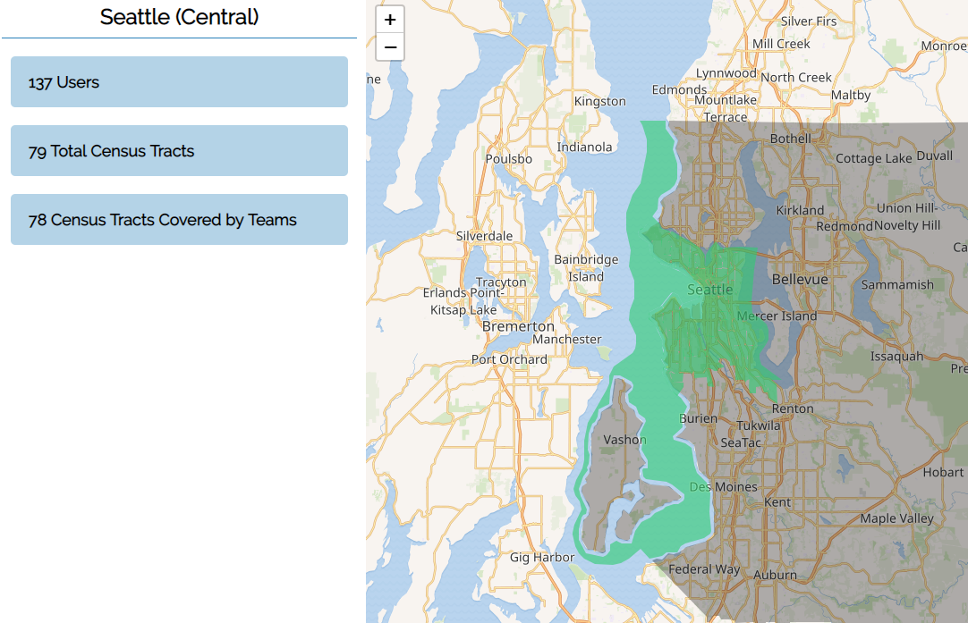
Count Planning (King County)
Assign volunteers to regions
Split regions into teams
Ensure each census tract is covered by a team

Slide 10
Training (TX-BOS)
For PIT Leads and back-ups:
All virtual trainings
Mandatory “train the trainer”
How to use the tech
Q & A session
PPTs and supplemental materials
Guidance on how to conduct volunteer training
For volunteers:
In person training with PIT Leads
Online PPT training with knowledge check
“Quick-train” videos
Cheat Sheet materials
Free tools: Google form, Canva, Venngage
Notes:
Mention that we used Camtasia to create all videos
While we do allow our PIT leads to develop most of their own procedures and practices themselves, to help establish some consistency across the BoS we hold at least one mandatory PIT training every year.
It is mandated for at least one PIT lead from each region to attend the webinar. During this webinar we give a background of what the PIT is, why it is important, and best practices related to planning. We also introduce the additional training opportunities we will hold throughout the following months.
When it comes to volunteer trainings we had two different options (most areas used a combination approach of the volunteer training materials). We created presentations that the PIT leads could use for their in person trainings. We additionally recorded a volunteer training for the PIT leads that didn’t have the time to offer multiple trainings. We used an online survey form to test the knowledge of volunteers who used this method
For training on the app specifically we did live demos on each of our webinars, we created one page walkthroughs, and we recorded three short tutorial videos for each of the survey types. These were then posted on our website and sent to PIT leads.
Created a landing page on our org website where both PIT leads and volunteer have access to all PIT related materials

Slide 11
Training (King County)
For volunteers, guides/surveyors (paid):
Regional in person trainings made available
Online webinar trainings
Posted “Quick-train” videos
Are you ready “quiz”
Training components:
Unconscious bias and impacts on data collection
What is the PIT and our local methodology
How to complete a tally sheet and how to identify signs of someone living in their vehicle
Responsibility and safety
Notes:
We offer in person trainings at every deployment center, sometimes during the day and sometimes at the evening hours. Additionally we offer interactive webinar trainings and pre-recorded videos.
We lead with a conversation about implicit bias and how the only way to combat it for data quality is to recognize when it might come up for someone.
One of our Action Group members and local leaders around understanding the unique needs and challenges for people staying in their vehicles created a identification tool to help unknowing volunteers make a determination of whether a vehicle should be included or not. There was a video recording for those who weren’t able to make the in person training.

Slide 12
Messaging (TX-BOS)
Social media
Local news and paper
“How to engage” materials
Discussed at CoC meetings
Local meetings
Listserv
Free tools: Facebook, Twitter, Instagram, Canva
Notes:
We created short reminder documents for each of the PIT leads to send out to their volunteers prior to the count. They listed out the things the volunteers would need as well as do’s and don’ts. We used mainly free infographic websites.

Slide 13
Messaging (King County)
Utilized customized volunteer portal to message general and regional reminders and directions to volunteers
Highlighted the importance AND limitations of trend data
Discussed at CoC meetings
Local meetings
Notes:
Our primary way to communicate with volunteers once signed up was through our volunteer portal. We were able to send general messages and then regional specific.
An unstably housed young person was commissioned to design the Youth Count poster (above). In addition to the general street count, we have a “come and be counted” youth count recognizing the difficulty to accurately count young people in our general street count methodology.

Slide 14
Night of the Count (TX-BOS)
24 hour time frame
Community choice
Planned events
Community partnerships
Staff monitoring regions
Data quality checks
Technical assistance
Free tools: Facebook, Twitter, Instagram, Canva
Notes:
To track volunteer attendance/ hours we used google forms that were sent out to PIT leads and were posted on the website.
Prior to the count we used Tableau to assign staff members to remotely monitor PIT regions. Each team member was given around 3-4 areas and was given the contact information for the PIT leads in that area. Then there were three staff members who were monitoring the count as a whole and doing higher level DQ checks. Additionally, we gave our PIT leads the option of whether or not they wanted to have access to the command center. Those that did were given a separate training specifically related to the functionality of the command center and how to monitor and correct incoming surveys.
-Staff members that were monitoring specific regions were given two short trainings on anticipated DQ issues. They were also given a live walkthrough of the system where they would be monitoring incoming surveys. Staff were asked to look for missing demographic information (race, ethnicity, gender, age, relationship to HoH). They were also tasked with correcting any errors that occurred with the geolocation. Additionally if there were patterns of surveys that were not being counted (because they selected a sleeping location that didn’t meet guidelines), those volunteers were contacted directly and staff members worked with them on correcting the surveys remotely or explaining why they were archived.
-The other three staff members pulled full excel reports every hour/hour and a half as the surveys were coming in. The types of survey errors that were being monitored were: Duplicated surveys, surveys being attached to the wrong team/region, HH information not matching, and mismatched age information.
-We could’ve done a better job with publicizing the count. We only posted a few times about it on our own social media; however, we gave each of our communities an infographic which provided detailed instructions on how to post about the count on social media without violating the confidentiality of those being surveyed. We also added a promotional banner onto our website.
Some of the creative things our PIT leads did are:
-One area planned a full day event with guest lecturers, a pot luck, and a raffle. Individuals experiencing homelessness were encouraged to attend and volunteers surveyed them. Additionally volunteers would leave the event to go conduct street counts as teams.
-Other areas met and created bags of necessities together and then posted pictures on their social media sites and shared them with us.
-Many regions partnered with their local media outlets and conducted interviews prior to the count (both on television and in the paper). THN provided a guide for engaging with media for those interested in doing so.

Slide 15
Night of the Count (King County)
Report to regional command center at 2:00AM to conduct observation count only
Review how to complete census
Distribute any census tracts not assigned
Sign volunteer teams with guide out
Staff monitoring team needs and returns
Data quality checks
Community breakfast
Notes:
Volunteers and guides currently use paper tally sheets and large printed census tracks. Before leaving the deployment center they are also asked to write down their personal information again which is duplicate of what they provided through their registration.
Technology can help with tally data accuracy including missing information and inaccurate reporting. Additionally because our count is at night, technology would be an easier way to light up work instead of fumbling with flashlights, paper and clipboards.
Technology would also streamline check in and checkout process so volunteers don’t feel like they are providing information they already submitted and would have more time for their census tracks.
Technology can help orient on to maps and ensure more thorough census track completion.

Slide 16
After the Count (TX-BOS)
Data clean-up
Analysis
CoC wide
Community based
Racial Disparities
Community reports
Extrapolation
Thank you e-cards
Free tools: Google sheets, Punchbowl, Tableau
Notes:
**We had several communities who opted to use paper surveys as well as a service-based count approach. For this reason, we still had data coming in several days after the count which made our clean-up process take longer than we initially anticipated**
Due to the incredible work by our staff, we already had a much better head start on data cleanup this year than we did last year. With the addition of having required questions within the app we didn’t have any surveys missing sleeping location. When we pulled the report for our full geography on the night of the count our percentages for missing demographic info were in the single digits. We highly recommend doing everything in your power to address DQ issues during the count rather than after if you have the staff capacity to do so.

Slide 17
After the Count (King County)
Paid peer surveyors conduct paper surveys following the count
Transitional housing projects conduct surveys with program participants
Contractor receives tally and survey data for extrapolation, analysis and reporting
An electronic thank you and participation survey goes out to volunteers and guides
We hold an appreciation celebration for Action Group Members and Area Leads
Notes:
Peer surveys are currently conducted on legal sized paper. The size and formatting of the paper has limited the number of questions that are asked, the formatting of the questions and the order of the question in order to fit neatly on one page – this would not be an issue if the survey was electronic.
Given the current format, it’s easy to miss a question which can also be addressed by an electronic survey.
Because we have to work with a printed for scantron surveys, there is a deadline for any survey question changes – this limits our ability to be nimble to last minute changes or corrections.
There are high costs in creating and printing and then processing surveys, which could be significantly reduced with technology.
We would also be able to analyize and report data more quickly.

Slide 18
Summary (TX-BOS)
Start planning early
Get local buy-in
Find a “champion” in each community
Provide on-going support and supplemental materials
Technology is a game changer
Notes:
Due to our large geography having some type of technology is necessary for the following reasons:
It allows us to monitor and correct surveys in real time
It significantly reduces the amount of time it takes to finalize the data, report to HUD, and get the information back to our communities
It allows us to create more robust surveys and we believe it allows us to reach more individuals to give us a more accurate representation of the homeless population in our area.
This doesn’t mean it does not have flaws though:
Many of our volunteers are reluctant to trust technology and prefer to use paper surveys because they are more personal and they believe it yields better results.
There is a risk of volunteers not actually submitting their surveys and only saving them in draft format, so we have heard from some areas that we did not get all of their surveys accounted for.
It places more burden on our PIT Leads and volunteers because they not only have to be trained on the technology, but they also then have to make sure they have a device with them that is fully charged (Which is difficult in many of our communities because the volunteers do not have smart devices).
There were reports of the app actually slowing them down and potentially not allowing them to complete as many surveys as in depth as they wanted to.

Slide 19
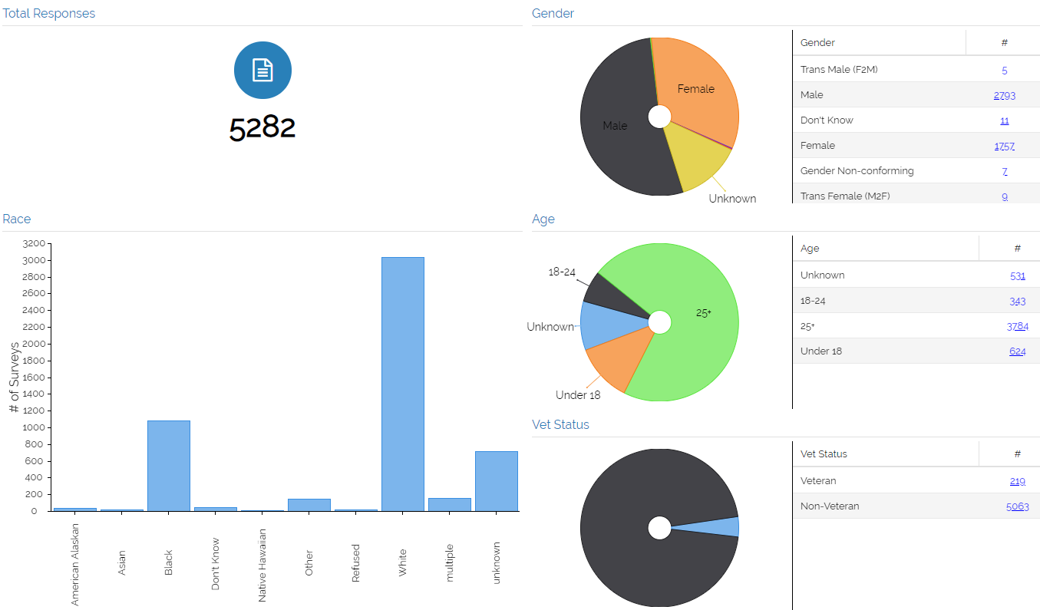
Texas Balance of State Point in Time Count Results

Slide 20
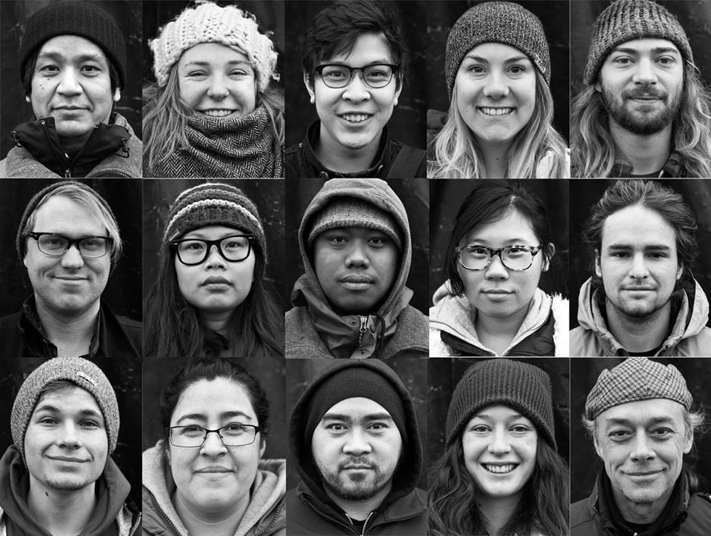
Summary (King County)
Strategies to pave the way for technology
Start thinking about it now
Volunteer/guide experience
Cost saving
Efficiency and nimbleness
Build on HMIS framework for data privacy
Leverage partners outside of the CoC
For more information visit http://allhomekc.org/king-county-point-in-time-pit-count/
Notes:
The CoC is situated in local government that is risk adverse when it comes to client confidentiality. In the lead up to this process we encountered real and perceived risk with using technology in the count. There is a lot of local, including media, interest in homelessness and the count always gets a lot of attention. In order to assure that the data is accurate with context, we have worked with third party vendors to hold and analysis the data so we can be compliant under the Freedom of Information Act and not provide data until the report and context can be provided alongside the numbers. There is also the concern that not all jurisdictions appropriately address unsheltered homelessness and that the specific, geocoding information could be used for harm. Currently data is reported by high level region.
Strategies
Outline real and perceived risks for CoC, government, region, providers, folks with lived experience now
Turn fear of how data could be negatively used as a tool for decision making and resource allocation
Build a budget and cost savings case now
Build a process and efficiency case now
Build a user/volunteer case now
We use HMIS for client data every day, build on that framework
Leverage partners outside of the CoC who are excited about technology, understand technology and can offer solutions – coalition build to build the case!
Leverage our RFP process to see what experts would offer as solutions to real and perceived challenges and how technology can be used in the count

Slide 21
Notes:
King County is made up of 39 cities, including the City of Seattle and is a mix of urban, suburban, and rural areas
Count includes:
General Street Count
Youth and Young Adult Count
Sheltered Count (Emergency Shelter, Safe Haven, and Transitional Housing)
Peer-Conducted Survey
We work with a contractor to support, provide technical assistance, participate and ultimately complete the analysis and report for the Count. Overtime, we’ve learned the challenge of relying solely on a contractor because so much of our success relies on local knowledge and relationship to implement successfully.
Nearly 1000 volunteers and paid guides participate in the general street count
Technology:
We continue to use paper tally sheets and surveys, with our goals set towards increasing our technology tools for improved volunteer/guide participation, data accuracy and time/cost efficiencies.
In 2018, we identified 6320 people unsheltered and 5792 sheltered.
Increase from 2017
Disproportionate rates of homelessness experienced by people of color
Majority of unsheltered were in vehicle

Slide 22
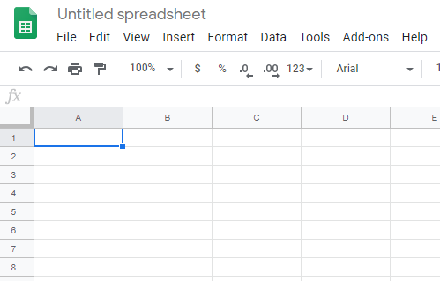
Google Sheets
Online, web based spreadsheets
Freely available via Google
https://sheets.google.com

Slide 23
Google Sheets
Benefits
Familiar interface (same as Excel)
Allows for easy collaboration
Very flexible
Drawbacks
Not secure
Need to start from scratch

Slide 24
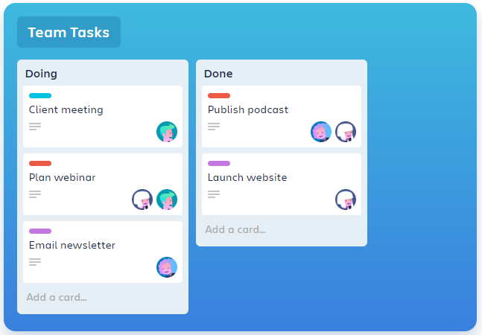
Trello
https://trello.com
Web-based project management tool
Uses Lists and Cards to help manage tasks

Slide 25
Trello
Benefits
Great for tracking tasks
Allows for uploading/sharing of various documents and images
Sends email alerts
Drawbacks
Not secure enough for client-data
Needs buy-in from all users
Free version is limited in how many integrations it can do

Slide 26
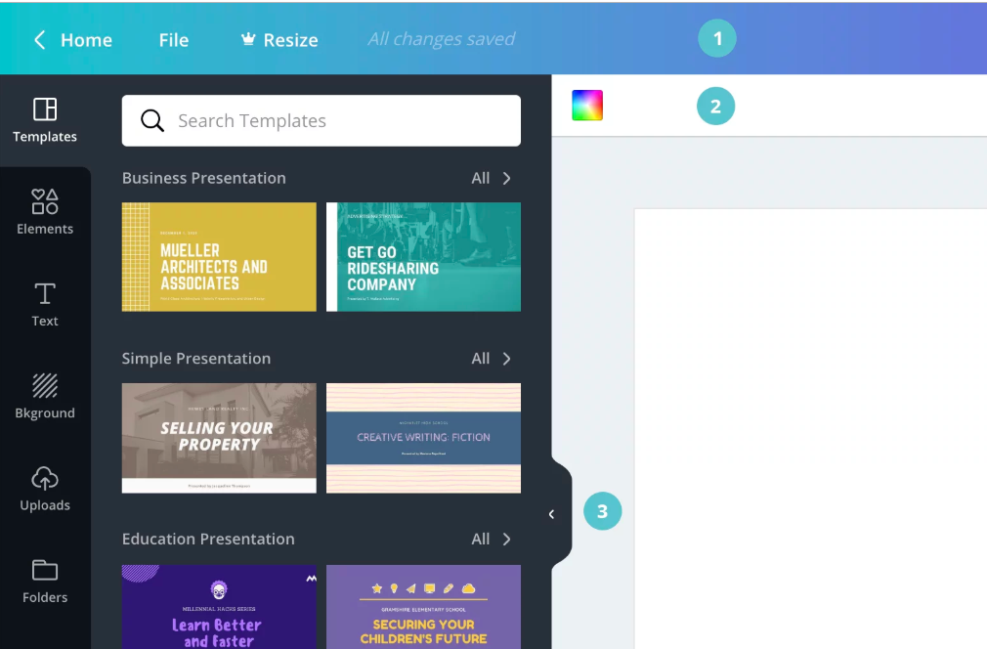
Canva
Create high quality graphics and designs, such as posters, flyers, etc
https://about.canva.com/canva-for-nonprofits/

Slide 27
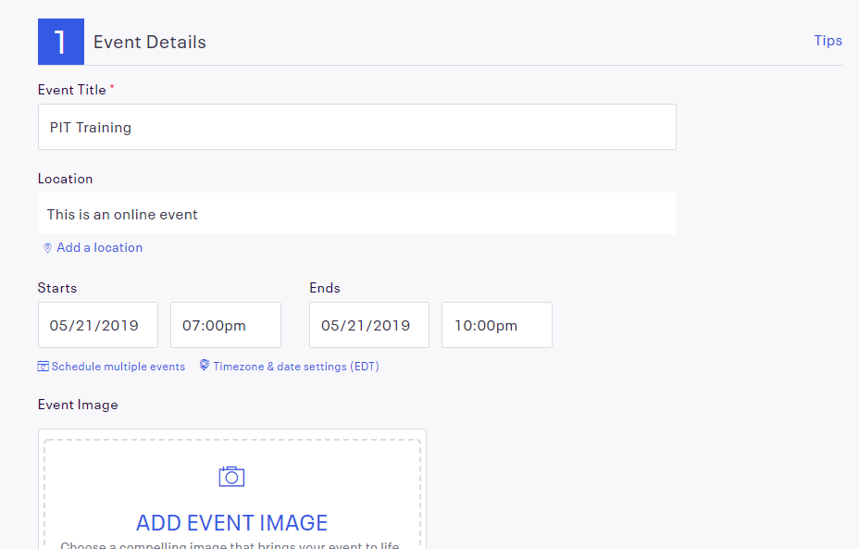
EventBrite
Web-based event management software
Great for trainings
https://www.eventbrite.com/

Slide 28
EventBrite
Benefits
Great for planning/managing training sessions
No charge for free events
Drawbacks
Need to manually send link to list of potential users for them to sign up

Slide 29
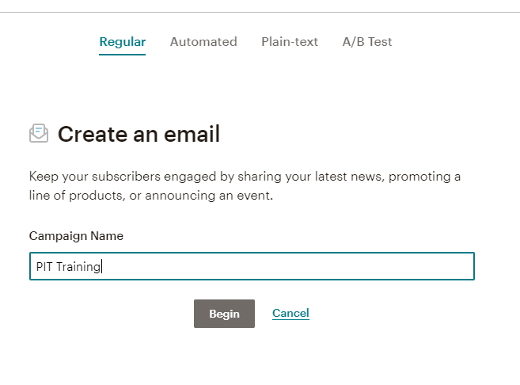
Mailchimp
https://mailchimp.com
Email sending service
Quickly and easily create emails to send to your volunteers regarding count info, training, etc

Slide 30
Mailchimp
Benefits
Allows you to send automated emails to volunteers regarding trainings/night of count information, etc.
Drawbacks
Manually upload the list of users you’d like to email
Free version limits on the number of users you can send to/emails that can be sent.

Slide 31
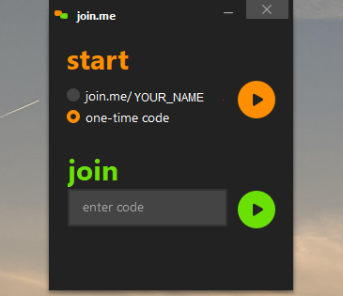
Join.Me
Virtual meeting software with a free option
https://join.me/
Allows for screensharing and conference calling

Slide 32
Join.Me
Benefits
Able to have a customized link for users to quickly join a meeting/screensharing session
Easy to set-up/join for meeting hosts and participants
Drawbacks
Free version limits number of meeting participants

Slide 33
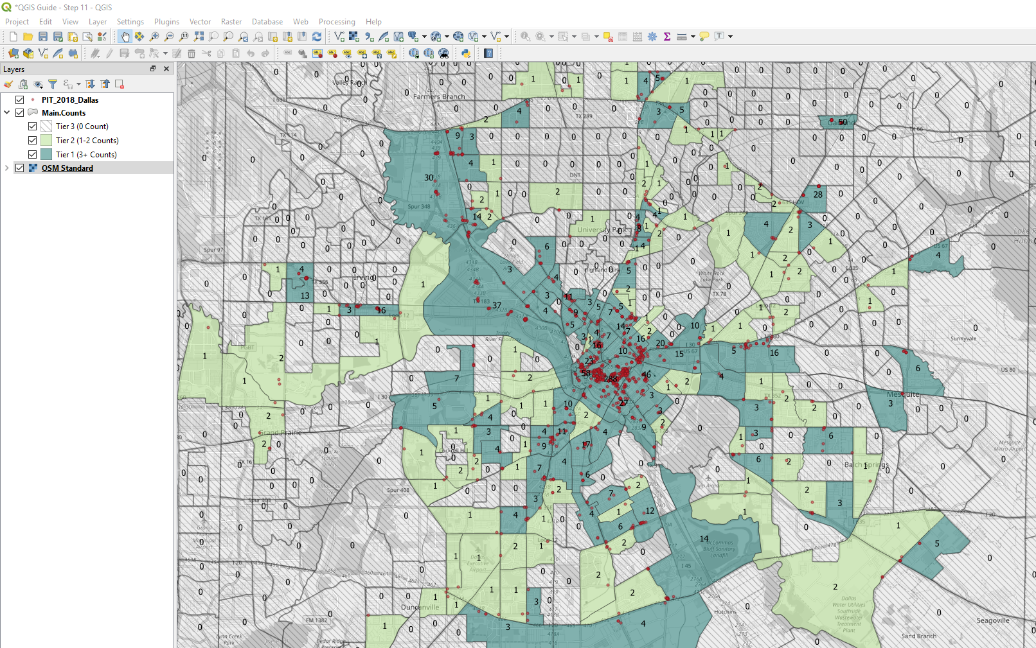
QGIS
https://qgis.org
Completely free, open source Graphic Information Systems (GIS) Software

Slide 34
QGIS
Benefits
Fully-functional GIS software
100% free and open-source
Can create beautiful maps for the count
Great for doing analysis on past or current PIT Data
Drawbacks
Steep learning curve
No dedicated support
Does not allow for easy collaboration, not web-based
Can be slow depending on your computer

Slide 35
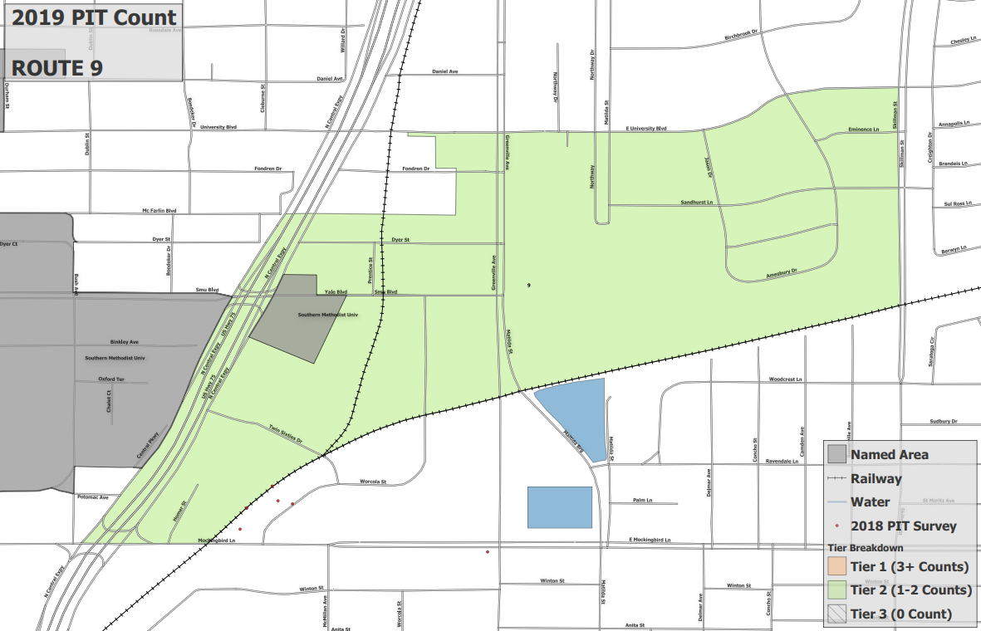
QGIS

Slide 36
U.S. Census Data
https://data.census.gov/
Lots of freely available data
Great for doing racial disparity analysis

Slide 37
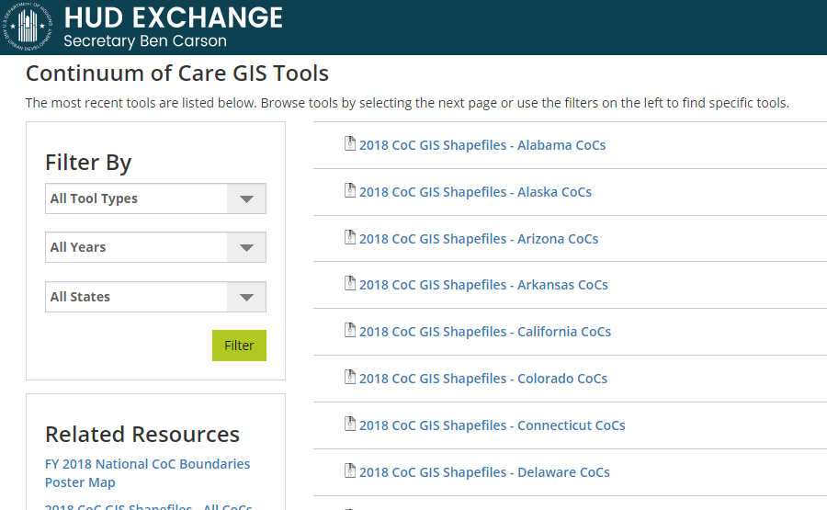
HUD GIS Tools
https://www.hudexchange.info/programs/coc/gis-tools/
Great for looking at both geographic and census data for a particular CoC or County

Slide 38
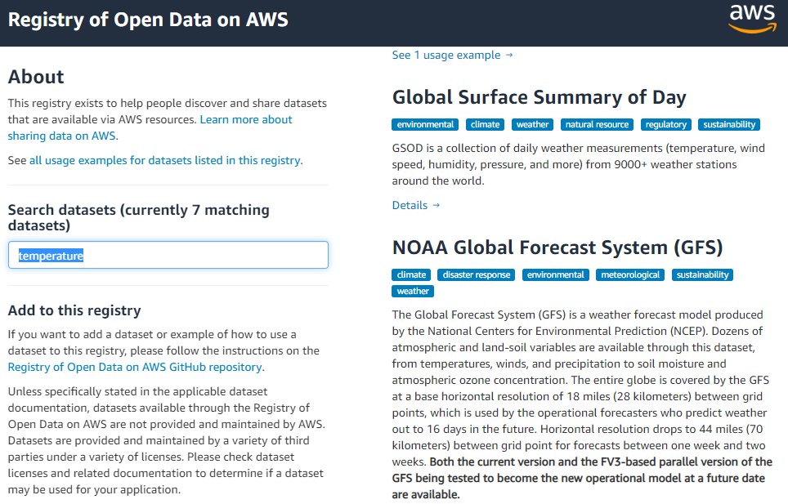
AWS Open Data
https://registry.opendata.aws/
Currently has 109 open data sets, constantly being added to

Slide 39
Questions?
Eddie Barber – Eddie@simtechsolutions.com
Kristin Zakoor – Kristin@thn.org
Danielle Winslow - Danielle.Winslow@allhomekc.org

