Slide 1
Racial Disparities Analysis Using Data from Homeless Response Systems
Nathan Andrade, Programmer Analyst, Simtech Solutions Inc
Alexandra Espinosa, Metro Dallas Homeless Alliance, HMIS Director
Eric Samuels, Texas Homeless Network, President/CEO

Slide 2
Community Profile: Texas - THN

Slide 3


Community Profile: Texas - THN
THN is a statewide agency that…
  Provides solutions to end homelessness in Texas communities through education, resources and advocacy
  We provide support to agencies and communities that build systems to end homelessness.

Slide 4
Community Profile: Texas – THN
THN has two primary focus areas:
Texas Balance of State CoC
Statewide Initiatives
TX BoS CoC
Establish a CoC and a CoC Board
Administer and Operate HMIS
Conduct CoC Planning and Operations
Facilitate Application for Funds
Statewide Initiatives
State level clearinghouse
AmeriCorps VISTA project
SOAR
Advocacy

Slide 5

Community Profile: Texas - THN
THN is the Lead Agency for the TX BoS CoC
THN is the HMIS Lead Agency for the TX BoS CoC
TX BoS CoC covers 215 of
Texas’ 254 counties
(86% of Texas’s land mass)

Slide 6
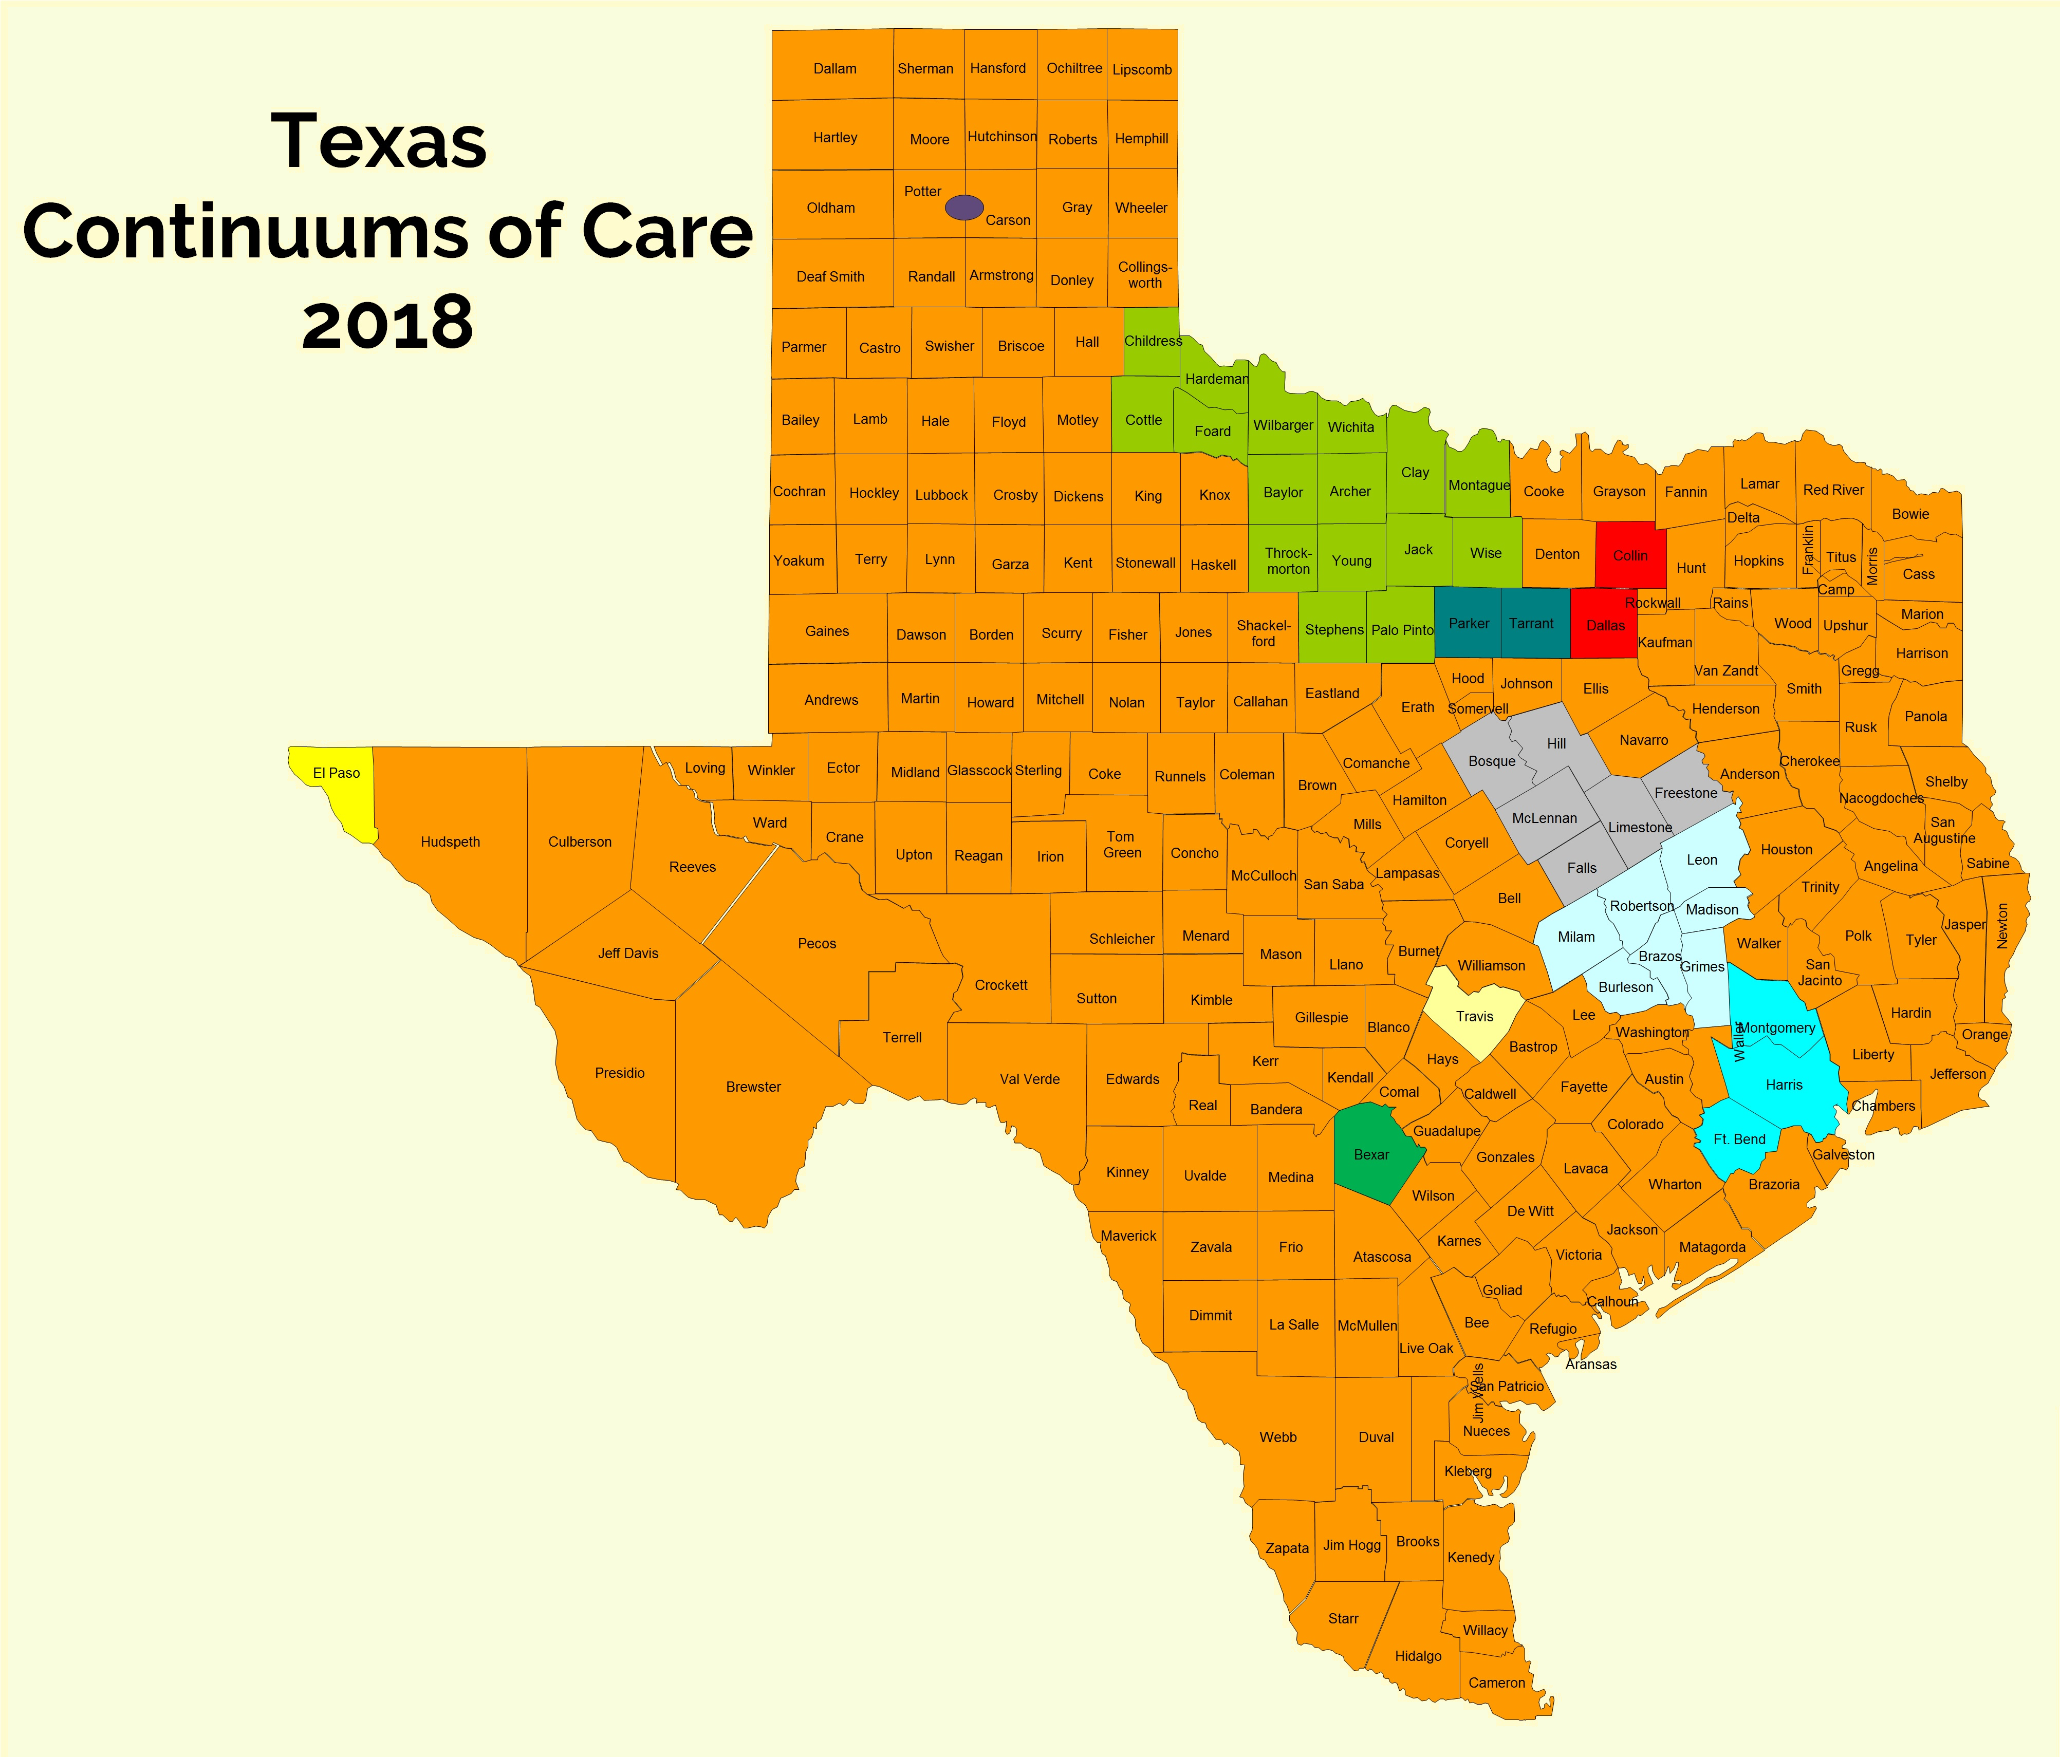
Community Profile: Texas – THN Service Area
Population 28 mil, 11 CoCs
Poverty rate: 15.6%
Only 29 out of 100 rental units are available to ELI Households (Austin, Dallas, & Houston have 20 or fewer per 100 units)
2017 CoC award amount = $88mil
2017 PIT Count: 23,548

Slide 7
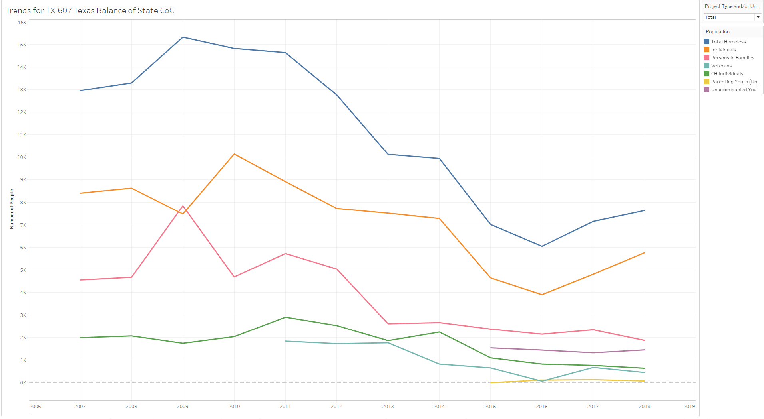
Community Profile: Texas – PIT Trends

Slide 8
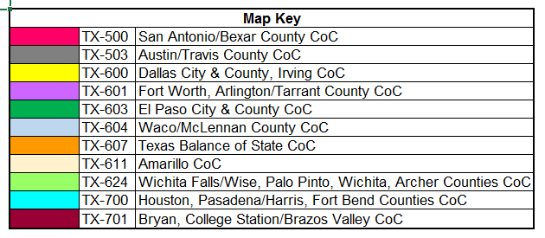
Community Profile: Texas – TX CoCs
8

Slide 9
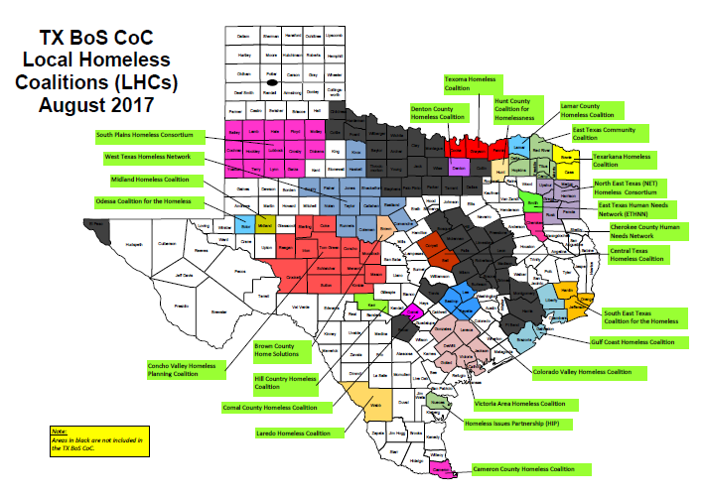
Community Profile: Texas – TX BoS CoC
THN is the Lead Agency for the TX BoS CoC
THN is the HMIS Lead Agency for the TX BoS CoC
TX BoS CoC covers 215 of
Texas’ 254 counties
(86% of Texas’s land mass)

Slide 10
Community Profile: Dallas - MDHA

Slide 11
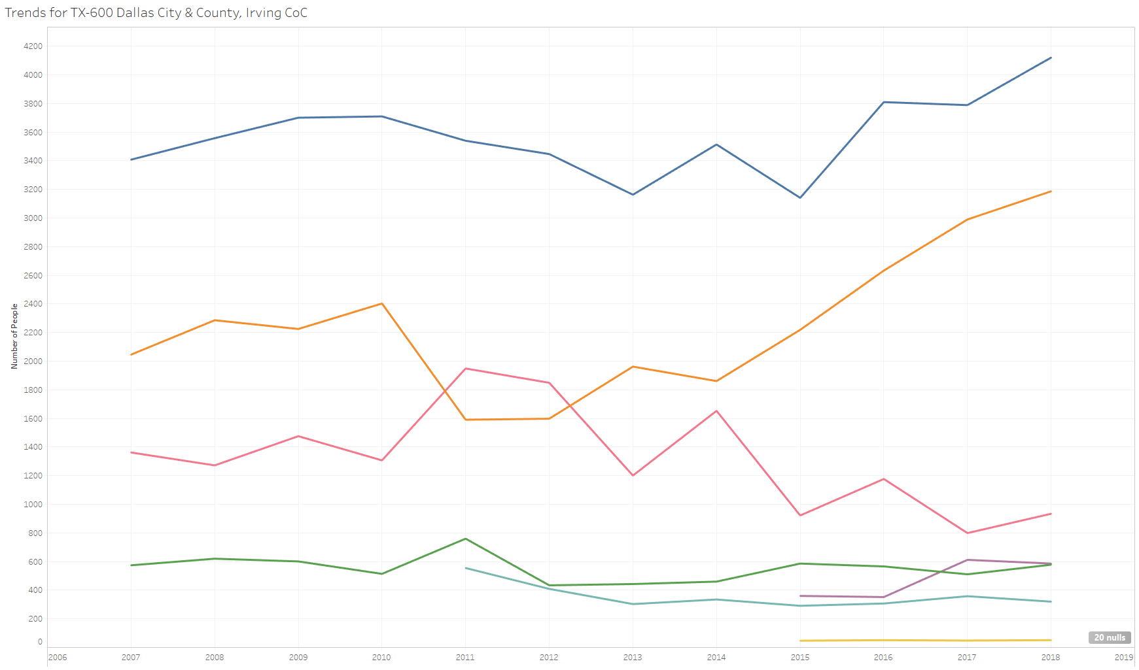
Community Profile: Dallas – PIT Trends

Slide 12
Racial Disparities Analysis

Slide 13
Racial Disparities Analysis – 2018 NOFA Application
In the 2018 HUD NOFA application, section 3B-5a asked applicants to indicate if any of the following statements applied to their CoC.
  People of different races or ethnicities are more or less likely to receive homeless assistance.
  People of different races or ethnicities are more or less likely to receive a positive outcome from homeless assistance.
  There are no racial or ethnic disparities in the provision or outcome of homeless assistance
  The results are inconclusive for racial or ethnic disparities in the provision or outcome of homeless assistance.
Determining statements 1 and 2 will inform answers for statements 3 and 4.
HMIS data can be used in conjunction with US Census data to provide a view into whether or not these disparities exist.

Slide 14
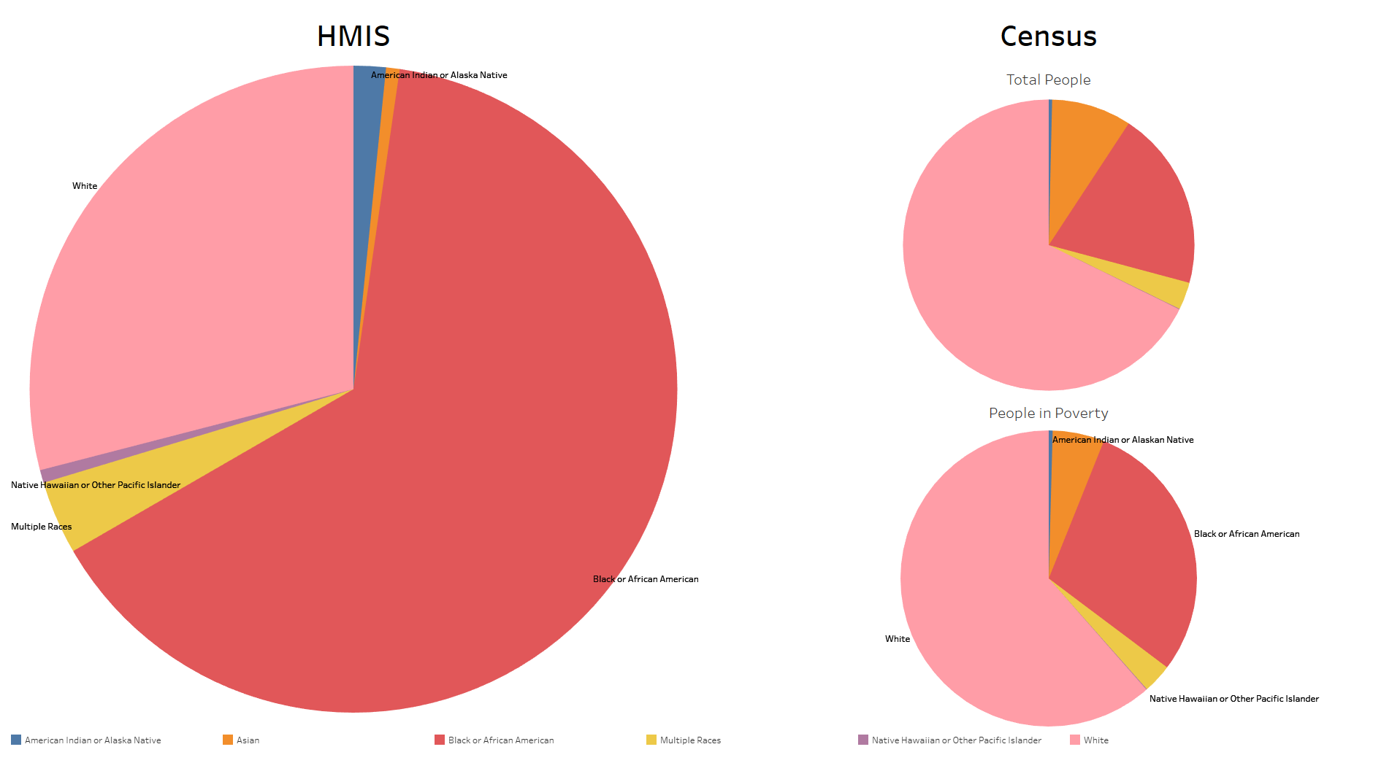
Racial Disparities Analysis – HMIS vs Census Population
  People of different races or ethnicities are more or less likely to receive homeless assistance.

Slide 15
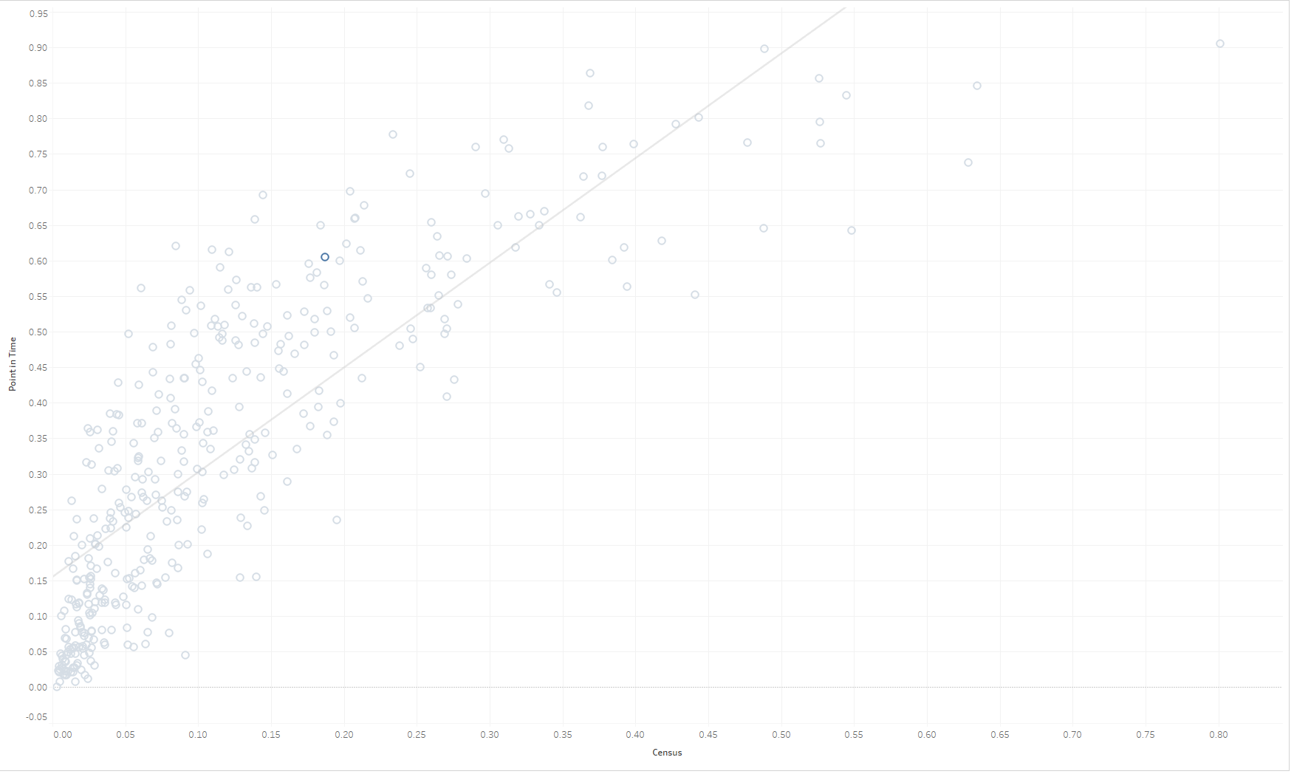
Racial Disparities Analysis – HMIS vs Census Population
http://www.simtechsolutions.com/analysis/race/

Slide 16
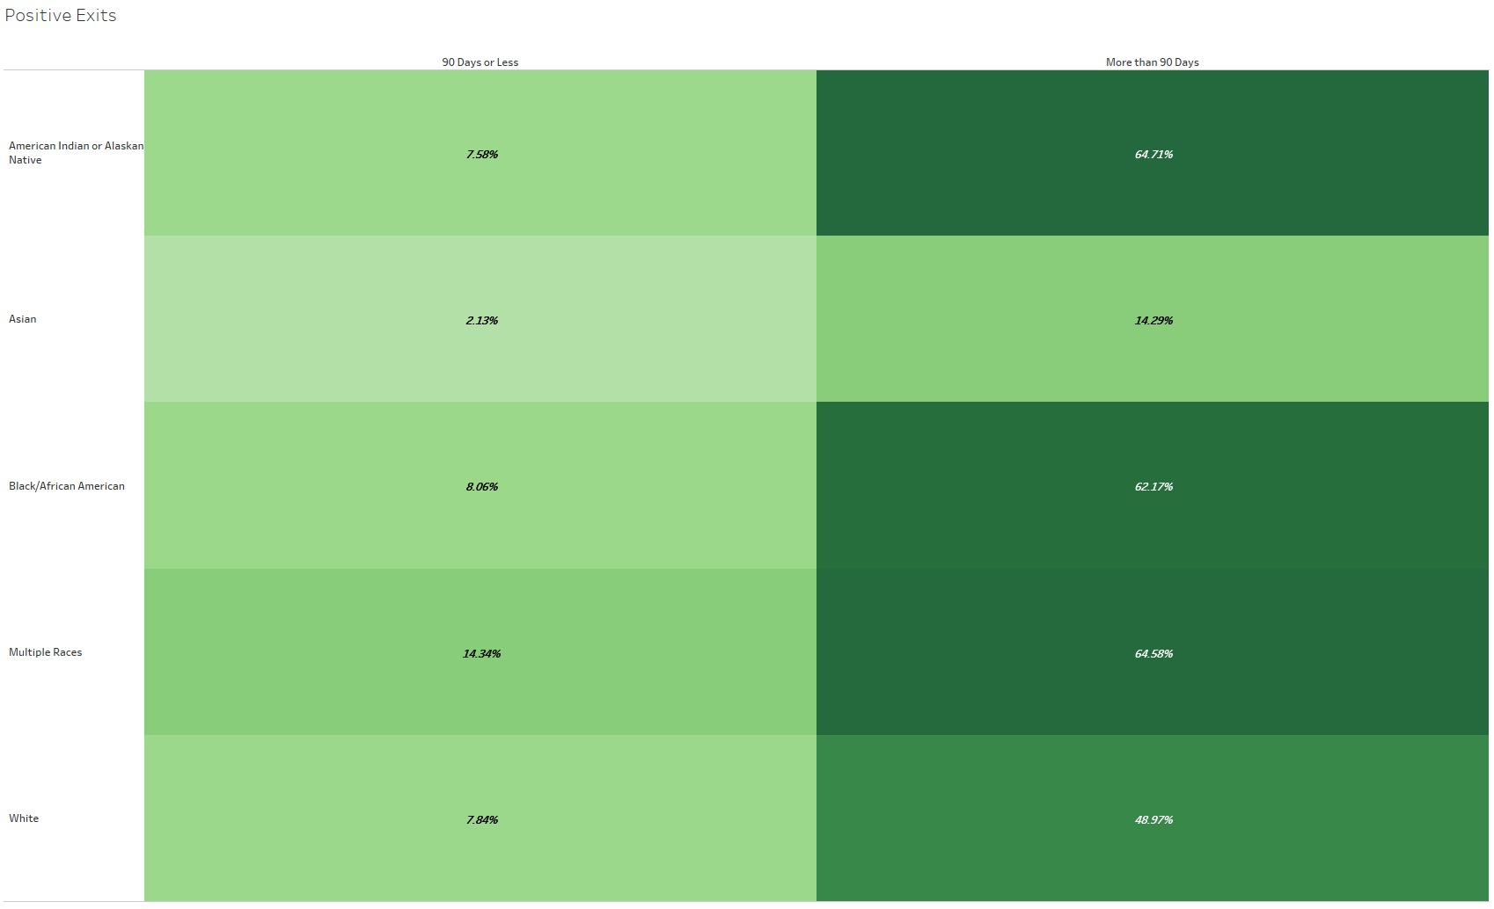
Racial Disparities Analysis – Positive Destination
  2. People of different races or ethnicities are more or less likely to receive a positive outcome from homeless assistance.

Slide 17
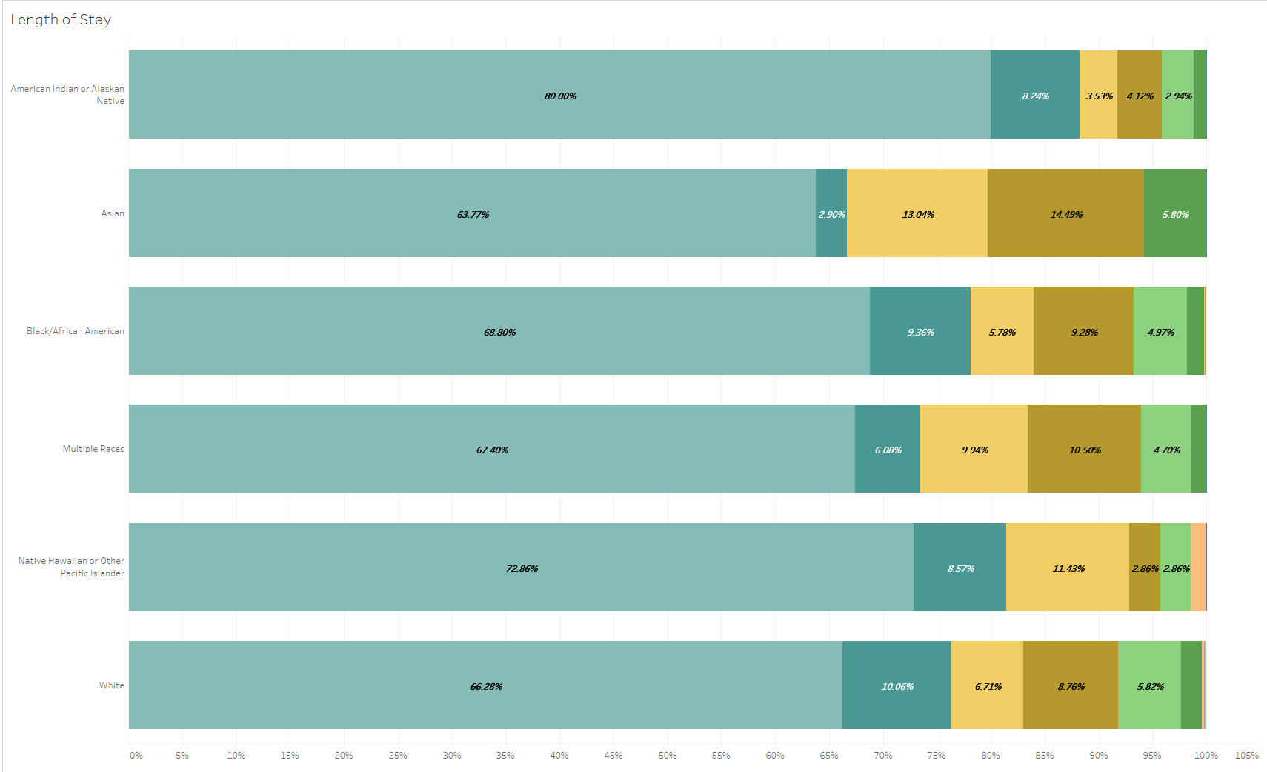
Racial Disparities Analysis – Length of Stay

Slide 18
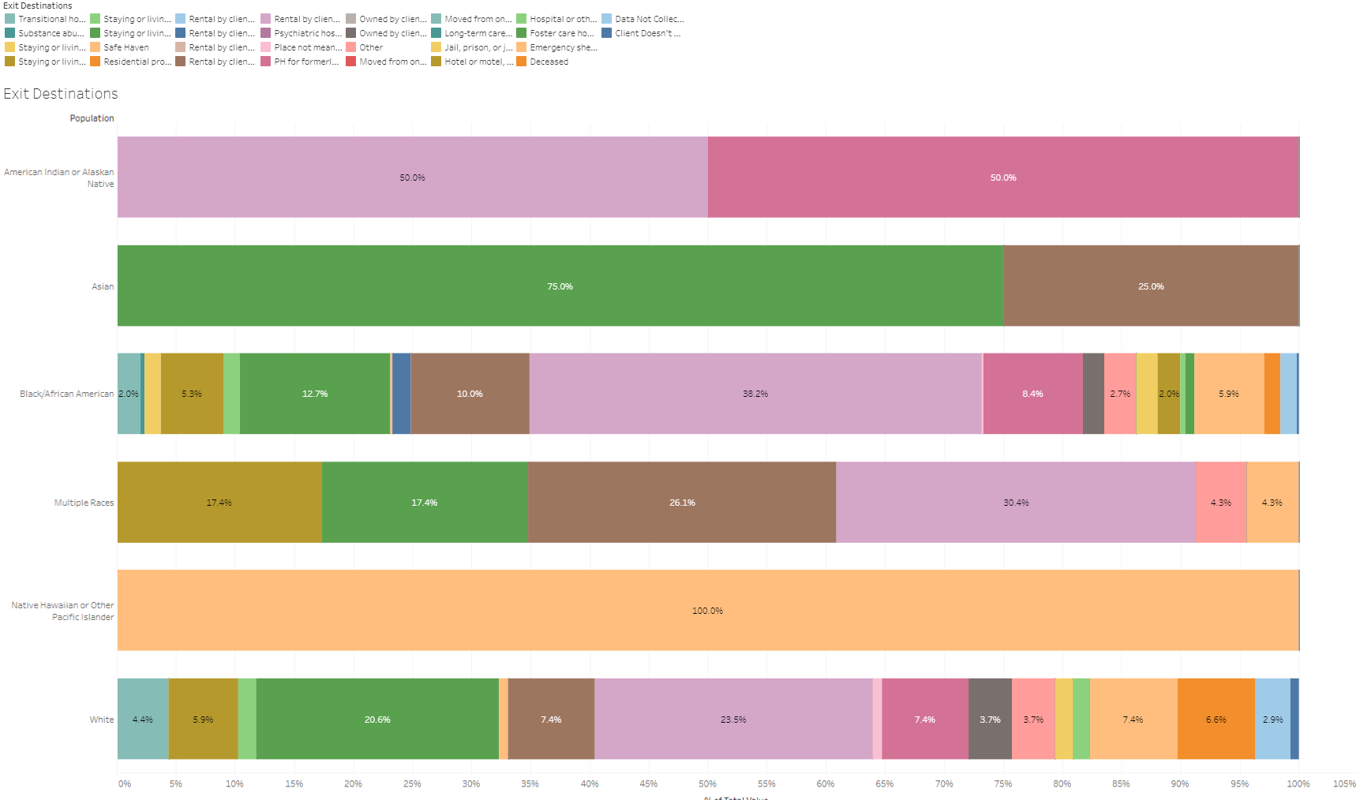
Racial Disparities Analysis – All Destinations

Slide 19
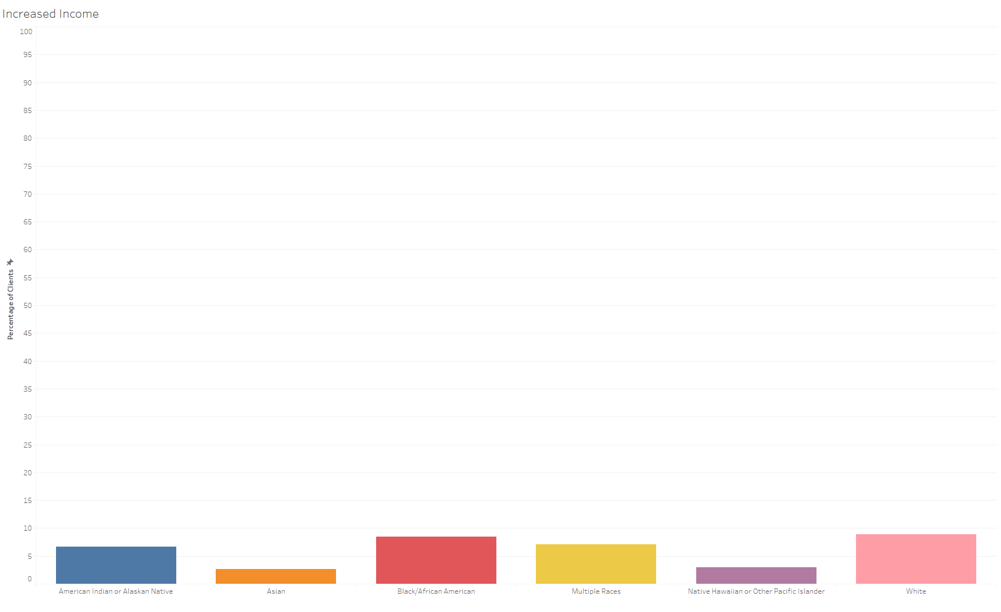
Racial Disparities Analysis – Increased Income

Slide 20
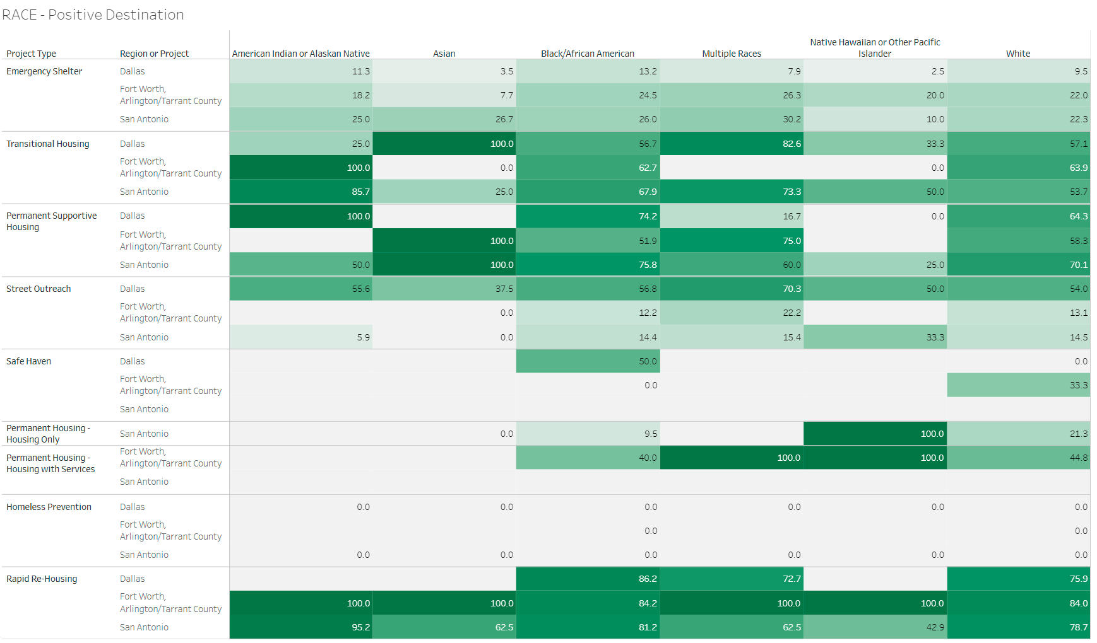
Racial Disparities Analysis – Comparing Results Across Multiple Regions

Slide 21
Community Response: Dallas - MDHA

Slide 22
Community Response: SPARC Report
In March of 2018 SPARC released their findings for a racial inequality research project that MDHA participated in.
They made the following recommendations to help address the issue of racial inequality in the homeless system:
  Design an equitable Coordinated Entry system.
  Incorporate racial equity into grantmaking and contracting for homelessness and housing programs.
  Include racial equity data analysis and benchmarks in strategic planning to end homelessness.
  Support organizational development to ensure racial equity at the organizational level.
  Encourage anti-racist program delivery.
  Promote ongoing anti-racism training for homeless service providers.
  Collaborate to increase affordable housing availability for all people experiencing homelessness.
  Utilize innovative upstream interventions to prevent homelessness for people of color.
  Investigate flexible subsidies to mitigate the effects of network impoverishment.
  Support innovative health care strategies to meet the health and behavioral health needs of communities of color.
Notes:
http://www.mdhadallas.org/wp-content/uploads/2018/03/SPARC-Dallas-Initial-Research-Findings-March-2018.pdf

Slide 23
Creating the Racial Disparities Analysis

Slide 24
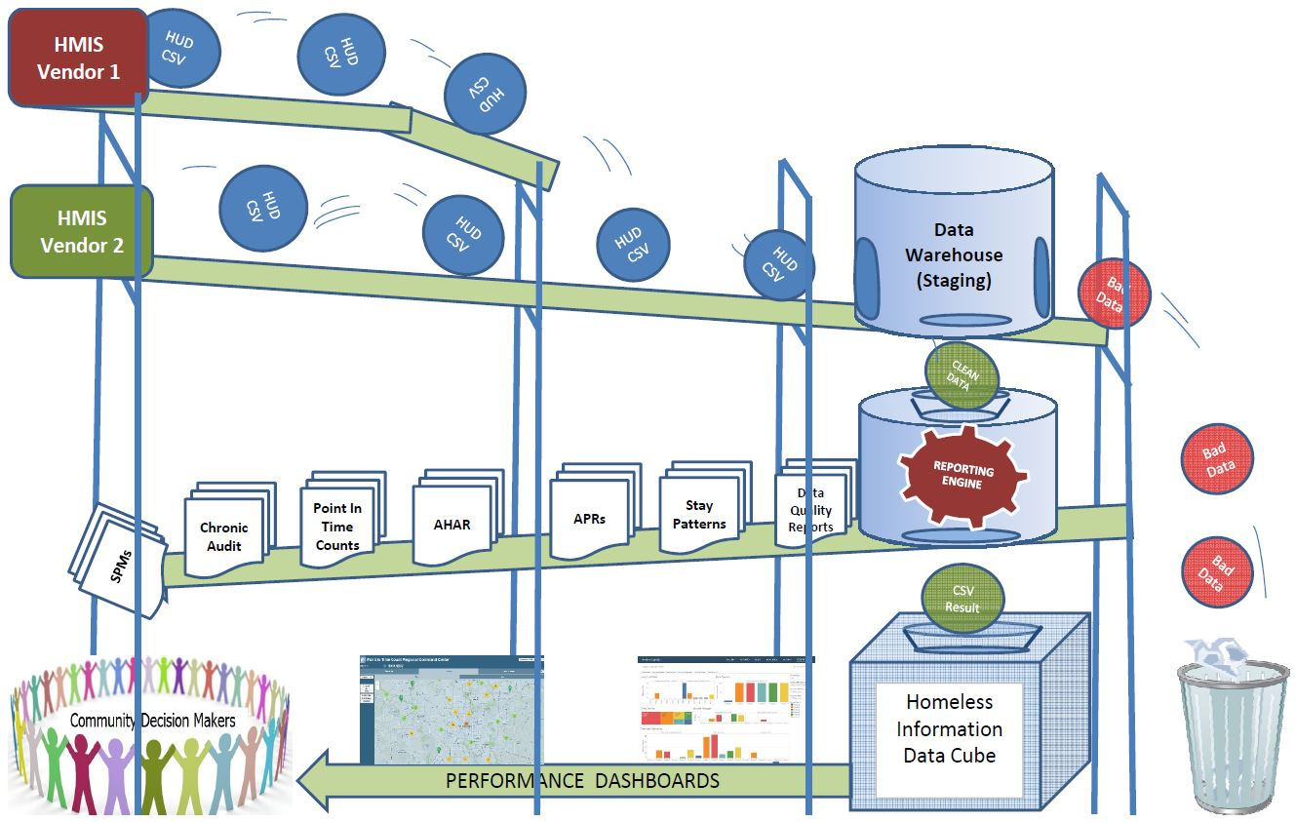
Creating the Racial Disparities Analysis – Data Cubes
Records results from HMIS reports to store aggregate project level data
Filters are applied to the reports to focus on specific sub-populations
Recorded results can be exported in a CSV format that can be consumed by data visualization tools

Slide 25
Creating the Racial Disparities Analysis – Data Cubes
Dallas Data Cube:
43 projects
x
2 report types (APR and HIC)
x
2 years of data
x
7 populations
______________________
1132 total reports run
(566 APR reports x 1011 APR data elements)
+
(566 HIC reports x 15 HIC data elements)
_______________________________________
580,716 total data elements recorded

Slide 26
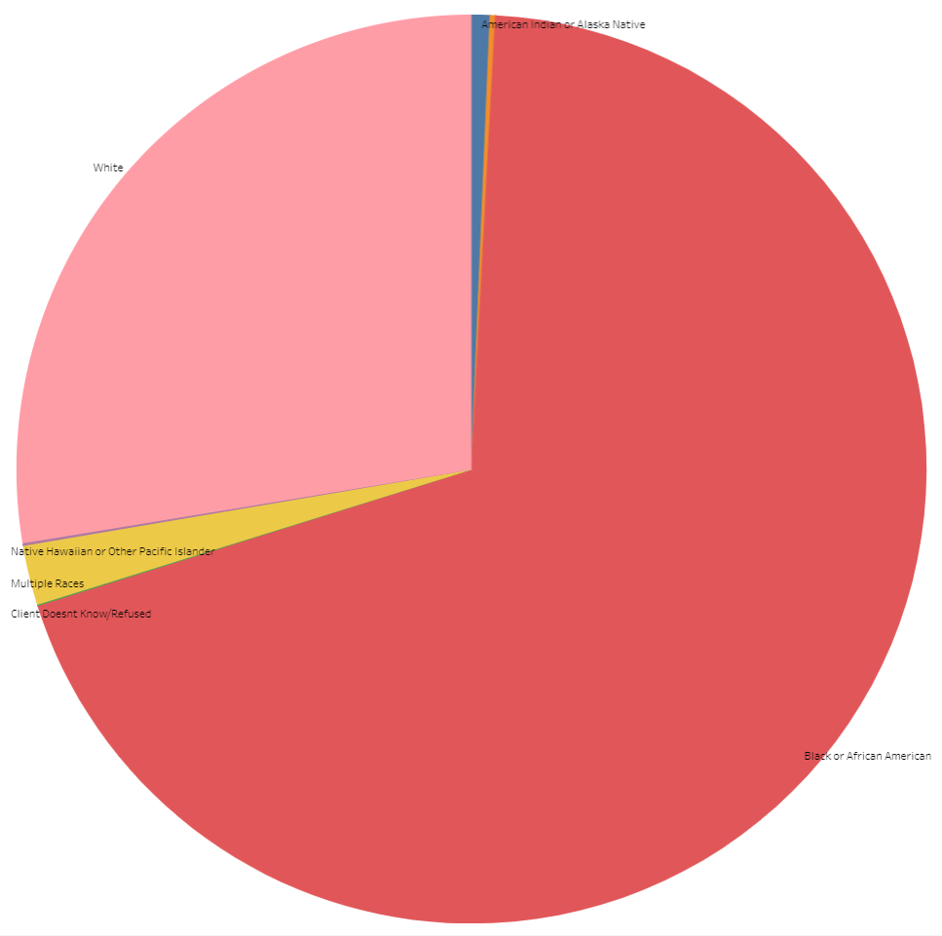
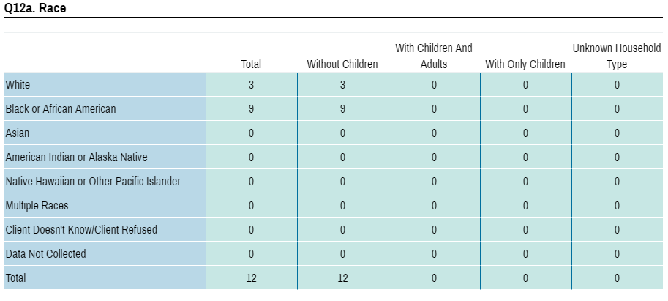
Creating the Analysis – APR Results Recorded
APR
Tableau

Slide 27
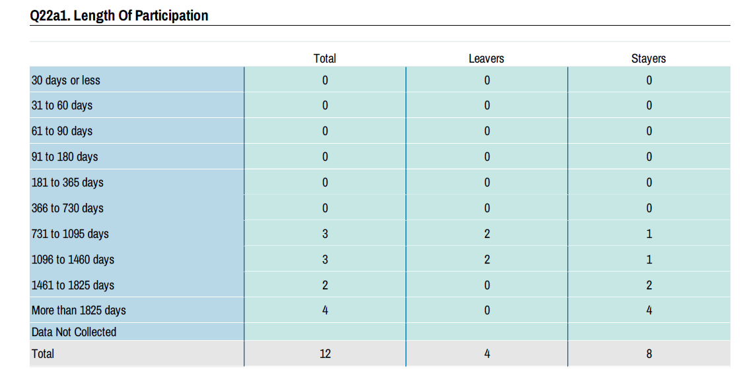
Creating the Analysis – APR Results Recorded
APR
Tableau

Slide 28
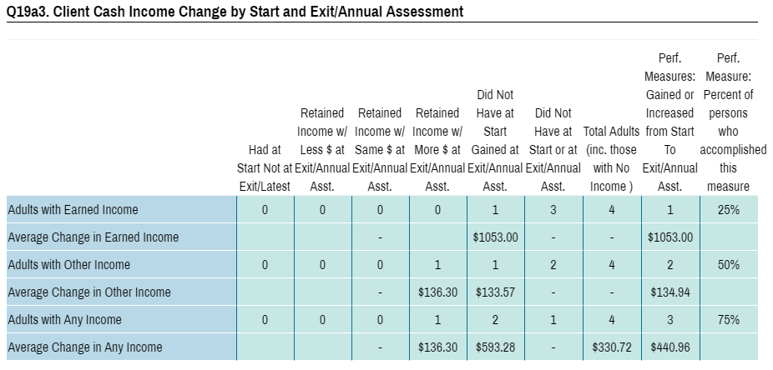
Creating the Analysis – APR Results Recorded
APR
Tableau

Slide 29
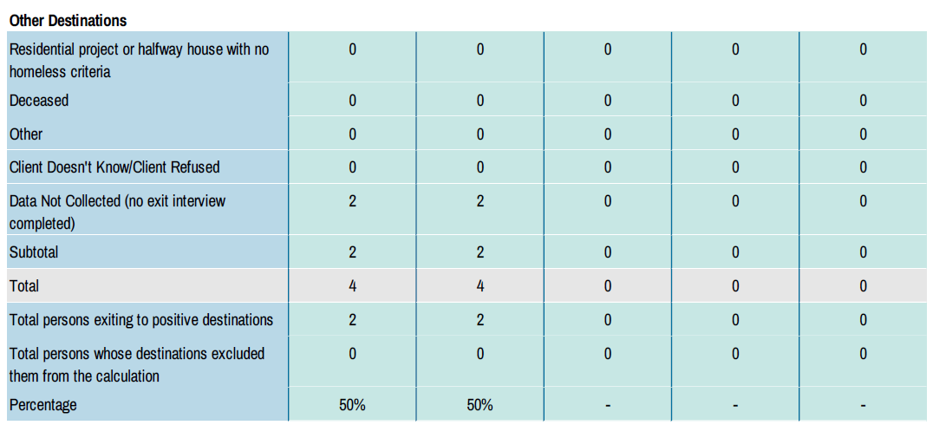
Creating the Analysis – APR Results Recorded
APR
Tableau

Slide 30
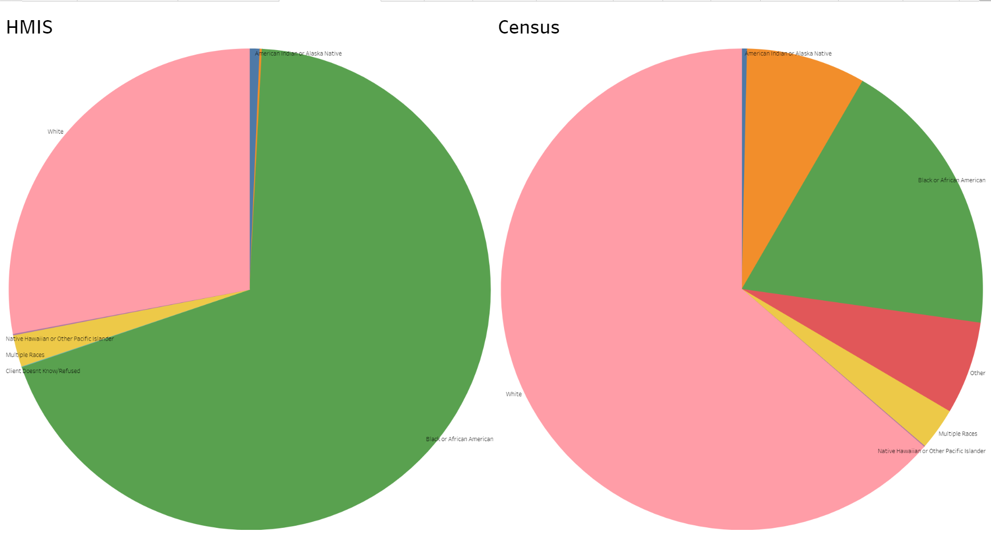
Creating the Racial Disparities Analysis – Census Data
Census data obtained from www.census.gov
  2017 5 year estimates were used
Data was broken down by census tracts
Census tracts were cross referenced with CoC shape files giving census figures by CoC that could be compared with HMIS data
Results were fed to Tableau to do a side by side comparison of Census and HMIS Data

Slide 31
Creating the Racial Disparities Analysis – Census Data
“Following the Office of Management and Budget's (OMB) Statistical Policy Directive 14, the Census Bureau uses a set of money income thresholds that vary by family size and composition to determine who is in poverty. If a family's total income is less than the family's threshold, then that family and every individual in it is considered in poverty. The official poverty thresholds do not vary geographically, but they are updated for inflation using the Consumer Price Index (CPI-U). The official poverty definition uses money income before taxes and does not include capital gains or noncash benefits (such as public housing, Medicaid, and food stamps).”
– United States Census Bureau
Poverty status does NOT vary geographically.
Poverty status is determined based on household income compared to size and composition.
Noncash benefits are not included.

Slide 32
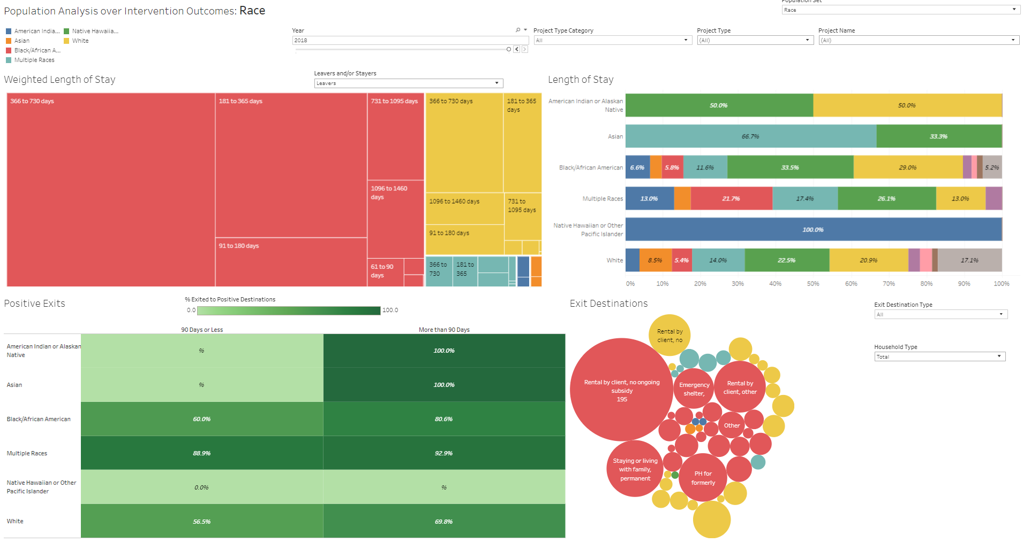
Creating the Racial Disparities Analysis - Tableau
All data from both data cube and census results were brought together in Tableau
Interactive data visualizations created within Tableau
Dashboards saved to Tableau Public where they could be shared via URL.

Slide 33
Next Steps
Incorporate ethnicity into analysis.
Consider the cost of living for different regions.
Create multiple year trends to gauge improvement.

Slide 34
Questions?

