Slide 1
When CE Best Practices Don’t Work: Setting Up CE in Regions with Closed and Fragmented Data Systems
Mary Ann Priester, MSW, Mecklenburg County NC
Eddie Barber, Simtech Solutions Inc.

Slide 2
Region Profile: Lowell, MA
Population: 110,558 (Source: 2016 Census)
Cradle of the American Industrial Revolution
Home of UMass Lowell and Middlesex Community College
4th Largest City in Massachusetts

Slide 3
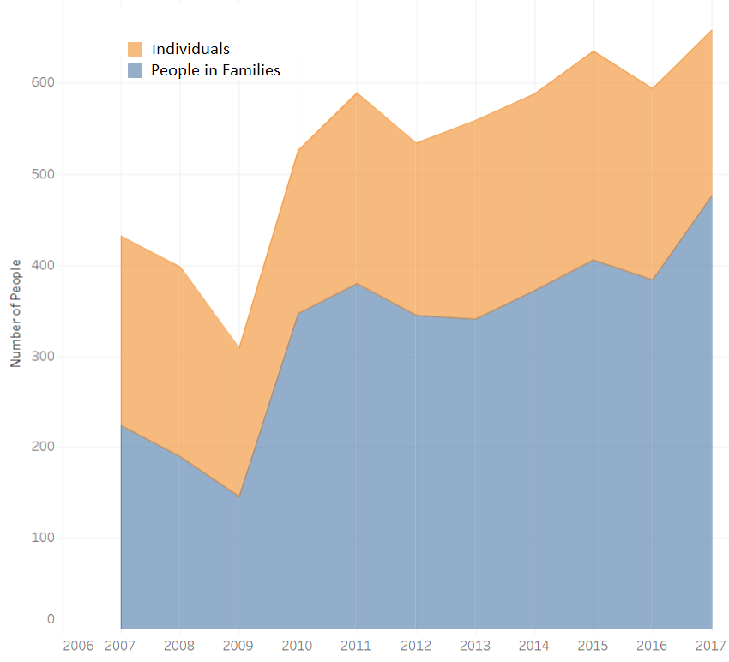
10 Year PIT Trends

Slide 4
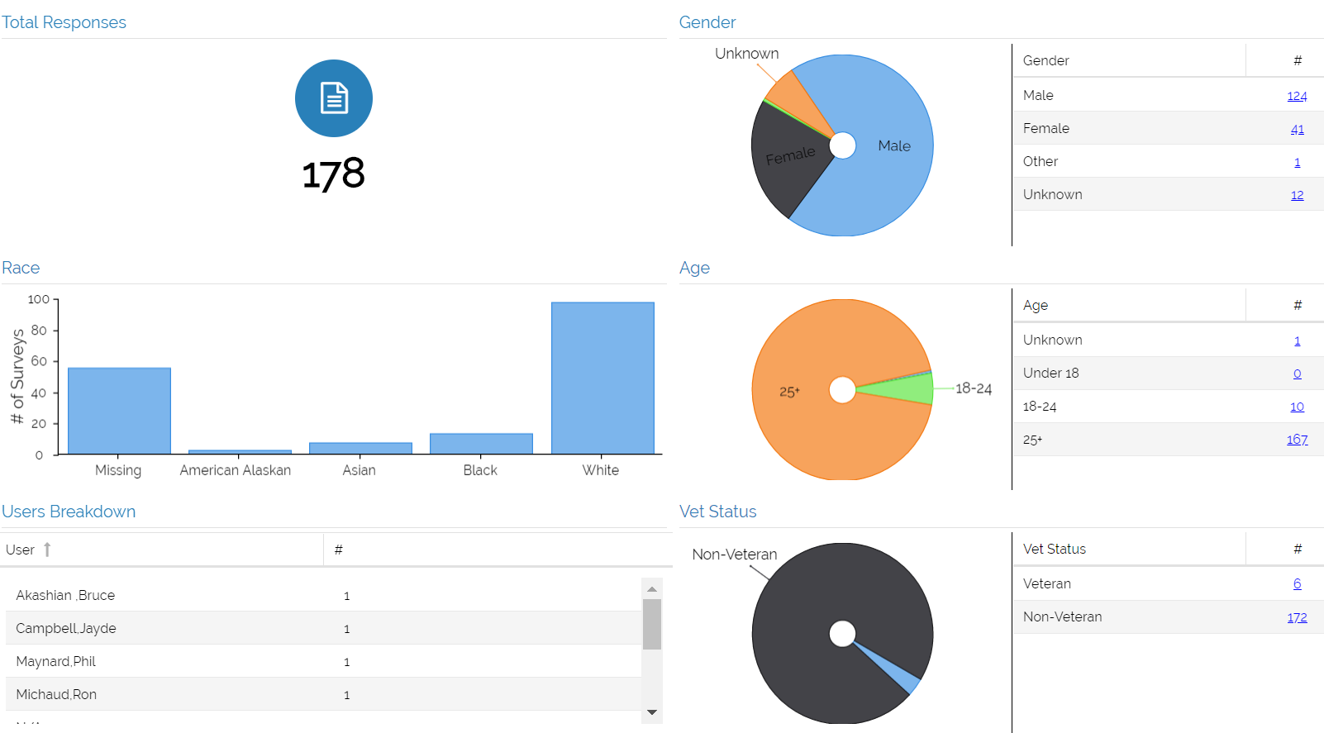
2018 PIT Demographic Breakdown (Individuals)

Slide 5
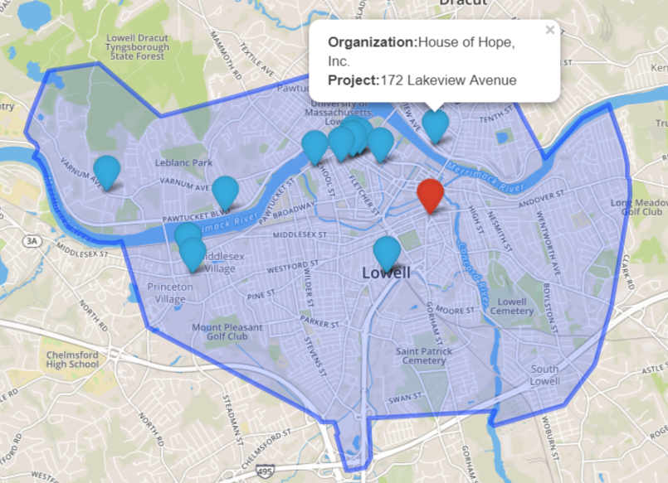
Region Profile: Lowell, MA
1 Emergency Shelter, 1 community action agency, 1 DV provider, 1 day program, PSH

Slide 6
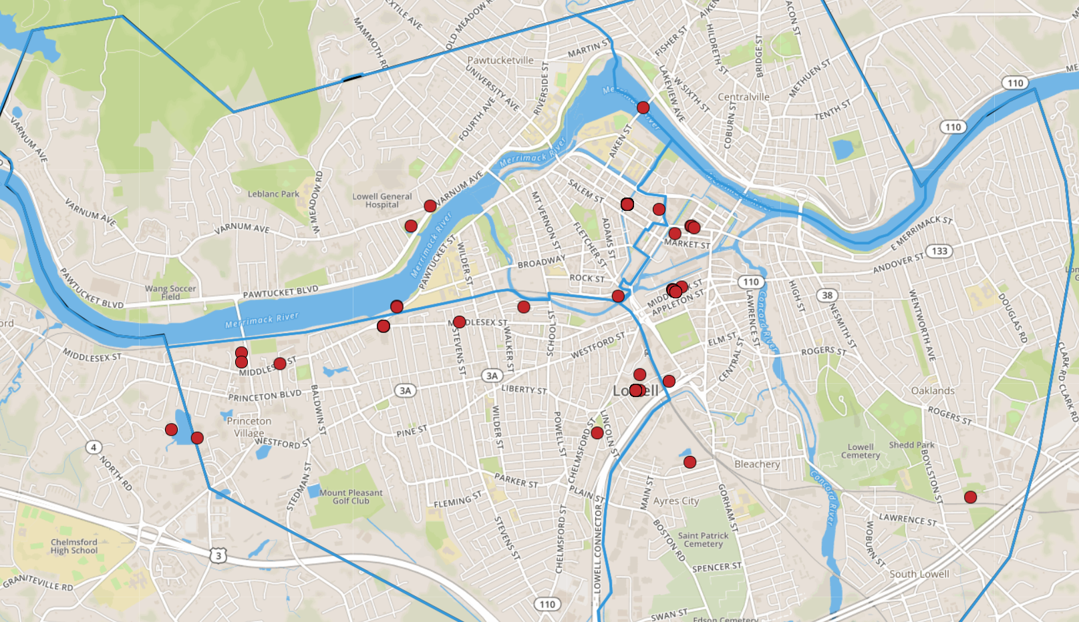
Region Profile: Lowell, MA
151 Individuals counted in Emergency Shelter, 27 on the street

Slide 7
Key Strengths
Excellent CoC board participation
HMIS is free
Involvement from police, fire, and ambulance
New youth demonstration project
Willingness (from some) to embrace new tech
Notes:
Get FMR figures for Lowell

Slide 8
Key Challenges: Community
No train access to Boston or other major city
Poorly ranked school system (278 out of 345)*
More than half of Lowell residents who rent housing pay more than 30 percent of their income to do so.**
* Source: SchoolDigger.com
** Source: 2015 US Census
Notes:
Get details on opioid usage from PIT or other source
Get info on school transportation costs
Get info on school system ranking
http://www.mass.gov/eohhs/docs/dph/aids/2012-profiles/geographic-distribution.pdf

Slide 9
Key Challenges: Community
Severe Opioid Crisis (68 deaths in 2016)*
High prevalence of HIV/AIDS
Notes:
Get details on opioid usage from PIT or other source
Get info on school transportation costs
Get info on school system ranking
http://www.mass.gov/eohhs/docs/dph/aids/2012-profiles/geographic-distribution.pdf

Slide 10
Constraints with the current HUD Data Standards
Lack of a common, future-proof, consent form
No consent tracking in HMIS Standards, or HUD CSV
HUD Standards do not support enrollments into a project at a physical location
Lack of a Closed-Loop Referral API
Reliance on self-reported information corrupts the integrity of the data
No commonly endorsed vulnerability assessment
Notes:
Get example of someone who said they were homeless earlier than they were.

Slide 11
Key Challenges: State Infrastructure
Homeless family shelter placements are controlled by the state (yet one half of the 17.3M in transportation costs spent in 2017 were paid for with local school budgets)
HMIS is managed by the state
HMIS is closed (i.e. no data sharing)
1 statewide PATH grantee (which needs medical billing software)
16 CoCs statewide
4 different primary HMIS systems
Notes:
Get details on opioid usage from PIT or other source
Get info on school transportation costs

Slide 12
Key Challenges: Local Infrastructure
Emergency shelter doesn’t receive CoC dollars
Emergency shelter doesn’t use a bed register
Emergency shelter isn’t low barrier
Unsheltered population is not well connected
Local VA operates in five CoCs (each with their own HMIS implementation)
Notes:
Get details on opioid usage from PIT or other source
Get info on school transportation costs

Slide 13
Local Factors Making CE Implementation Difficult
Emergency shelter has issues tracking bed utilization
Street population is not engaged
Minimal PH bed turnover
Closed HMIS system
Neighboring regions have different approaches for prioritization
Notes:
Get example of someone who said they were homeless earlier than they were.

Slide 14
First Attempt at CE for Individuals
Issues with Approach
Unsecure (people were emailing spreadsheet back and forth)
Version control issues
Hard to update and collaborate with others on
No set approach for prioritization
Not tied to HMIS
Insufficient information
Notes:
NOT SIMTECH

Slide 15
Establishing Baselines to Measure CE Progress
Technical Requirements
21 Projects
Need 3 years of data for trend analysis (2 points don’t make a trend)
Monthly results show the impact of weather, funding cycles, seasonal employment, benefit payments, etc. on bed utilization
To be actionable intelligence, data needs to be refreshed at least monthly
Performance results should impact NOFA rankings
Dashboard needs to show both growth and proficiency for each project
Growth is measured by comparing current results from the project vs prior years
Proficiency measured by comparing project results against results of its peers
Overhead to Support the Dashboard
Estimated time to run one APR and post the results to a separate database = 30 minutes
Total time to manually populate the data cube…
21 projects x 36 months x 30 minutes =22,680 minutes (or 378 hours)
Notes:
Total time each month to refresh the database of 21 projects = 10.5 hours

Slide 16
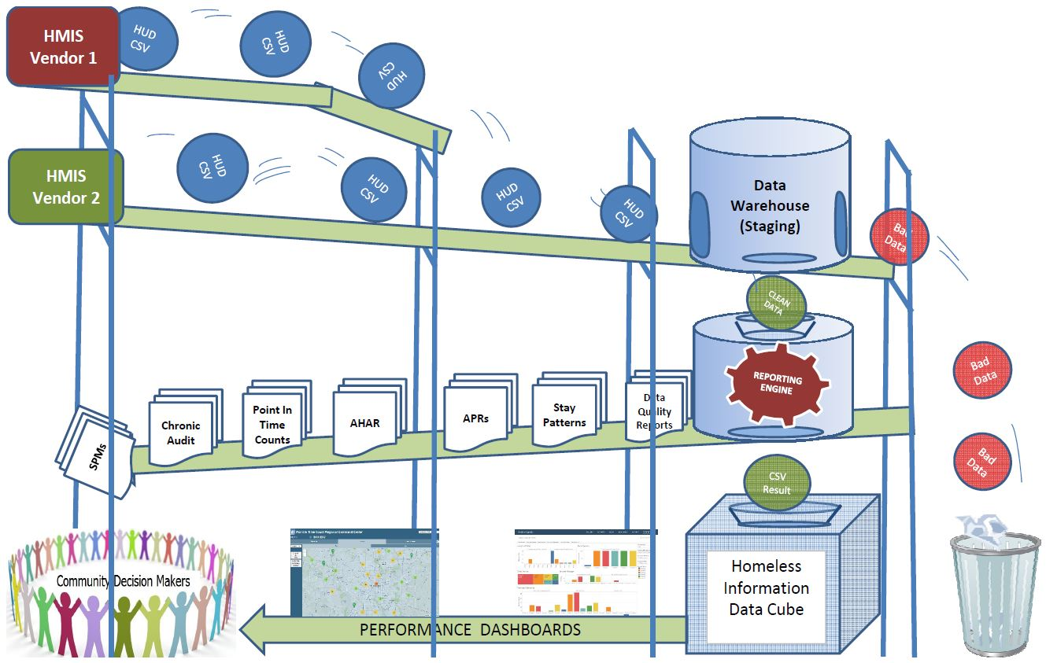
HMIS Data Cube Process Flow

Slide 17
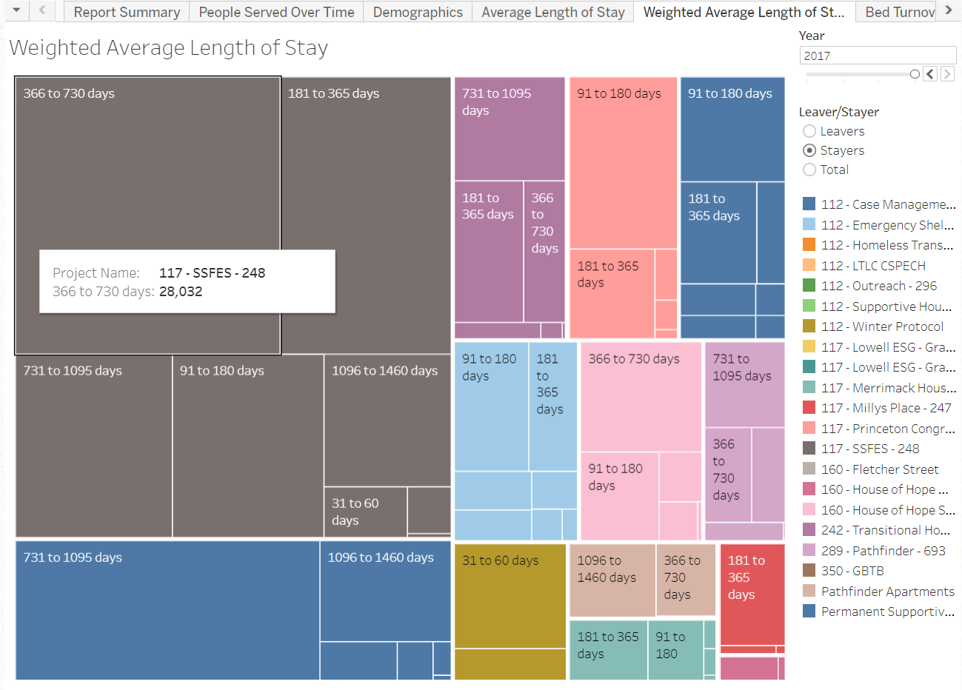
Project Performance Measures
Notes:
Weighted avg takes both total # of clients and total LOS into consideration. Those with largest cube have most upward impact on LOS figures. Ideally change these to be by project type and target population (ES-FAM, ES-IND, TH-FAM, TH-IND, PH-FAM, PH-IND)

Slide 18
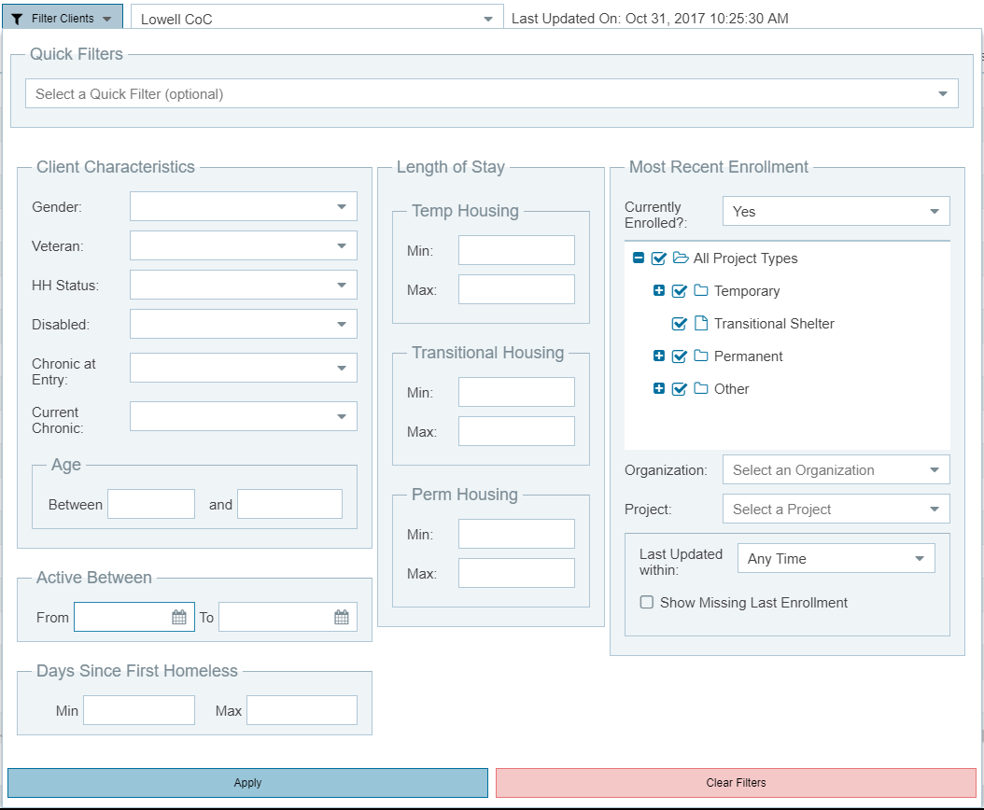
Second Attempt at CE for Individuals
Approach
Implement prioritized, filterable, “by name lists” that rely on self-reported client information that is captured in HMIS

Slide 19
Second Attempt at CE for Individuals
Issues with Approach
Data quality in the shelter is unreliable.
Shelter uses entry/exit bed tracking method but has people coming and going
Overlapping enrollments
Self reported data often conflicts with empirical data
Disabling conditions are under-reported
Missing data from street outreach

Slide 20
Proposed HUD CE Data Element Changes
“Since coordinated entry is a process that may be supported by multiple agencies and may span an extended period of time, CoCs are urged to set up a single coordinated entry “project” that all relevant agencies can access. Some CoCs may need to establish multiple projects if information cannot be shared or managed across agencies. As participants interact with the CoC’s first points of access, they should be “enrolled” in the Coordinated Entry “project” that is set up in the HMIS or other data collection system.”

Slide 21
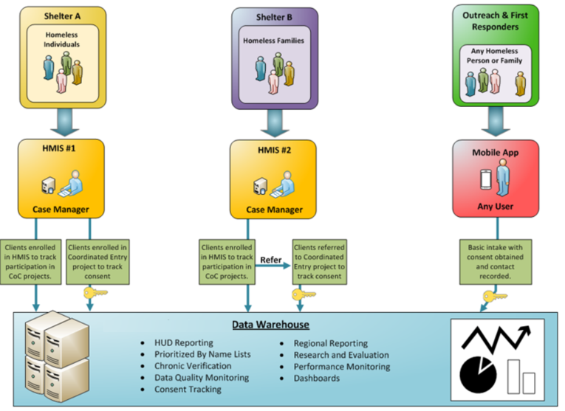
Third Attempt at CE for Individuals

Slide 22
Fix # 1 - Reduce Reliance on Self-Reported Info
“…the scarce supply of PSH is often rented out to the eligible population based on crude screening processes that rely on self-reported data.”
Prioritizing Homeless Assistance Using Predictive Algorithms: An Evidence-Based Approach
The Social Security Administration conducted a study of homeless people and their self-reported SSI/SSDI status and found that "Fully 41 percent (934/2,257) of clients who reported receiving SSI/DI benefits did not receive them according to SSA."

Slide 23
Fix #1 – Reduce Reliance on Self-Reported Data
Step #1
Use a HMIS warehouse, and mobile tech for outreach, to gather information from across regions to build a longitudinal picture of each person’s homeless history.
“HMIS reports of actual enrollments in ES, SH, or SO projects may be used to meet third-party documentation requirements”.
- HMIS Data Standards Manual, Page 56

Slide 24
Fix #1 – Reduce Reliance on Self-Reported Data
Step #2
Integrate with “systems of record” whenever possible to capture information that can be used either as a source of information or as a DQ check of what is captured in HMIS.
Examples of HMIS Data Elements, and potential sources for these, include…
HMIS Data Element Potential Data Source
Veteran Status SQUARES
Mental Health Status PATH Project Enrollment
Prior Living Situation Enrollment in prior project Destination and Exit Date Entry into subsequent HMIS Project*
Substance Abuse Bureau of Substance Abuse Services (BSAS)
Disabling Condition Social Security Administration
Others??
*Note that it would be ideal if HMIS did not allow a person to enroll into another residential project if he/she is already enrolled in one.

Slide 25
Fix #2 – Rapid Intake for Emergency Shelter
Key Requirements
Quick client self lookup
Name and DOB
Bar Code Scan
Facial Recognition
Ability to assign people to a service, not a service to each person
Ability to match service data to full HMIS project enrollment records

Slide 26
Proposed HUD CE Data Element Changes
“The intent is to collect data about people as they move through the CE process, thus the data collection is not intended to be strictly aligned with any one specific project or structure. In practice, coordinated entry data might be collected by different agencies phased over time, depending on how the coordinated entry is set up in each CoC.”

Slide 27
Proposed HUD CE Data Element Changes
“Coordinated Entry projects may record a project start with limited information about the client, using pseudonyms or code names along with data element 3.917 (as a starting point for understanding the participant’s homelessness history), and improve on the accuracy and completeness of client data over time by editing data as staff engage the participant through the assessment process”

Slide 28
Fix #3 – Mobile Tech for Street Outreach
Key Requirements
Usable by both street outreach workers and first responders
Capture GPS coordinates to support geo-spatial reporting
Client lookup by identifiers (name and DOB) or bar code
“Light Touch” capture of services
Ability to customize surveys
Notes tracking
Ability to post data to HMIS and/or a warehouse

