Slide 1
The Rapid Deployment of Mobile Technology to Support a Coordinated Response
to Hurricane Harvey
Ana Rausch, Senior Research Project Manager, Houston Coalition for the Homeless
Erol Fetahagic, HMIS Administrator, Houston Coalition for the Homeless
Eddie Barber, Lead Developer, Simtech Solutions Inc.
Matt Simmonds, President, Simtech Solutions Inc.

Slide 2
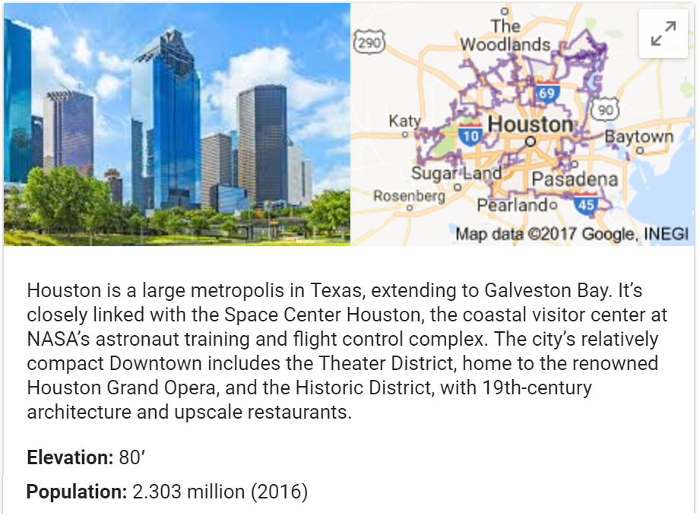
The Community: Houston, TX

Slide 3
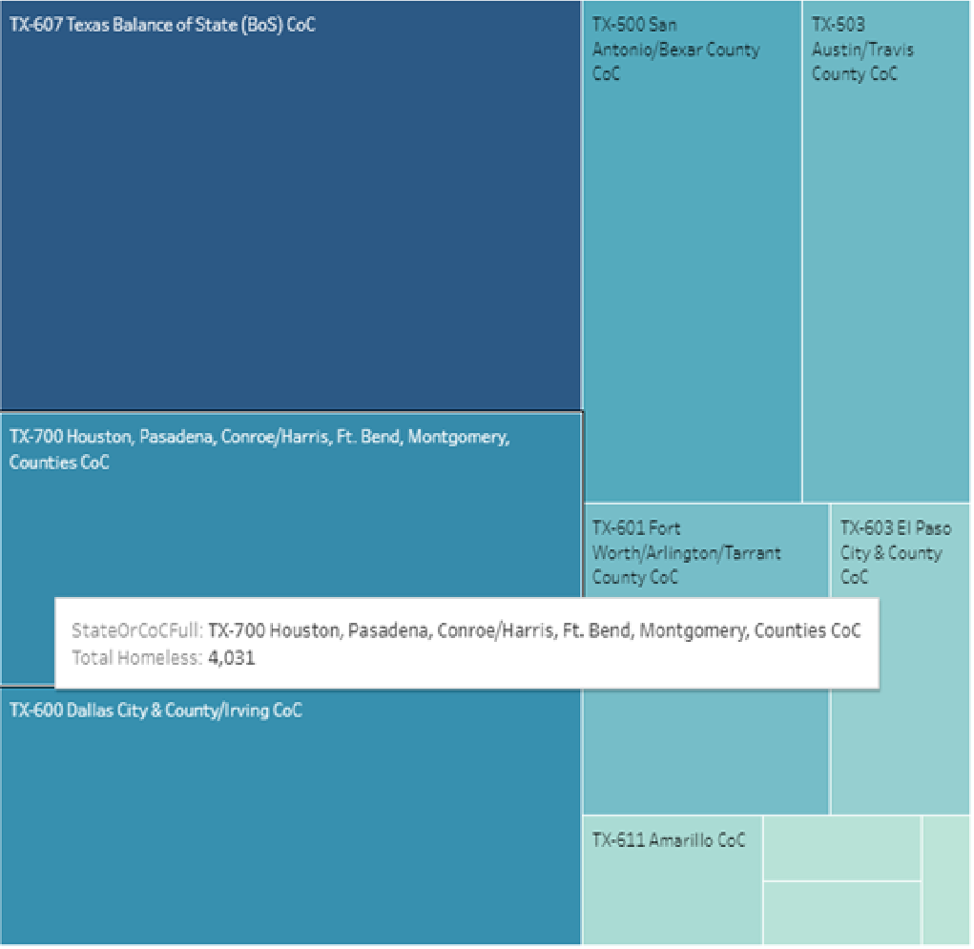
The Homeless Population in Texas
Source: http://www.HomelessData.com/Dashboard Tool Used: Tableau Licensing Model: Freemium
Data Set Used: 2016 HUD Point in Time Data

Slide 4
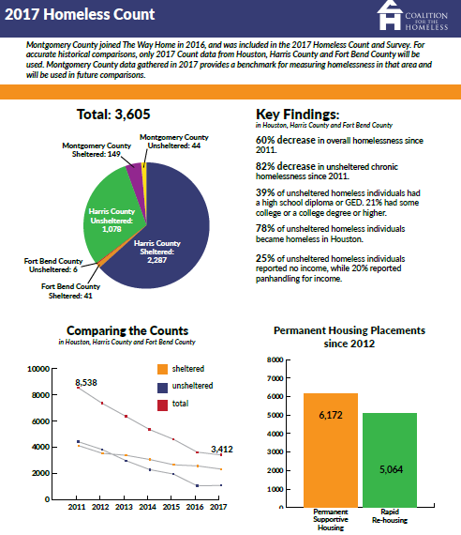
Houston 2017 PIT Summary

Slide 5
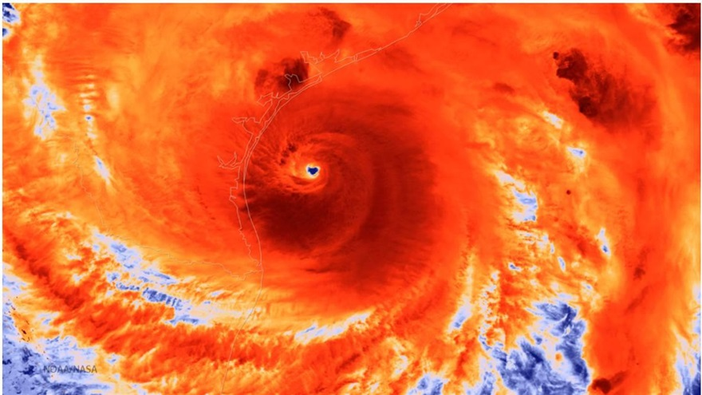
Hurricane Harvey
Source: NOAA

Slide 6
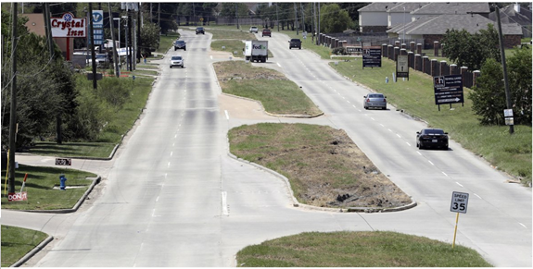
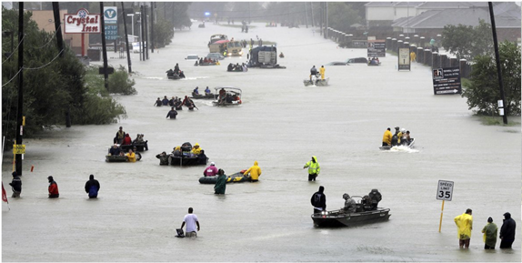
Tidwell St
Before
Tidwell St
After
Source: TIME

Slide 8
Disaster Response Coordination
Local government (city, county, state)
Federal government (FEMA, HUD)
Continuum of Care (CoC Lead, homeless service providers)
Non-profits (American Red Cross, local agencies)
Others (volunteers, local businesses)

Slide 9
Hurricane Harvey Response
Many people affected by the storm were evacuated to two major (and largest) shelters:
GRB: Operated by the Red Cross & the City of Houston
10K+ evacuees initially
NRG: Operated by Baker Ripley & Harris County
2K+ evacuees initially
TX-700 Continuum of Care received Disaster TA from HUD almost immediately

Slide 10
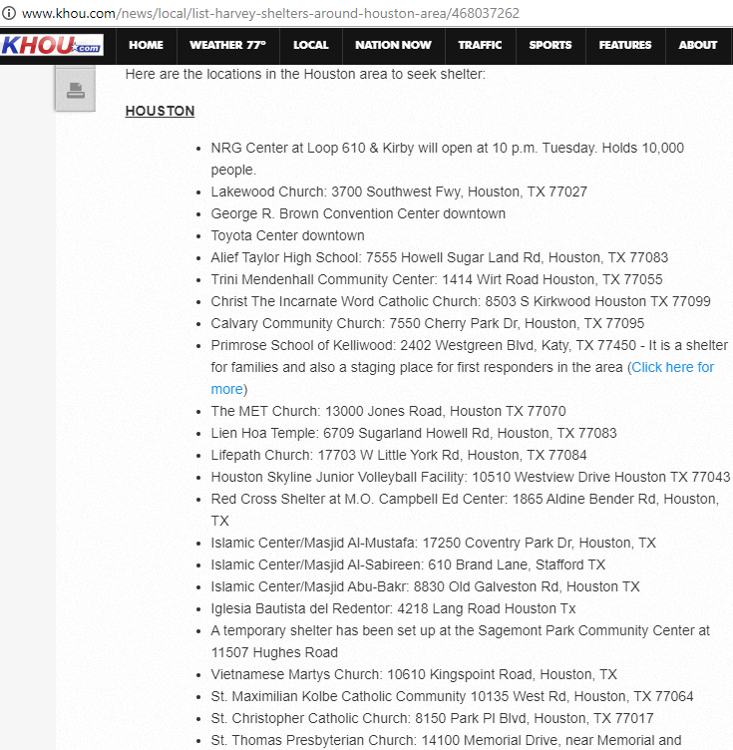
Shelter Resources

Slide 11
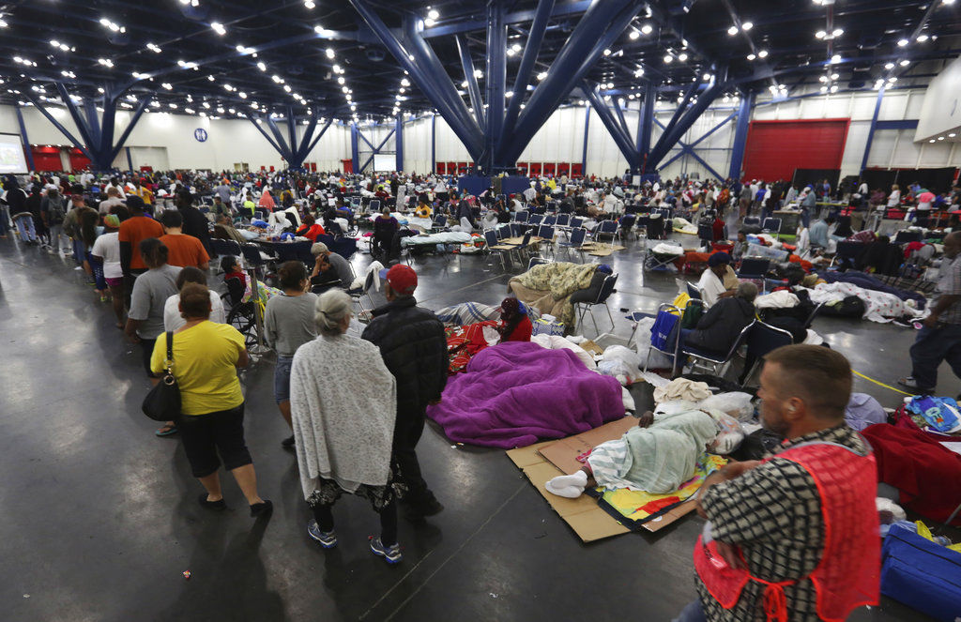
George R Brown (GRB) Convention Center: Emergency Response

Slide 12
Hurricane Harvey Response (cont.)
Homeless response system leadership called to GRB the end of the week of August 31st
Shelter census at 2400+
Task – Develop an exit strategy for all residents at the GRB
Call went out to all landlords from President of Texas Apartment Association and the Mayor
Almost 3K units volunteered by landlords
New Residences on Emancipation opened by New Hope Housing
295 beds in dormitory style living (4 per room)

Slide 13
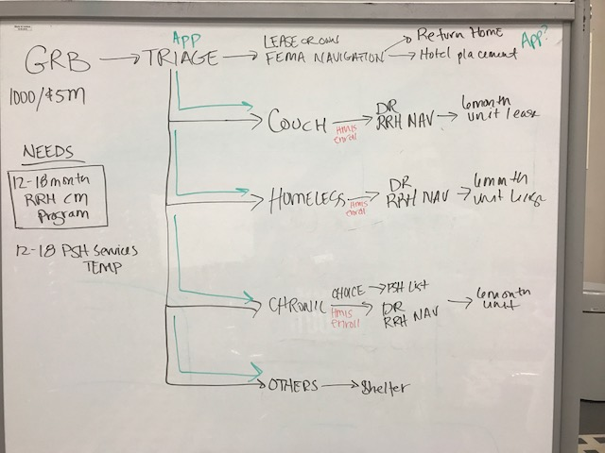
The Whiteboard
Tools Used: Join.Me for conferencing
Licensing Model: Freemium

Slide 14
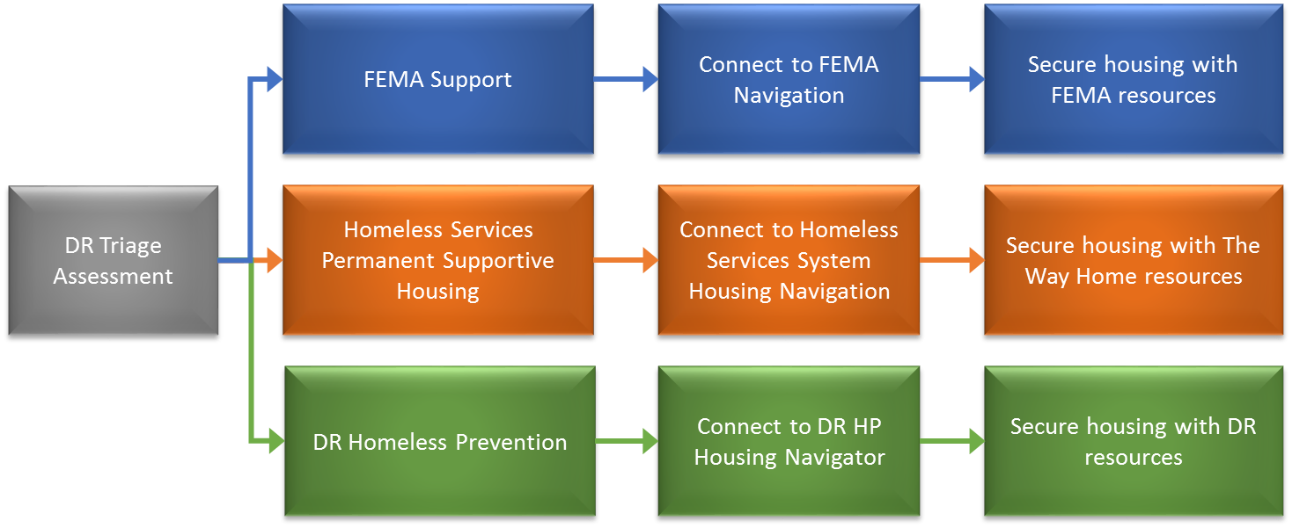
The Revised Approach

Slide 15
HMIS Pros
Existing database with client records
Customization capability
Unique HMIS identifiers
Capturing geodata
Local control
No additional cost

Slide 16
HMIS Cons
No time available for customization & sync
More complex user training & set up
New user friendliness issues
Bad quality data added in HMIS
Geodata accuracy issues
No direct geo-mapping capability

Slide 17
Mobile App Pros
Quick deployment
App download to many devices
Quick customizations
Simple user training & setup
Real-time geo-mapping
Available tech support

Slide 18
Mobile App Cons
Third-party software
Existing HMIS clients still must be recreated
Duplication & data quality issues
Data re-entry in HMIS
Additional privacy & security issues
Additional cost?

Slide 19
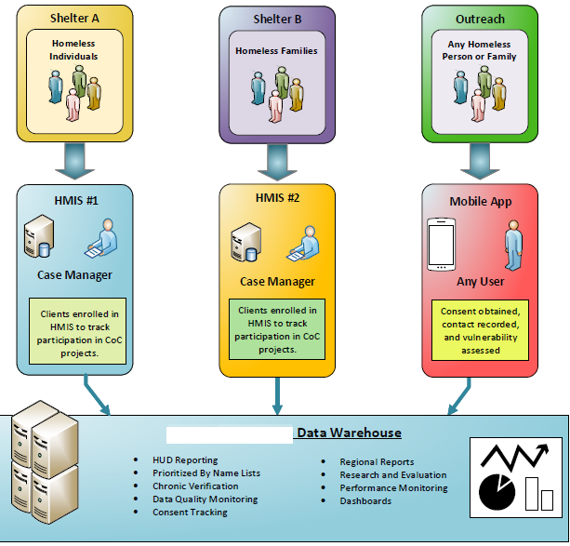
The Technical Framework
Tools Used: Microsoft Visio
Licensing Model: Licensed (cheap at TechSoup.org for non-profits)

Slide 20
Data Collection via Mobile App
Gathered info needed for triage & rapid response
Dashboards provided a high-level recap of the situation
Integration with HMIS will help us measure the impact on homelessness during the 2018 PIT and beyond
Mobile response allowed multiple staff to quickly and effectively gather information with minimal additional disruption to evacuees, and with minimal effort to deploy.
URL: App Store and Google Play
Licensing Model: Free

Slide 21
Hurricane Harvey Response (cont.)
HMIS Needs
Modified version of the CA Assessment to be used as Disaster Assessment
Harvey HMIS Assessment revised.pdf
Disaster Navigation program created to enroll those ready to be housed
Disaster RRH program created for long-term case management after housing
This will be through an RFQ process

Slide 22
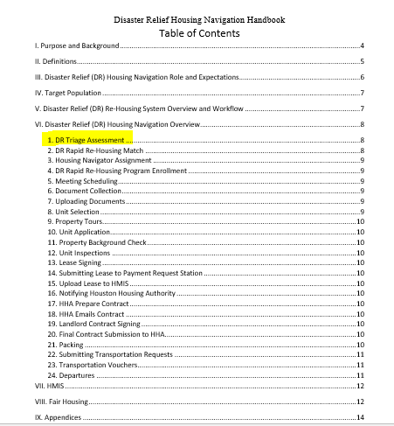
Disaster Relief Housing Navigation Handbook
From an emergency response to permanent housing
Housing Navigators are responsible for supporting households through the process of securing permanent housing and accessing disaster relief resources….

Slide 23
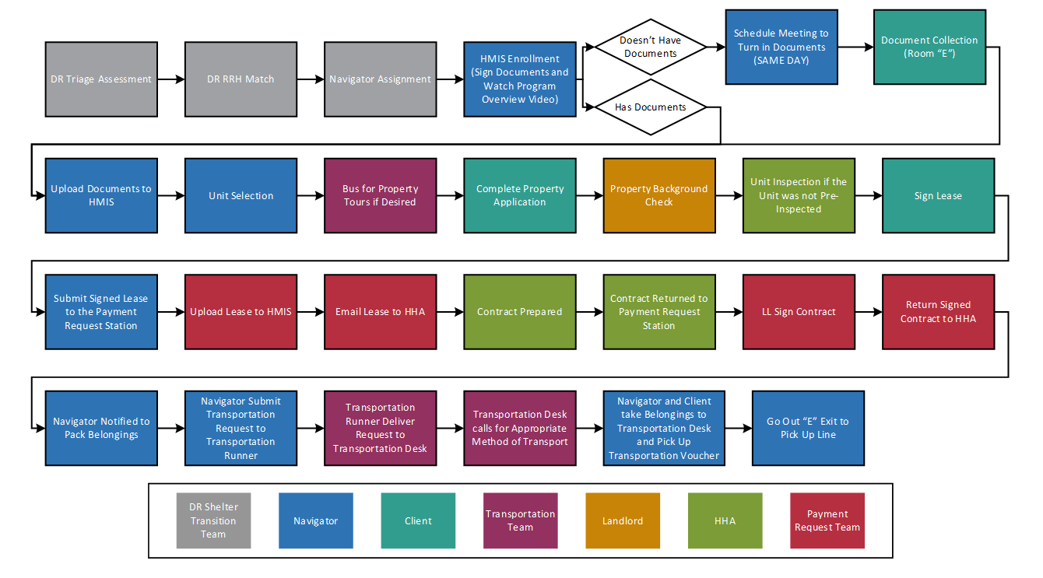
Disaster Recovery RRH Workflow

Slide 24
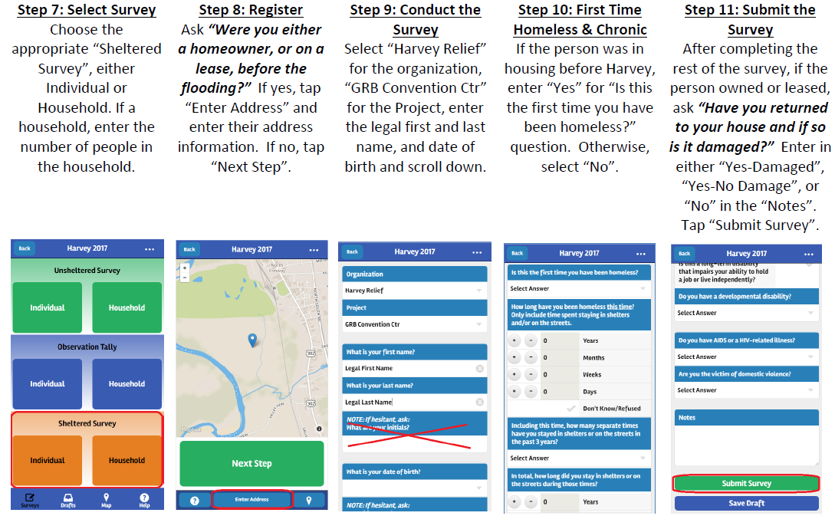
Triage Worker Guidance
Tools Used: Windows Snipping Tool and MS Word

Slide 25
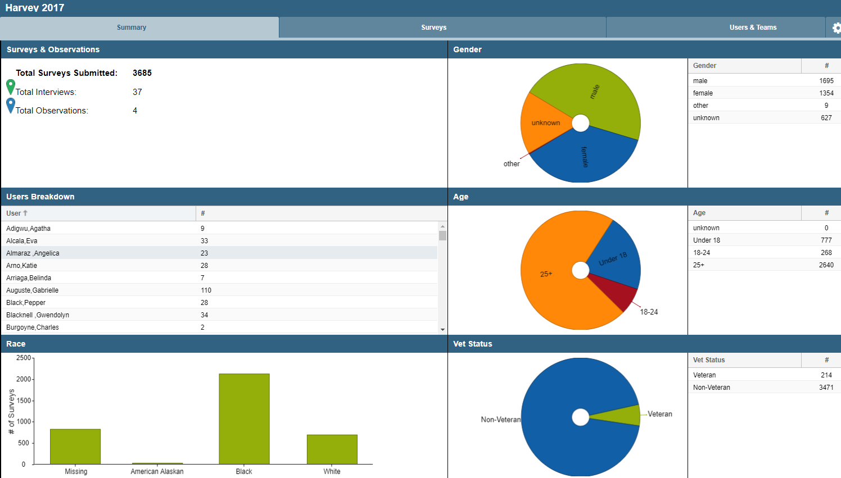
Command Center to Manage Info
URL: https://www.WeCantTellYou.com
Licensing Model: Proprietary

Slide 26
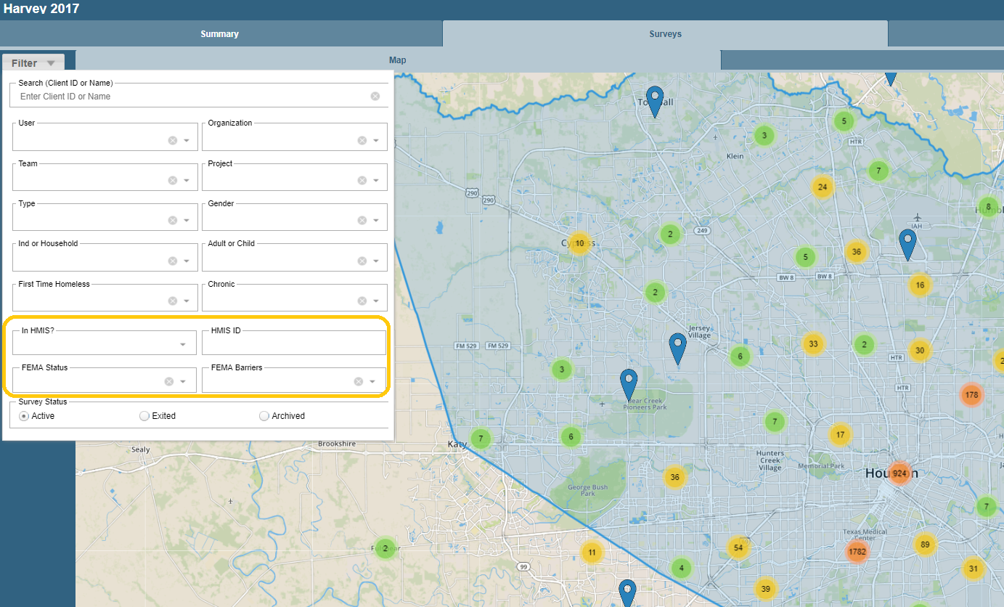
Command Center to Manage Info
URL: https://www.WeCantTellYou.com
Licensing Model: Proprietary

Slide 27
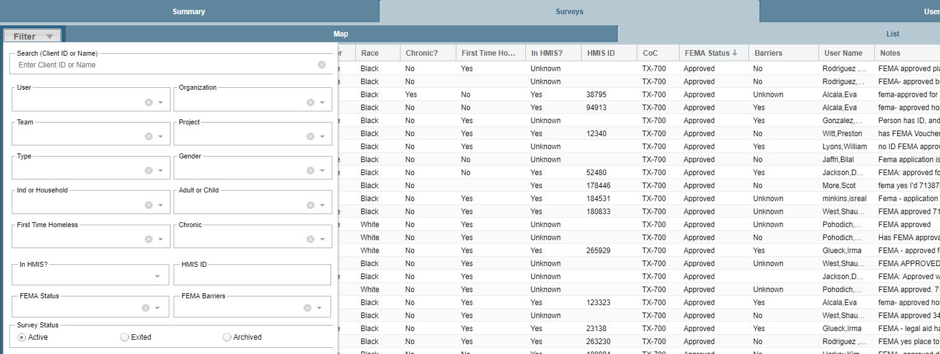
Command Center to Manage Info
The details from evacuees can be filtered as needed to support the triage efforts.
Disaster recovery specific fields include FEMA status and barriers.
CoC code is derived from the GPS coordinates.
HMIS ID was sourced through a data match.

Slide 28
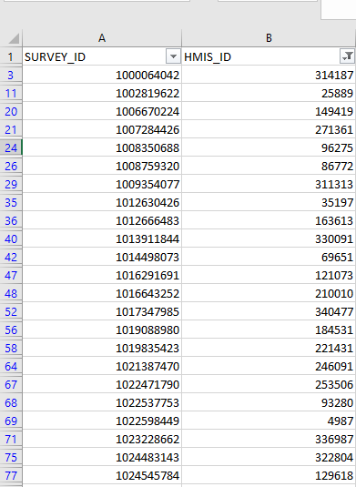
Who was Homeless Prior to Harvey?
Matching evacuee info with HMIS for historical and future analysis.
29% of evacuees had a record in HMIS
Tools: Excel, The-Link-King, SQL
Licensing Model: Per-Seat, OpenSource, and Proprietary

Slide 29
Matching Records in Excel
STEP 1 – Copy data from data sets to be merged into two tabs in Excel
STEP 2 – Create Unique Key Fields Using Demographic Info
DataSet1KeyField =concatenate(lastname,DOB,gender)
DataSet2KeyField =concatenate(lastname,DOB,gender)
STEP 3 – Match Records from One Tab with Records on the Other
=vlookup(DataSet1KeyField,DataSet2,ColumnNumberOfDataToBeReturned,FALSE)
Tools: Excel
Licensing Model: Proprietary but cheap on TechSoup.org

Slide 30
Using Excel to Pull Data Out of Notes
STEP 1 – Export data into Excel. (normally in a CSV format)
STEP 2 – Create a column (B2) next to the notes field (A2) to contain the value you are checking for. For example, “FEMA”.
STEP 3 – Use the “ISNUMBER” formula in cell C2 to check if the value “FEMA” in cell B2 is contained in the notes field in A2.
=ISNUMBER(SEARCH(B2,A2))
This will return a value of “TRUE” if the notes text in field A2 contains the string “FEMA” that was written in cell B2.

Slide 31
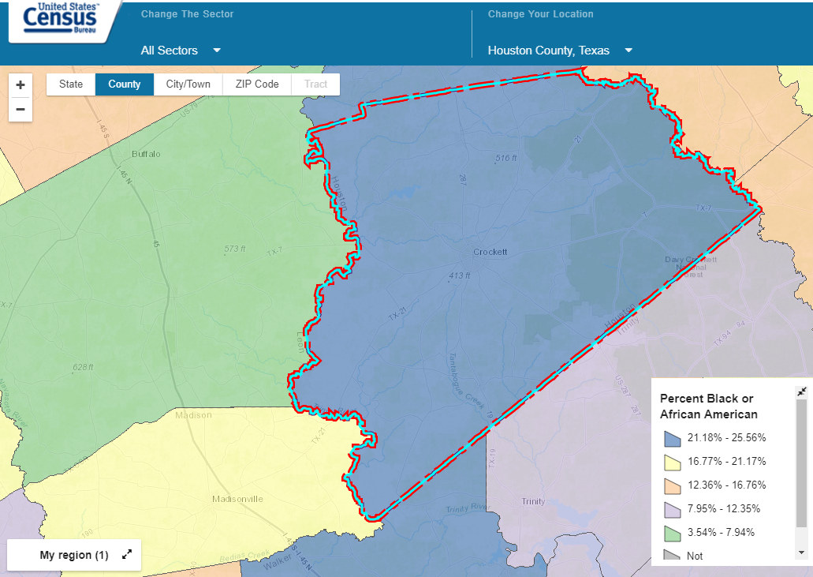
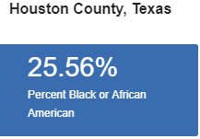
US Census Data
URL: https://cbb.census.gov
Licensing Model: Free

Slide 32
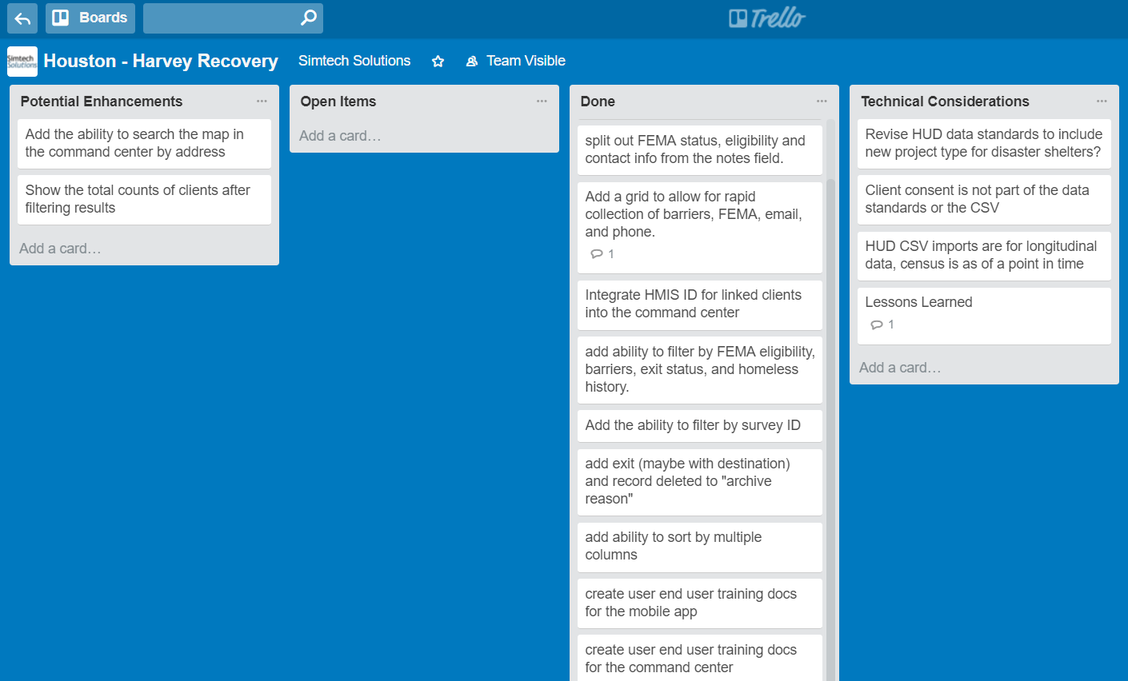
Project Management
Tools Used: Trello.com
Licensing Model: Freemium

Slide 33
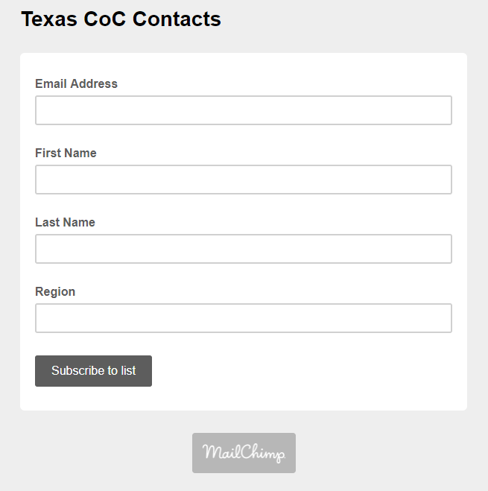
Contact Management
MailChimp is a simple tool to manage email lists and send out blast emails to all participants.
Tool: mailchimp.com, form is at http://eepurl.com/c4uPMr
Licensing Model: Freemium

Slide 34
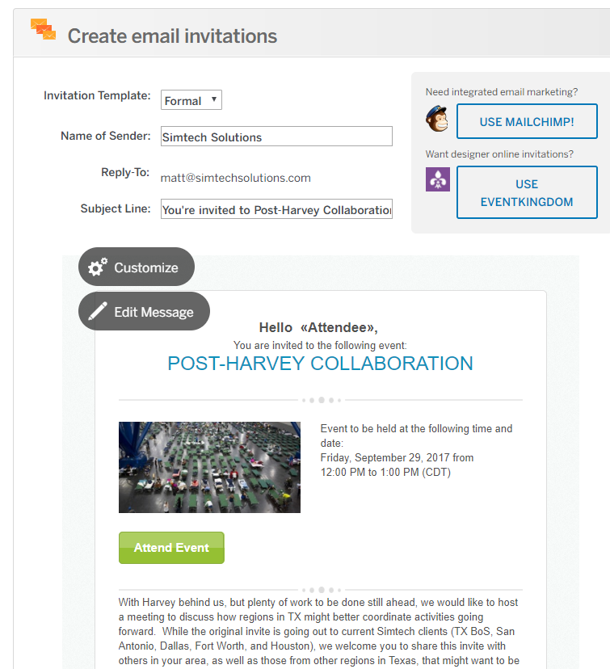
Event Management
Tool: EventBrite.com
Licensing Model: Freemium

Slide 35
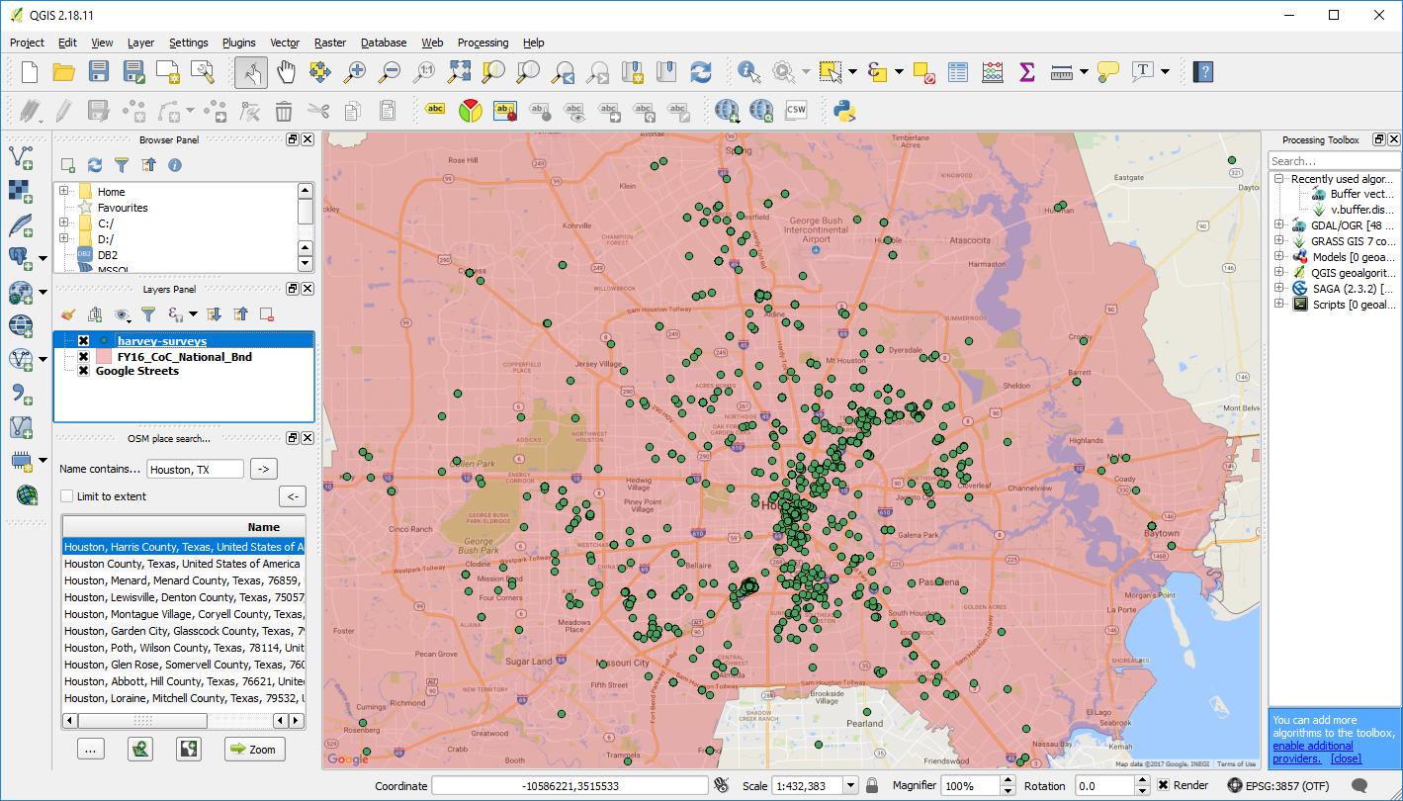
GIS Mapping
URL: https://QGIS.org
Licensing Model: Open-Source, no hosting required (FREE)

Slide 36
Hurricane Harvey Response (cont.)
Now:
GRB & NRG shelters closed
300 currently in Red Cross HCC
100 currently in Red Cross Shell
400 currently in Red Cross Greenspoint
50 currently in St. Thomas More
230 residents moved into Residences on Emancipation
40 families enrolled into HMIS & moved into apartments
Households continue to be assessed & assigned to Navigators to be housed and then connected with long term Disaster Case Management

Slide 37
Preparedness for Future Disasters
Facilities
Staff
Electricity
Internet
Database platform
Pre-planning

Slide 38
Future Technical Considerations
Disaster-specific data elements in future HMIS Data Standards?
HUD CSV Export from Mobile App & Import to HMIS?
Status of Temporary Emergency Shelters re: HUD reports (PIT, HIC, AHAR, SPM)?

Slide 39
Lessons Learned
People with mental health conditions may not be able to access meds
Those with severe mental and physical health conditions have more extensive service needs
Senior citizens also have different care needs
Hard to match the need for help with the resources
FEMA, Red Cross, and shelters need to be connected ASAP to ensure an effective workflow
Need to be careful of survey overload
The Boy Scout motto rings true

Slide 40
Questions?

Slide 41
Contact Info
Matt Simmonds – Matt@SimtechSolutions.com
Eddie Barber – Eddie@SimtechSolutions.com
Ana Rausch – arausch@homelesshouston.org
Erol Fetahagic – efetahagic@homelesshouston.org

