Slide 1
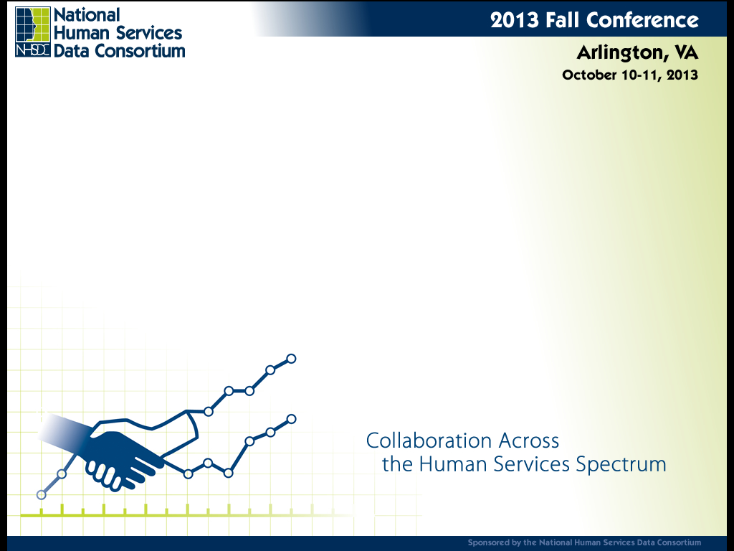
Adopting the HUD Point In Time Mobile App to Assist with Regional Counts
Matthew D. Simmonds - Simtech Solutions Inc.
Edward Barber – Simtech Solutions Inc.
Jonathan Lanham – Father Bill’s and MainSpring

Slide 2
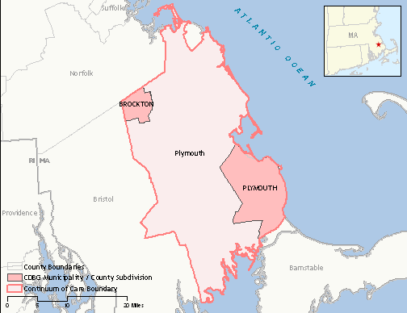
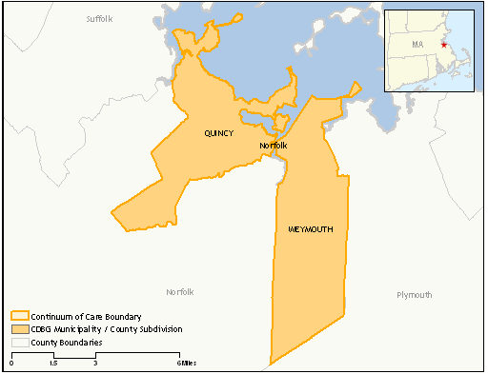
2013 PIT Count – Alpha Test
CoC Description - Brockton-Plymouth
Point in Time Count – As of January
30th 2008, 645 persons were homeless
Median Income - $71,113*
General Population Count – 494,000*
CoC Description - Quincy-Weymouth
Point in Time Count – As of January
30th 2008, 256 persons were homeless
Quincy Median Income - $55,113*
General Population Count - 142,013**
Source: * US Census ACS Survey, 2007 ** US Census 2000
Notes:
In 2007 Quincy had 83,597 people living there.

Slide 3
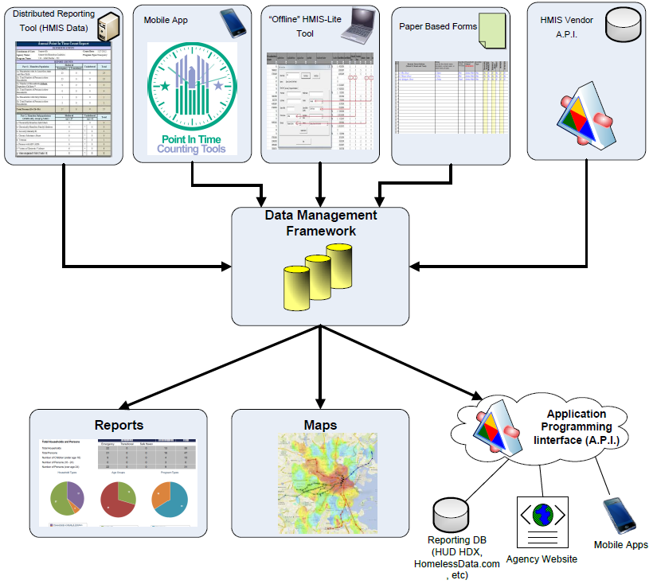
Point In Time Framework – All Sources

Slide 4
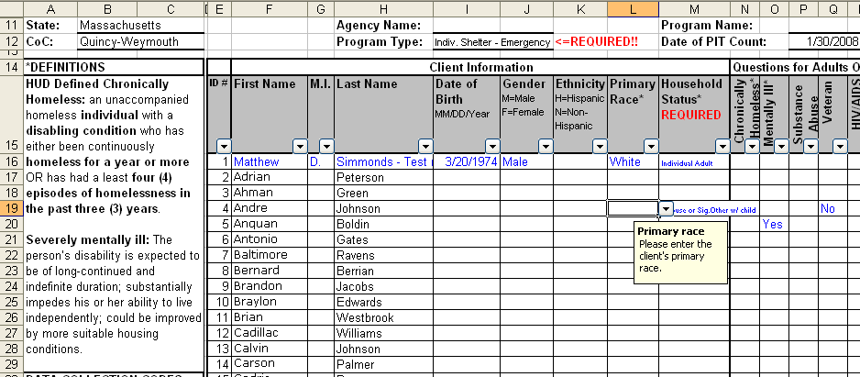
Sheltered Count: HMIS Users
Distributed Reporting Tool allows for the HMIS data for active clients on the night of the PIT to be pulled into the tool.
Report and data are verified by the program staff prior to being aggregated.
Simple process helps to encourage programs to conduct “dry run” counts and is effective for HMIS data cleanups.

Slide 5
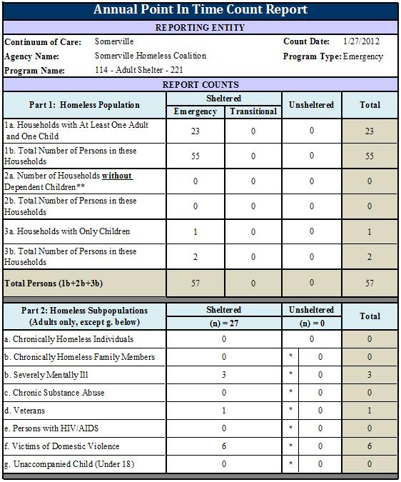
Sample Report Output from HMIS Data fed into a DRM Tool

Slide 6
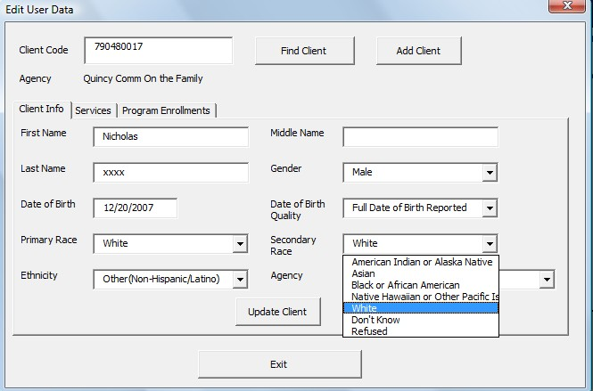
Sheltered Count: Non-HMIS Users
Alternative to paper for those not participating in HMIS
DV providers and others do not need to share client level data
Simple format alleviates training needs
Only requires MS Excel to use.
Can produce HUD CSV as well as reports such as the HUD APR and the PIT.

Slide 7
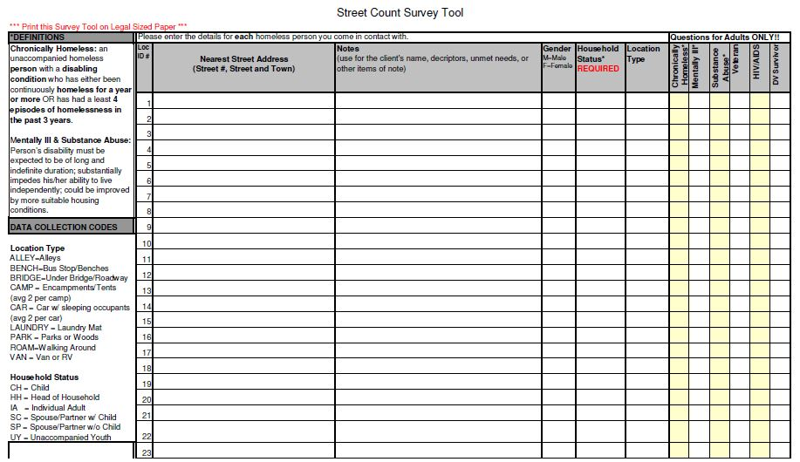
Paper Based Intake Form

Slide 8
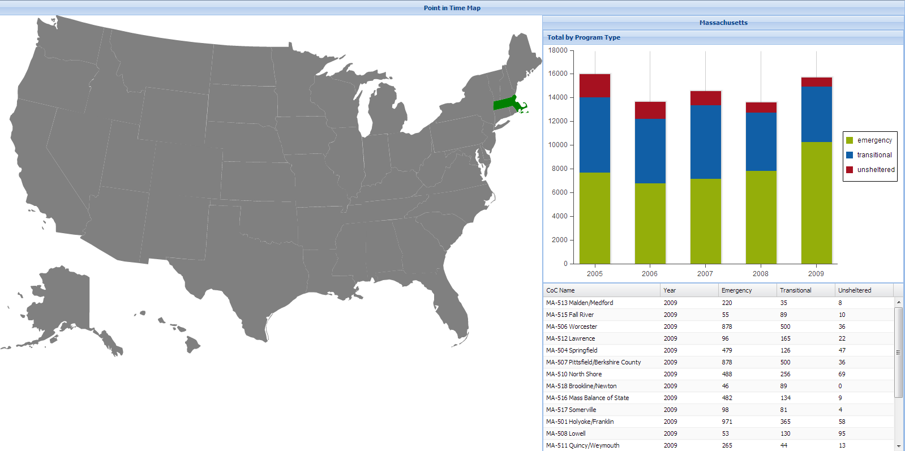
Vendor API
Would allow for transmission of counts per program, or per region, to be submitted
Avoids issues with client level data being sent to a 3rd party while allowing for peer to peer benchmarking, regional trend analysis etc.
Notes:
http://www.huduser.org/portal/datasets/fmr/fmrs/FY2013_code/select_Geography.odn
datasets/
http://www.huduser.org/portal/datasets/il/il2013/select_Geography_mfi.odn

Slide 9
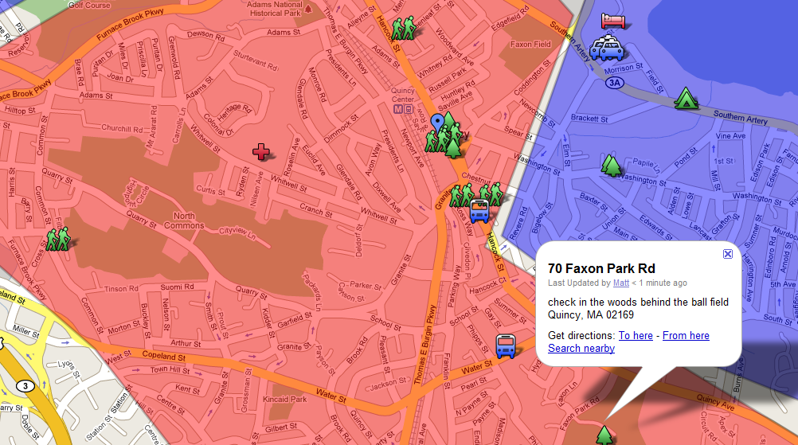
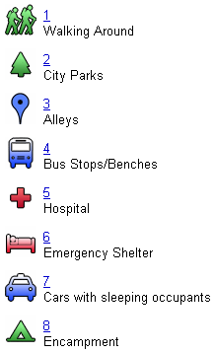
Unsheltered Count: Pre-Count Logistics
Mapping prior contact locations allows for better coverage.
Establishing coverage areas with map-based overlays helps to prevent double counting.

Slide 10
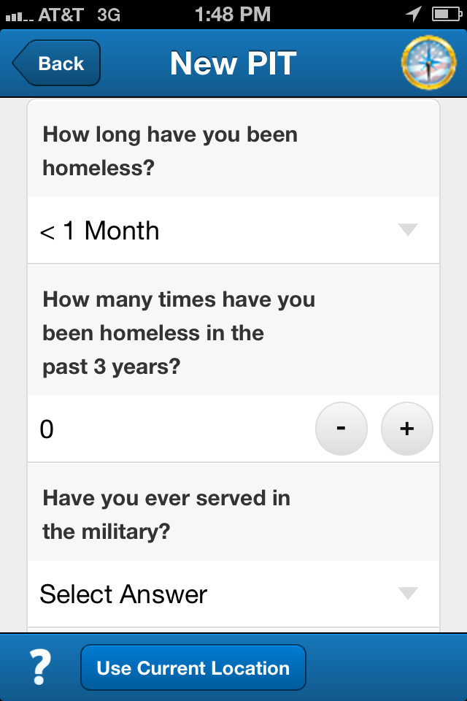
Unsheltered Count: Mobile App
  Uniform and Consistent Approach
  Real-Time Feedback
  No Paper Trail
  Exact Location Details with HUD GeoCodes
  Less Prone to Error

Slide 11
Benefits to the Interaction with Clients
  Reduced size makes it less intrusive
  Can easily be viewed and shared with the client
  Prompts and in-line support can guide the user

Slide 12
Feedback from the Beta Tests
  Process for assigning a location is confusing
  Could benefit from an integrated resource directory
  Needs an observation survey
  Region specific questions would add value

Slide 13
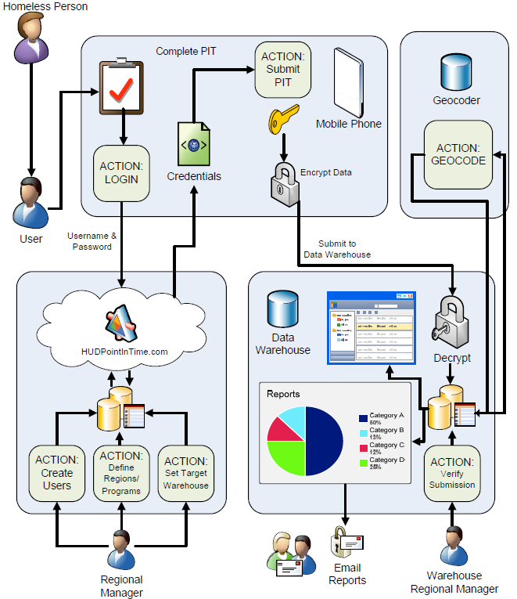
PIT App Data Collection Framework

Slide 14
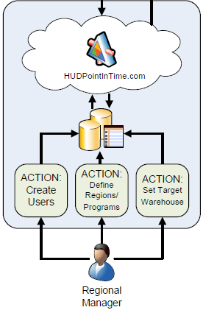
Regional Control Panel
  Define Participating Regions
  Set Regional Administrator
  Assign Target Warehouse

Slide 15
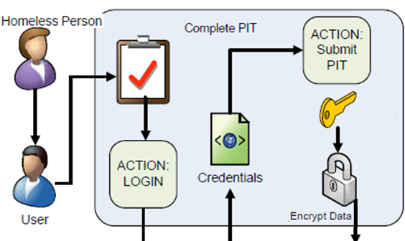
The PIT Counting Tool App

Slide 16
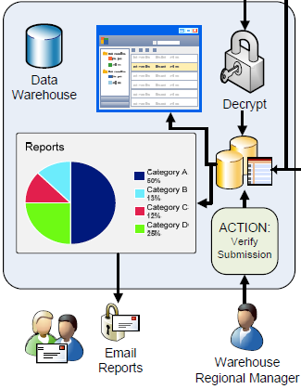
Regional Warehouse
  Support the PIT App API
  Decrypt the Data
  Aggregate the Data
  Verify All Submissions are Received
  Proof the Data
  Produce the Unsheltered Reports
    By HUD GeoCode
    Summary

Slide 17
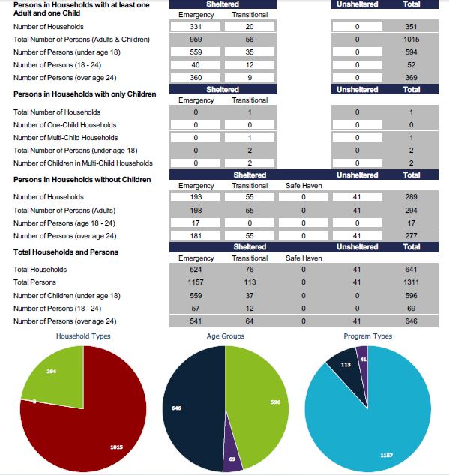
Regional Homelessness
Brockton, MA January 27, 2013
Notes:
Sample Queries:
Vets with mental illness and stays over 180 days
APR results for all single adults over age 50
Highest Level of Education for all young adults.

Slide 18
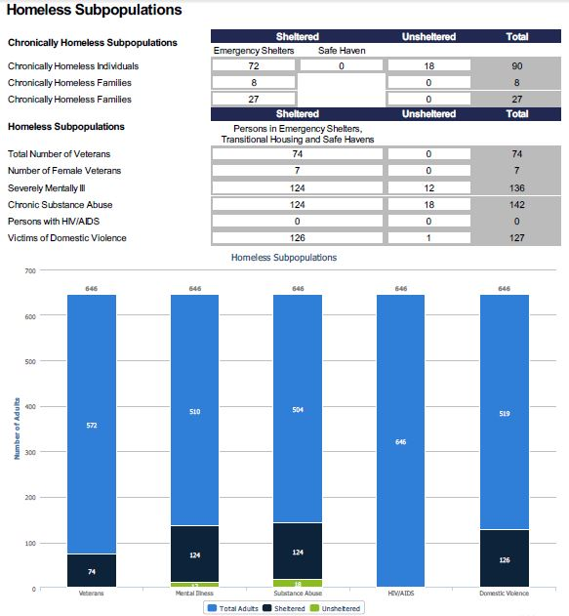
Homeless Sub-Population Details
Brockton, MA January 27, 2013
Notes:
Sample Queries:
Vets with mental illness and stays over 180 days
APR results for all single adults over age 50
Highest Level of Education for all young adults.

Slide 19
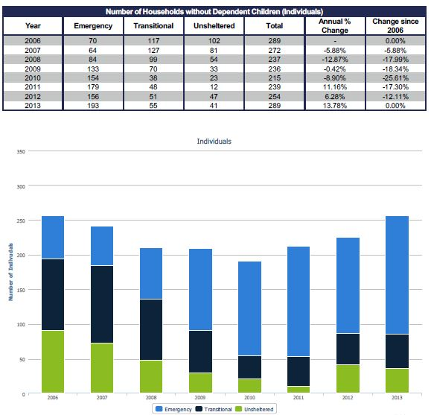
Trends in Individual Homelessness
Brockton, MA 2006 to 2013
Notes:
Sample Queries:
Vets with mental illness and stays over 180 days
APR results for all single adults over age 50
Highest Level of Education for all young adults.

Slide 20
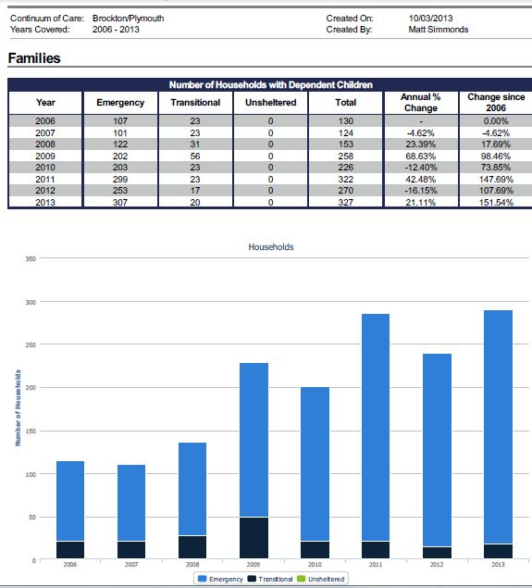
Trends in Family Homelessness
Brockton, MA 2006 to 2013
Notes:
Sample Queries:
Vets with mental illness and stays over 180 days
APR results for all single adults over age 50
Highest Level of Education for all young adults.

Slide 21
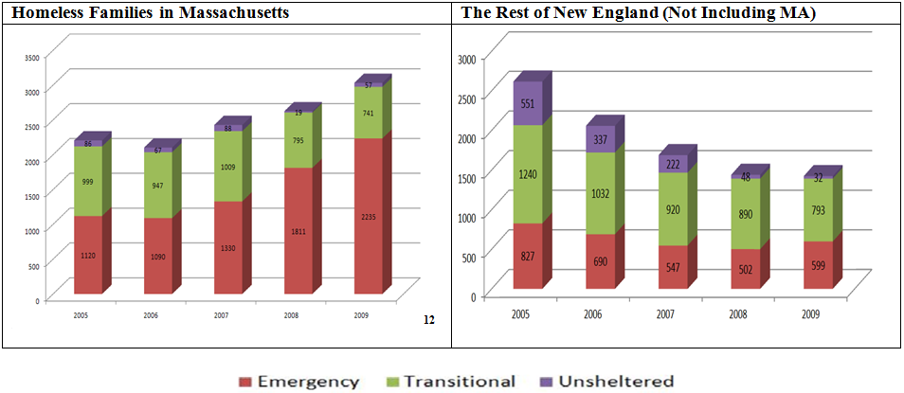
Family Homelessness in Massachusetts
Versus Other States in New England
SOURCE: Simtech Solutions Inc. in conjunction with NERHMIS - 5 Year Trend Analysis of Homelessness Throughout New England
Notes:
As of 10/4/2013 there were 2037 families living in hotels, 2006 in shelter for a total of 4043 homeless families. In 2009 there were only 2235 homeless families on the night of the PIT in MA.
https://hed-dhsentry.azurewebsites.net/default.aspx

Slide 22
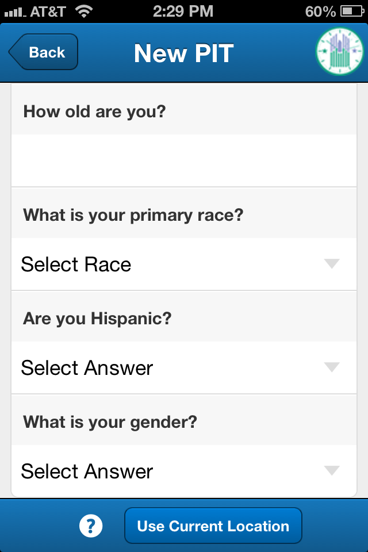
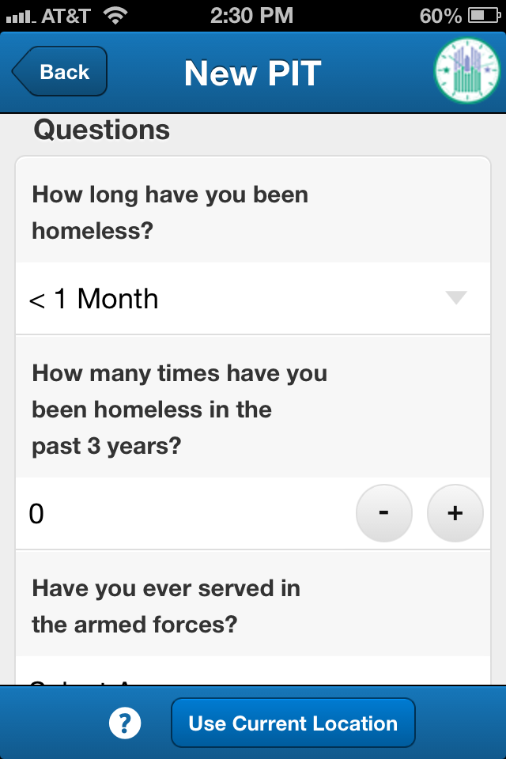
App Demo

Slide 23
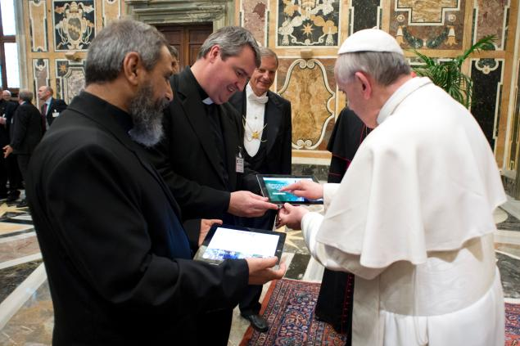
Training

Slide 24
Training Components
HUD P.I.T. Requirements for CoC’s
Benefits of HUD P.I.T. Mobile App
Target audience(s) of training
D. Review P.I.T. Mobile App Pilot Phase and Evaluation
E. What is required to use P.I.T. Mobile app
Notes:
A. HUD P.I.T. Requirements for CoC’s
B. Benefits of HUD P.I.T. Mobile App
Easier to use (data collection, analysis, reporting)
Saves time and money (reducing additional data entry steps)
Consolidates across programs, CoCs
Utilizes popular technology
Improves data quality
More consistency among field values
More efficiency in storing data while building trust with a client
Consistency across records (same user)
Consistency across users
C. Target audience(s) of training (explain briefly how the training will support each group)
P.I.T. Count/ Census enumerators/interviewers
Staff
Volunteers
Those uncomfortable with technology (particularly mobile phone application technology)
CoC leadership utilizing P.I.T. data
Technical staff (an additional technical support staff training will be available too)
D. Review P.I.T. Mobile App Pilot Phase and Evaluation
What we heard from users
What users liked
What changes users suggested
What would be most helpful in a training
E. What is required to use P.I.T. Mobile app
Mobile Phone
iPhone
Android
Blackberry v 7.0 or higher
Download application onto phone
Download at least 2 days ahead of P.I.T. Count
Goto XXXXXXX to download app or iPhone App store (for iPhone users)
For an on-line video instruction on downloading app goto this YouTube link:
Identify a point person from your CoC responsible for the following:
View/attend training
All HUD P.I.T. Mobile App users should attend
Users can view online training webinar and complete simple quiz
Be available to answer questions for other users/volunteers
Track that data is entered from all designated programs/locations for the COC P.I.T. count
Ensure that PIT Count Report is created from HUD P.I.T. Mobile App after the count is completed
Complete Learning Objectives Quiz/checklist
Charge your battery (with back up if possible)!
H

Slide 25
Q & A

Slide 26
Contact Information
Eddie Barber – Eddie@SimtechSolutions.com
Jon Lanham – JLanham@HelpFBMS.org
Matt Simmonds – Matt@SimtechSolutions.com

